Slide 1
Physical Development
Reception Term 1
This is me!
Communication & Language
PSED
What does good listening look like?
Following directions
Asking & understanding questions
Talking about myself and my family
Mark making in a variety of ways
Starting to write names
Looking after ourselves
Healthy eating & exercising
Learning class rules and routines
Making friends and playing cooperatively
Discussing and sharing feelings
Outdoor Learning
Characteristics of Effective Learning
Weekly welly walks
Daily outdoor Explore and Learn
Sound/shape walk
Finding out & exploring our new classroom/school
Being involved and concentrating
Thinking of ideas

Slide 2
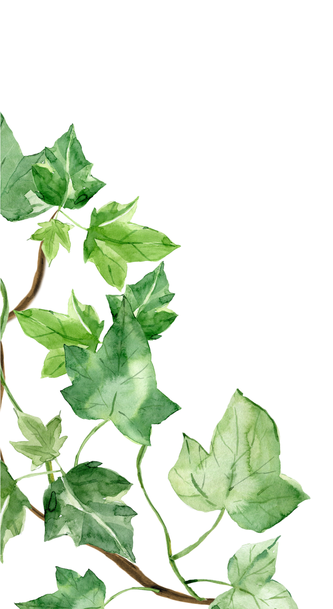
ESR
Expressive Arts & Design
Creating family pictures using a variety of materials
Self portraits
How to look after our school.
Looking after nature – welly walks and garden exploration.
Recycling milk bottle.
Understanding the World
Phonics
Phase 1 – rhyme and listening
Begin phase 2
Meet Tricky Troll and Beegu
Hearing & saying the first sound in words
Talking about our families
Home corner role play
Discussing different cultures/festivals/celebrations
Signs of autumn
Literacy
Mathematics
Forming some recognisable letters
Blending sounds together to read simple words
Reading and writing names of our family
Starting to recognise numbers to 10
Discussing sand and water play
Numbers 1, 2, 3 (one a week after baseline completed)

