Slide 1
Reception at Badbury Park Primary School
Ash Tree Class and Oak Tree Class

Slide 2
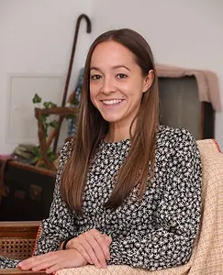
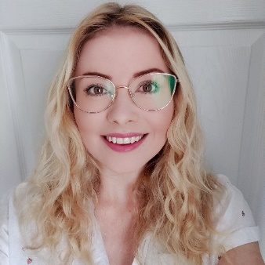
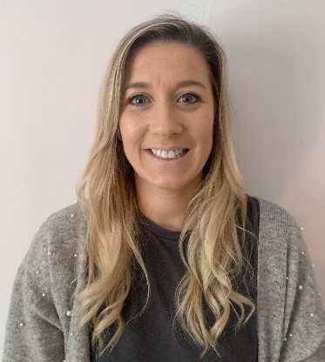
Meet the Oak Tree Class Team
Miss Andrea Lanham
Reception Class Teacher
Miss Perkins
Teaching Assistant (Monday-Wednesday)
Mrs Bell
Teaching Assistant (Thursday & Friday)

Slide 3
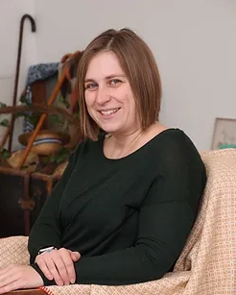
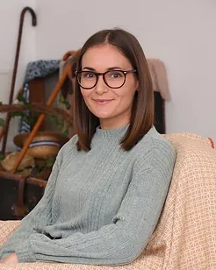
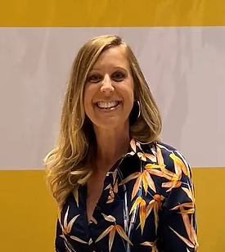
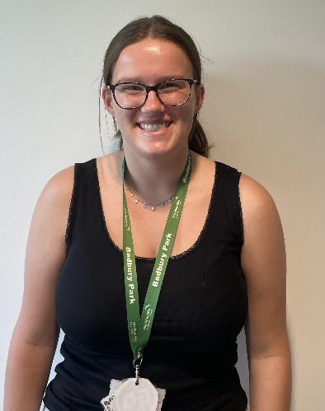
Meet the Ash Tree Class Team
Miss Lauren Coley
Reception Class Teacher
Mondays, Tuesdays & Wednesdays
Miss Amy Boase / Miss Stone
Reception Class Teacher
Wednesday, Thursdays & Fridays
Miss Hatton
Teaching Assistant

Slide 4
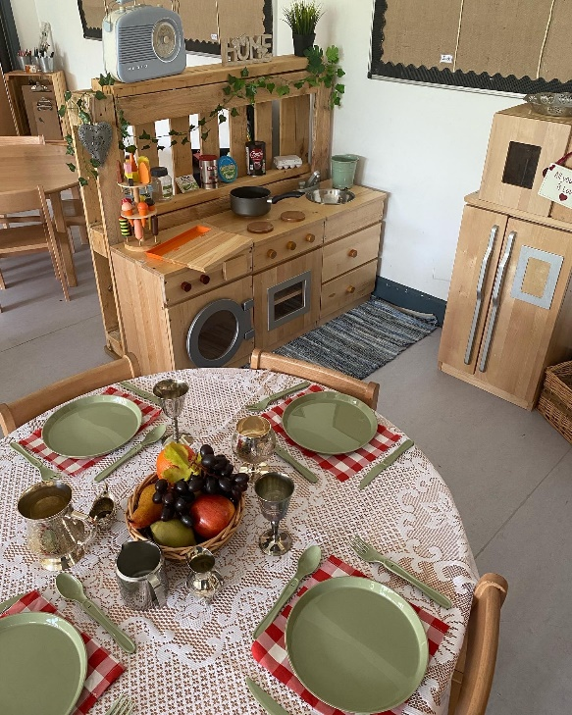
Our Vision
We want happy, engaged leaners within a
beautiful, authentic learning space that is calm
and consistent.
We use natural, versatile, open-ended resources that are carefully chosen to provoke creativity, wonder and concentration both inside and outside.
We want an environment where children are confident to take risks and problem solve whilst learning both knowledge and skills and where the natural world takes center stage.

Slide 5
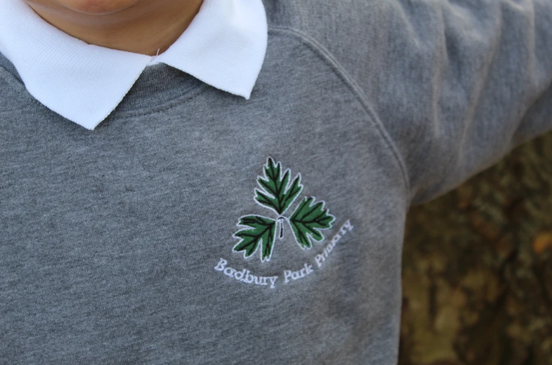
What uniform does your child need in Reception?
School uniform:
- Grey school jumper/cardigan
- White polo t-shirt
- Black trousers/skirt
- Black shoes/trainers
PE kit:
- Green t-shirt
- Black joggers/shorts
- Daps/trainers
Please let your child practice taking their uniform on and off by themselves and ensure their clothing is easy for them to take off/pull down.
Please name everything!

Slide 6
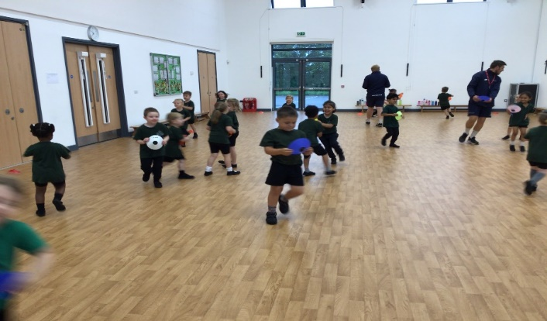
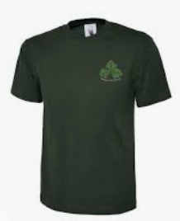
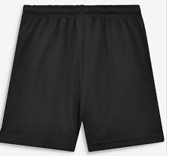
PE
At least 1 session a week
Please help to support your child’s independence by giving them opportunities to dress themselves at home- this will help with a quick change for PE in school.
All uniform will stay in school. PE kits will go home at the end of every term.
Please name everything!

Slide 7
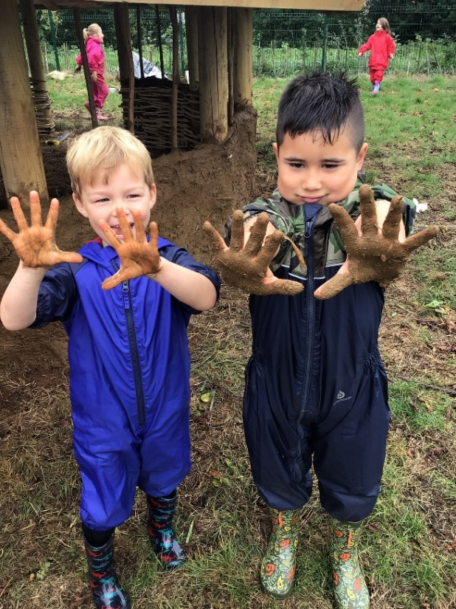
What else does your child need in Reception?
Water bottle (with only water)
Wellies and waterproofs
Bookbag or folder containing your
child’s reading book and record
Please name everything!

Slide 8
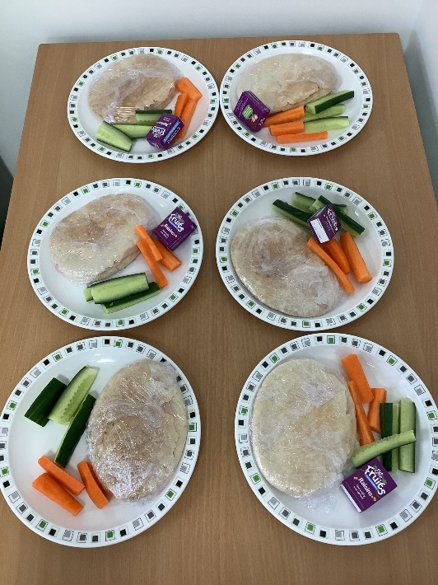
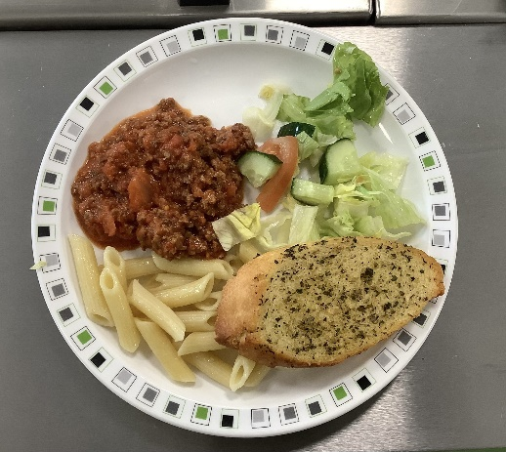
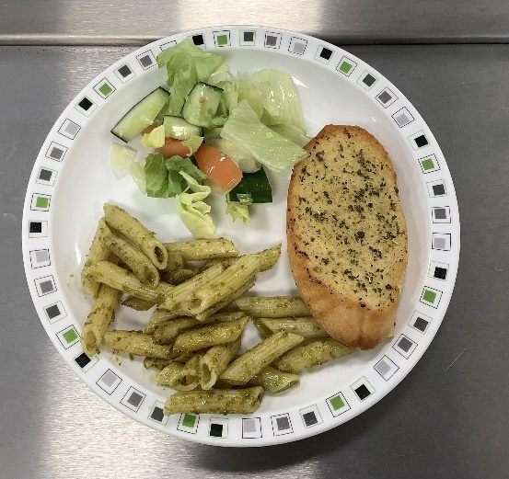
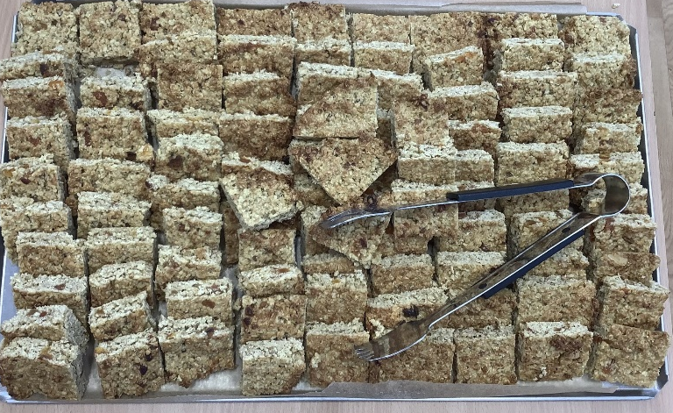
Food, Glorious Food!
Mrs Biggs - Catering Manager
Fresh cooked meals (meat, vegetarian, jacket potato)
A school packed lunch including wraps and baguettes (meat/vegetarian)

Slide 9
The Big Adventure Club - After School Club
At Big A we are able to offer you a week-to-week service where you can book one day or five, the choice is yours. Each week you will be required to book via our web page by Friday of the proceeding week the care is required.
No booking can be made without the appropriate payment in advance.
After School club provides a light snack inclusive of the price and each day the children have a variety of outdoor and indoor activities on offer to choose from. The planning within each unit is child-led and we aim to meet the demands of each child within our care.
The after-school care price is £15* for the first child and £13* for a sibling. This covers until 6pm. There is a session available 3 - 4pm for £7.50 per child.

Slide 10
Starting School – Days & Times
Week 1
Monday 4th September 2023 Tuesday 5th & Wednesday 6th September 2023 Thursday 7th & Friday 8th September 2023 | Teacher Training Day Home Visits Children who are new to Badbury will attend 9am – 11am. Children currently attending Badbury will attend full time.
Week 2 | Children who attend Badbury Nursery will be full time.
Monday 11th September 2023 Tuesday 12th September 2023 Wednesday 13th September 2023 Thursday 14th September | 9am-12.30pm (includes lunch) 9am-12.30pm (includes lunch) 9am-12.30pm (includes lunch) All children full time (unless on a bespoke transition)
Notes:
Come and speak after if you have any concerns over the transition or want to discuss your child.

Slide 11
Stay and Play Sessions
A chance to meet and explore inside and outside together with parents attending the sessions.
Class teachers, Mrs Dance (Headteacher) and Mrs Christmas (SENDCo) will be available during these times if you want to discuss specific needs.
The dates for this are:
Friday 9th June at 3.30pm
Friday 16th June at 3.30pm
Tuesday 27th June at 3.30pm
Tuesday 11th July at 3.30pm

Slide 12
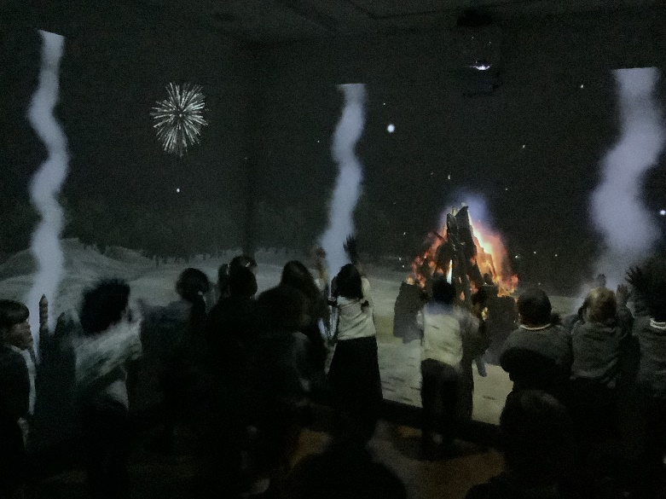
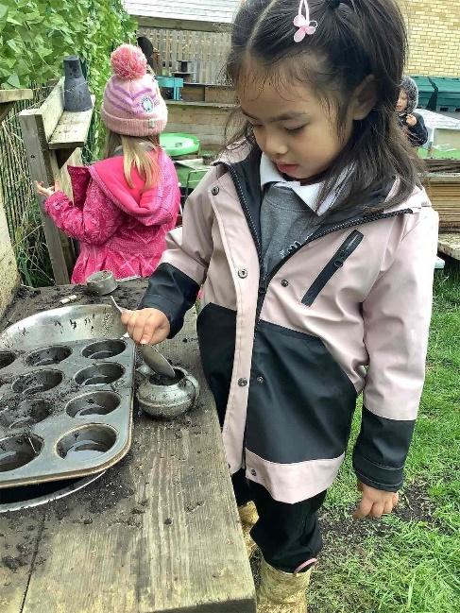
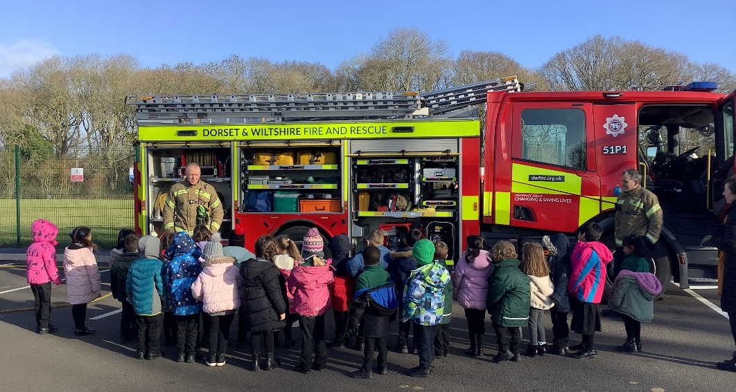
“Children learn best when a reception class is managed and organised by the adults, but led by the children”
Anna Ephgrave
The Reception Year in Action

Slide 13
So, what does this look like?

Slide 14
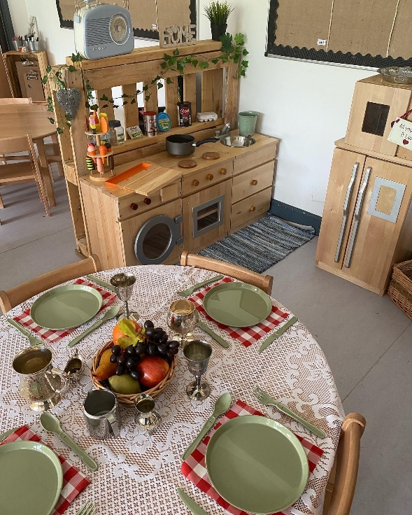
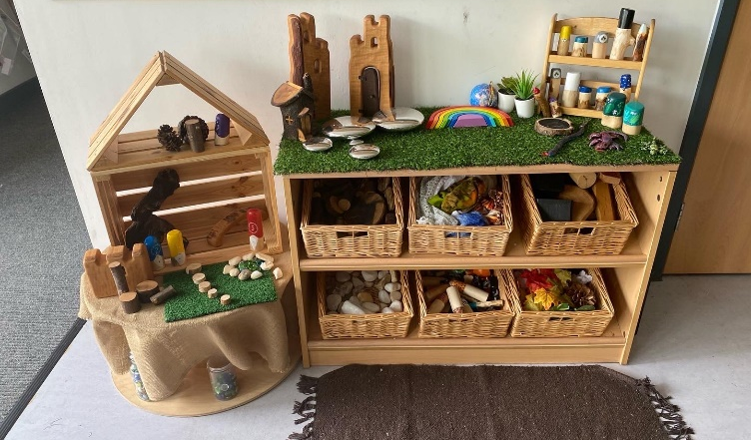
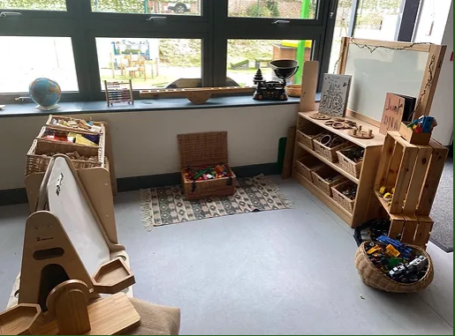
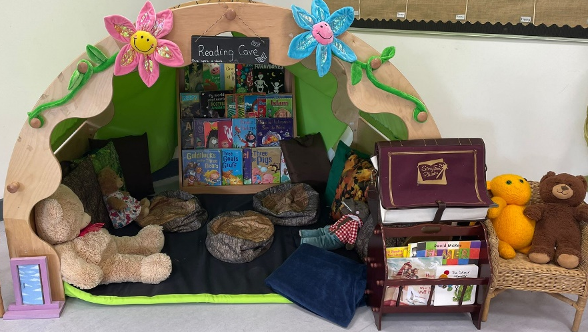
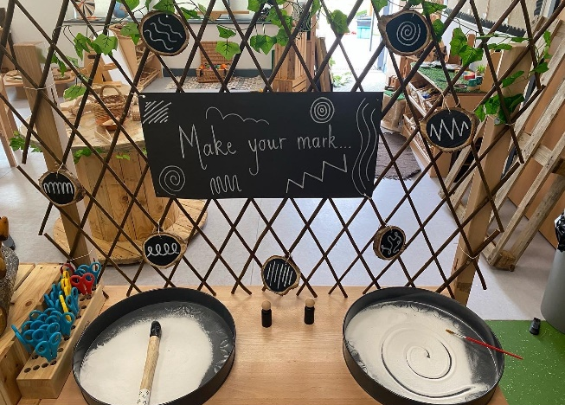
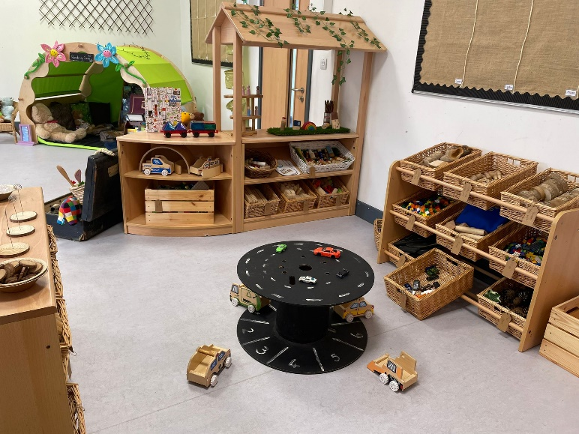
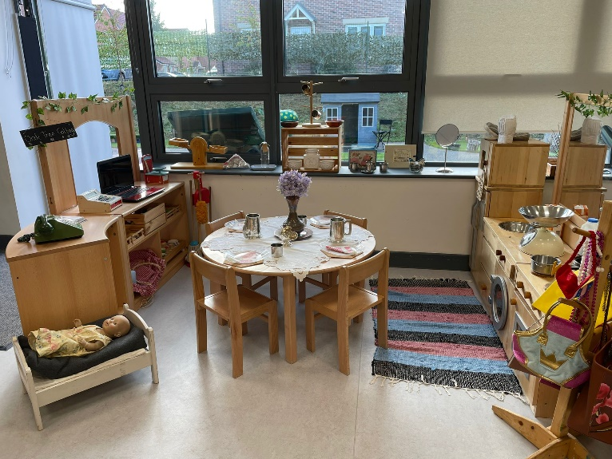
Ash Tree Class
&
Oak Tree Class

Slide 15
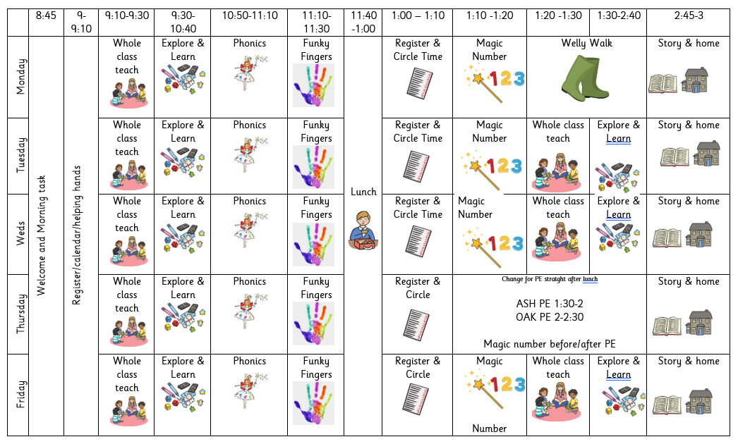
Snack – rolling snack (children access independently, or whole
class snack)

Slide 16
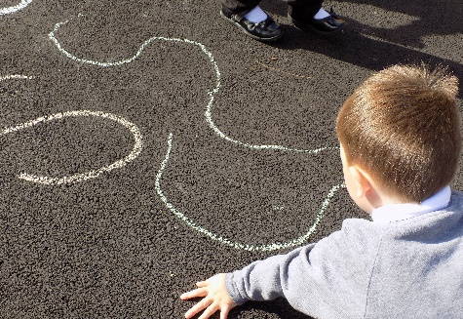
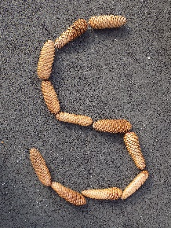
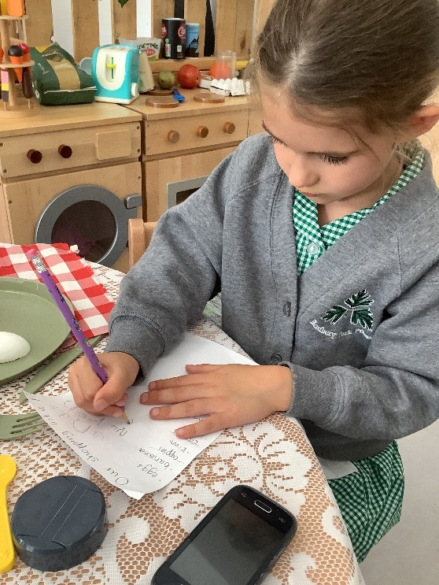
We follow the Twinkl Phonics scheme underpinned by the magic of a Phonics Fairy and use the structure of Letters and Sounds to facilitate the learning.
We will recap phase 1 during the first few weeks of term and assess the children’s knowledge. We will teach phase 2, 3 and 4 in Reception. Each day a new sound will be taught and then we will move onto applying them in our reading and writing. Each sound has a ‘caption action’ and a ‘sparkle mark’. The children will hear a story and watch a video to help them remember the sound.
We will send the sounds home weekly to practise at home and so the children can teach you! Very quickly the children will learn to blend sounds together to read and write words. They will also meet Tricky Troll and Beegu words!

Slide 17
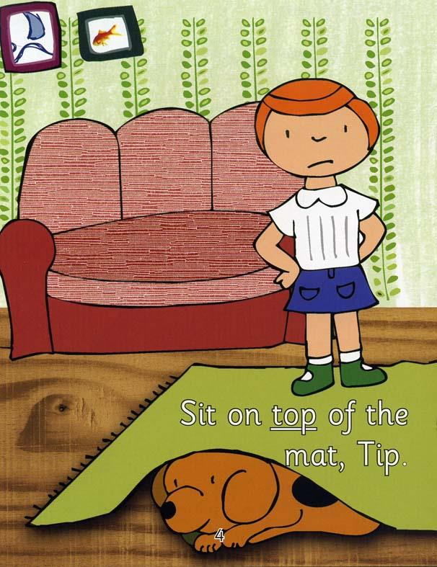
Reading
- Your child will be read with at least once a week and their reading book will be changed on the day they read in school.
- They will have a book and reading record sent home for you to read with them at home.
- Some books may not have words in - this is an important part of their reading journey. Wordless books help develop language, storytelling and comprehension. Look at the story, ask them questions, talk about the setting and the characters, think of a sentence for each page.

Slide 18
Reading at home
Reading at home is one of the best ways to support your child’s learning.
Top Tips:
No distractions – turn off the TV, put down the tablet
Straight after school is the best time to read with your child
If your child does not want to look at a school reading book,
choose a book from home to read or look at a magazine
4. When you are out and about, encourage your child to read shopping
lists, familiar logos
5. Please log all reading in the reading record

Slide 19
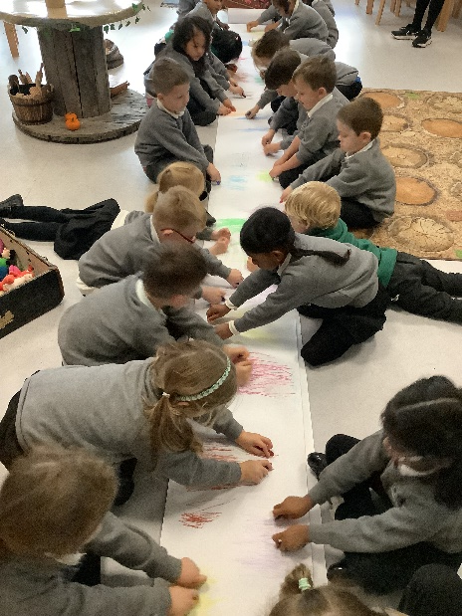
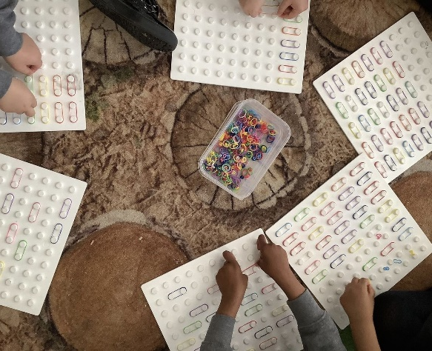
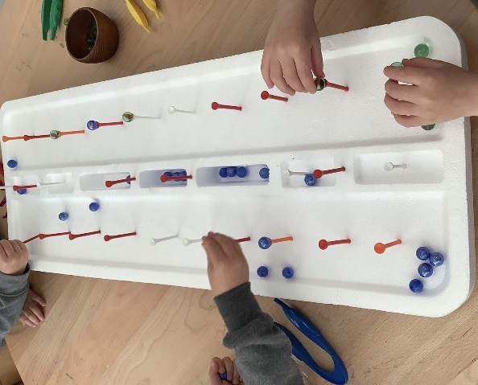
Funky Fingers and Squiggle Wiggle
Both are used to help children develop the fine motor control they need for writing, eating, manipulating objects and getting dressed.
Squiggle Wiggle
- Uses dance and large movements to support
gross motor
Funky Fingers
- Involves the small muscles working with the brain and
nervous system to control movements in children’s hands,
fingers and eyes.

Slide 20
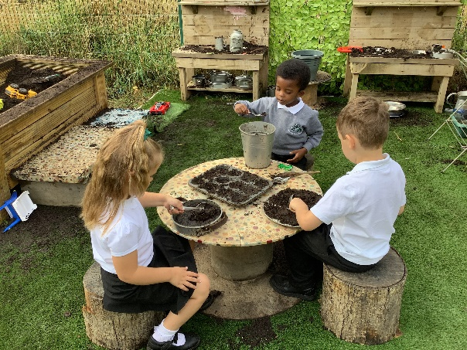
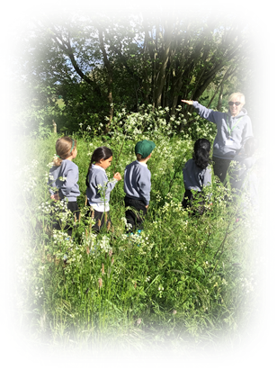
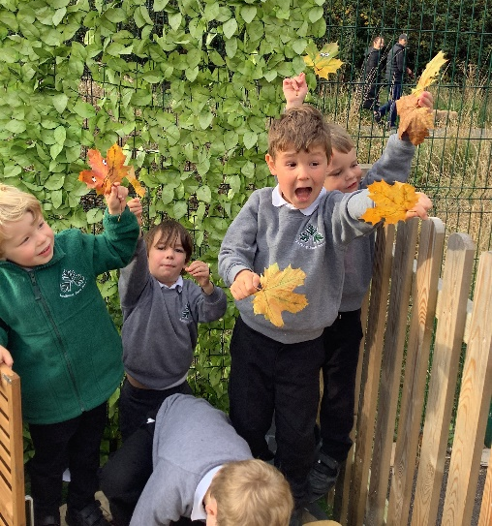
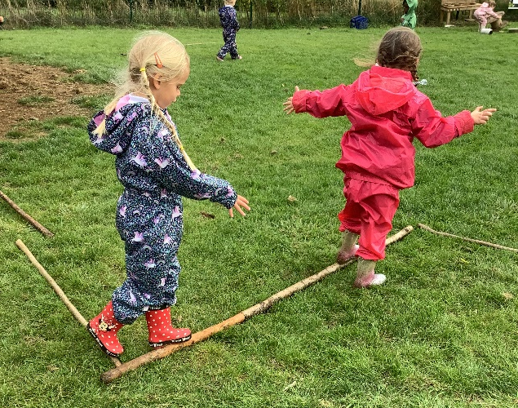
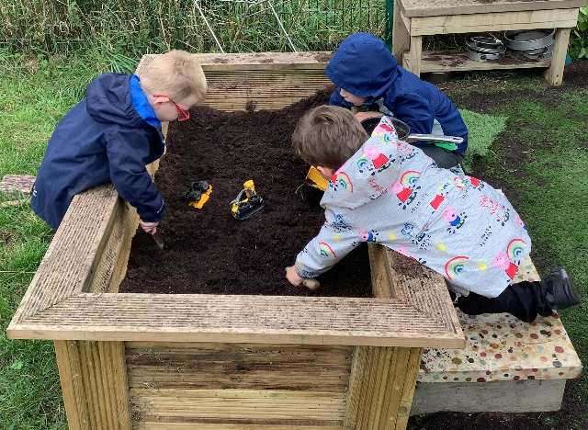
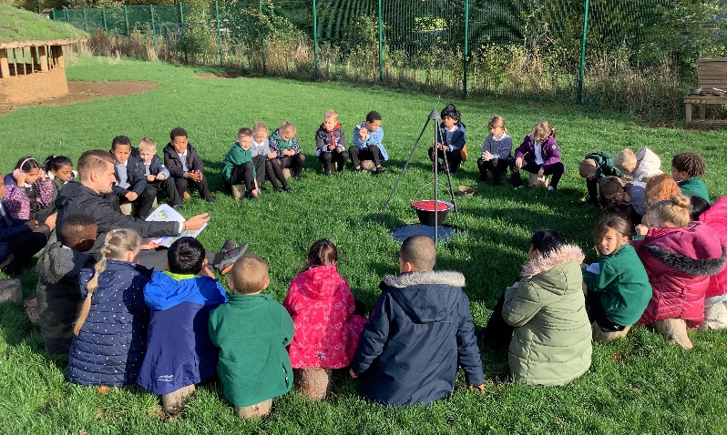
Outdoor Learning, Welly Walks and Forest School
Children will need
warm and waterproof clothing
old trainers or wellington boots
Children will learn
risk taking and boundary setting
scientific and environmental knowledge
respect for the environment
communication skills
Children will build
confidence and self esteem and a sense of
awe and wonder

Slide 21
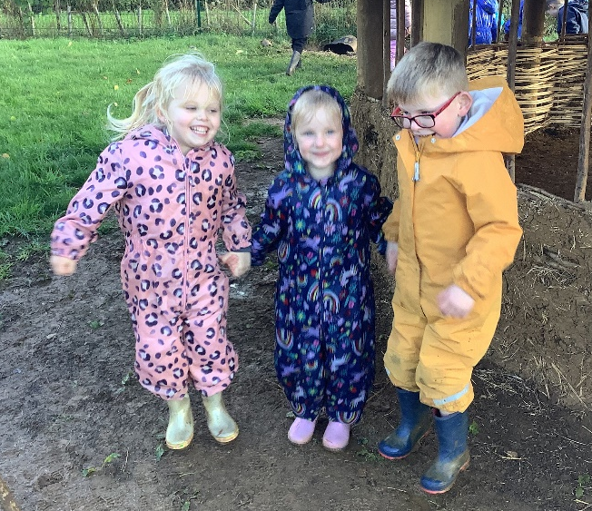
Expectations
Up until Christmas – the first term of Reception – we focus on settling in, building relationships, exploring our learning environment, securing routines and boundaries and ensuring your child is happy to come to school.
The children will practise recognising and writing their name, number formation, letter formation, beginning to recognise some Tricky Troll words and begin to blend simple words using their phonic knowledge. They will be encouraged to dress themselves, independently putting on their coats and shoes.

Slide 22
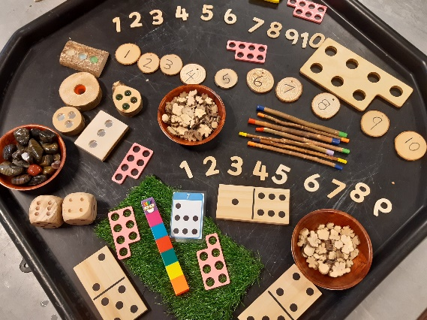
EYFS Curriculum
Prime Areas
Personal, social and emotional development
Physical development
Communication and Language
Specific Areas
Literacy- including phonics
Mathematics
Understanding the World
Expressive Arts and Design
Characteristics of Effective Learning and Executive Function Skills
Playing and Exploring
Active Learning
Creating and thinking critically

Slide 23
Interactive Learning Diary (ILD)
Used to observe and assess children
Parents able to sign up and create an account
Able to view observations and next steps
Create your own observations from home and share achievements from out of school
Good way to communicate with us if you need to send us a message
Each week your child will have at least one observation
Please do not share these photos on social media

Slide 24
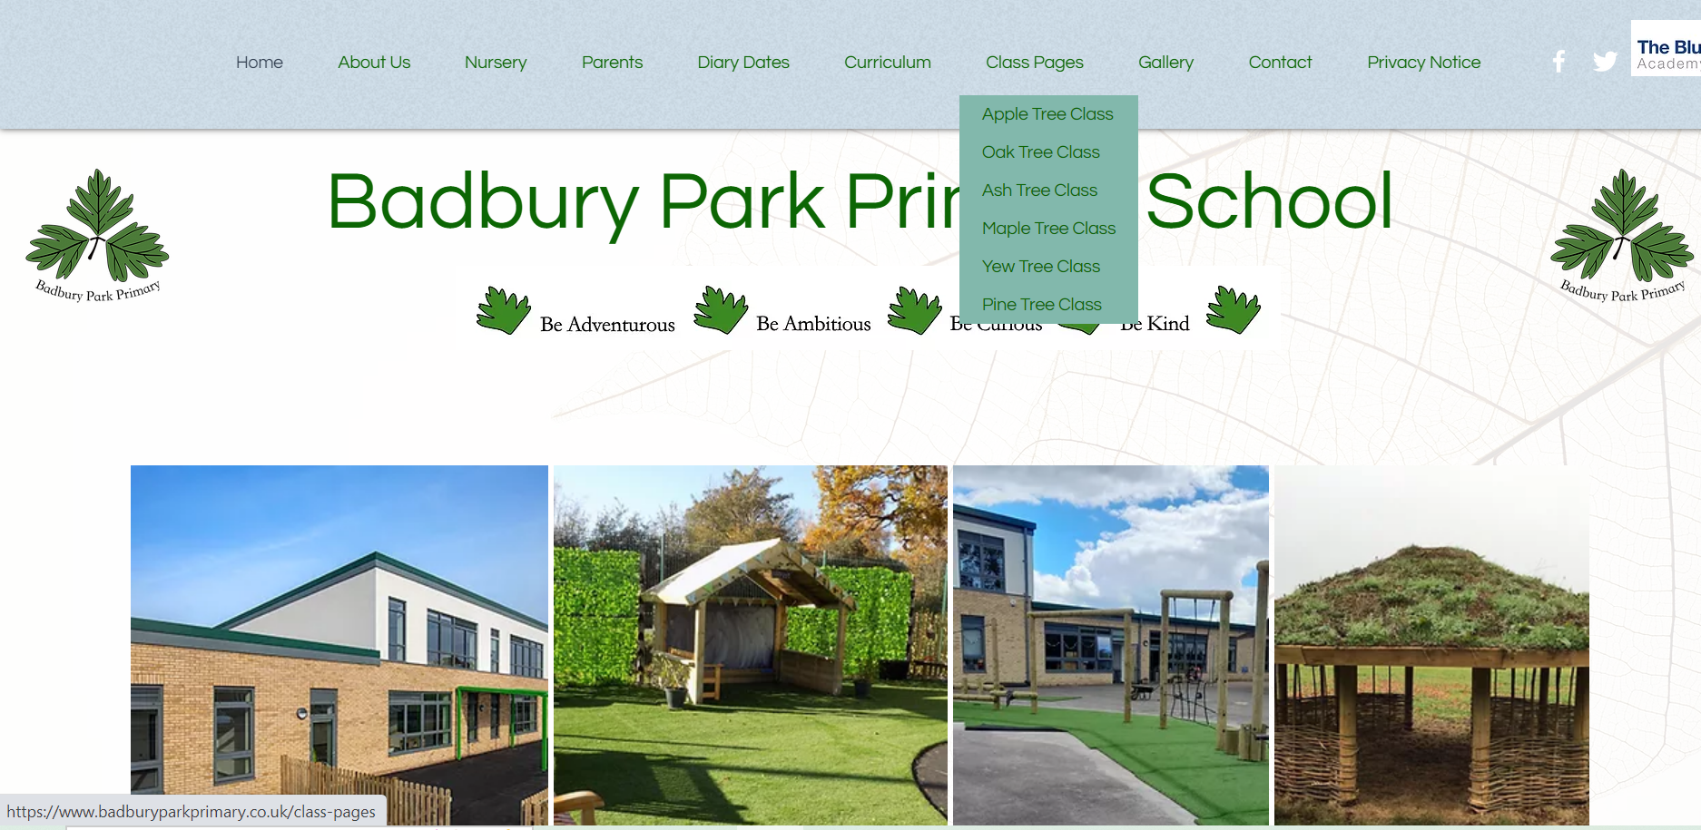
School website – class pages
https://www.badburyparkprimary.co.uk/

Slide 25
How can you help at home?
Encourage indoor voices and walking indoors
Encourage children to tidy away their toys
Independently put on coats
Independently use the toilet
Use a knife, fork and spoon
Encourage your child to be curious and enjoy the outdoors
Read together at home – magazines, picture books, school books
Encourage name recognition and writing

Slide 26
“How was your day?” “Fine!”
Ideas of questions to ask your children…
What did your friend tell you that you did not know before?
Who did you sit next to at lunch?
Who was the first person you smiled at?
Who made you laugh?
What was your favourite moment from today?
What did you find easy and what did you find hard?
Also be ready to share some of your day too.
“What did you learn?”
“Nothing, I just played.”

Slide 27
Other notices:
First aid:
We will notify you of a head injury or if we feel your child needs to be collected, as stated in our policy.
You will receive a notification if your child has been given first aid.
If no first aid was given to a child, you will not be notified.

Slide 28
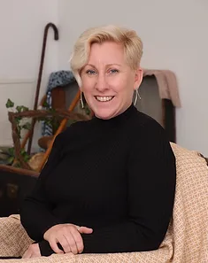
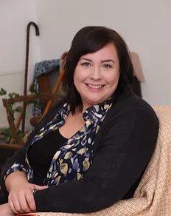
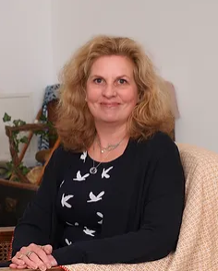
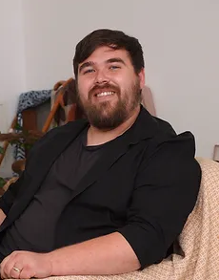
Other Adults:
Mrs Dance Mrs Christmas Mrs Debono Mr Hanks
Headteacher SENDCo Assistant Headteacher Inclusion Worker
Assistant Headteacher

Slide 29
Safeguarding
We aim to promote wellbeing and maintain a safe, secure and caring environment where everyone is treated with respect.
If you have any concerns about a child please report it to Mrs L Dance as the designated safeguarding lead. You can also report your concerns to Mrs Christmas if Mrs Dance is not available.

Slide 30
Please do come and talk to us!
In the morning, on the door can be busy, but if it is urgent, please let us or the office know. You can make an appointment through the office. They have access to our diaries and can pass a message on.

Slide 31
Online Safety
The age restriction is a MINIMUM age for each platform.

Slide 32
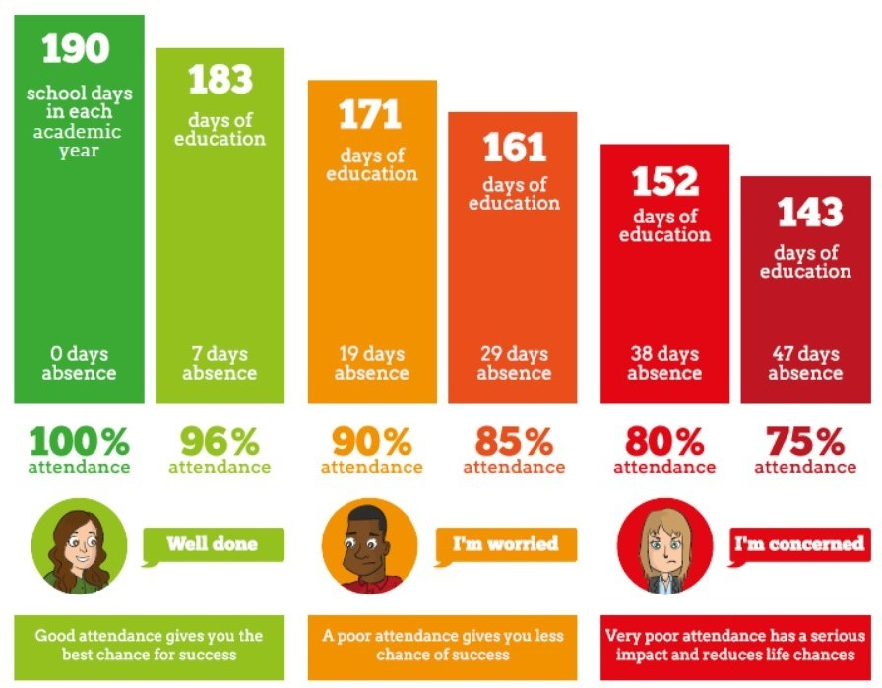
Attendance

Slide 33
Can you help?
We would love to have some reading volunteers in school. Is this something you would be interested in? Please let us know ☺
Any Questions?

