Slide 1
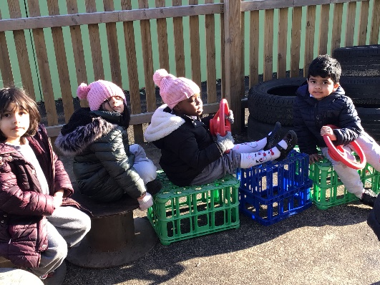
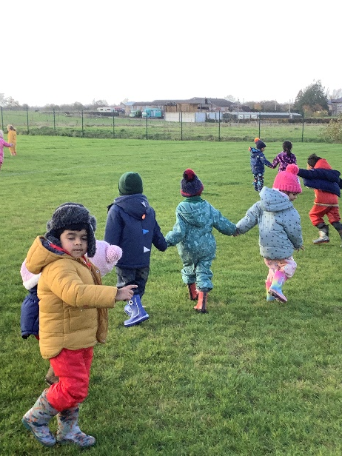
Nursery at Badbury Park Primary School
Apple Tree Class

Slide 2
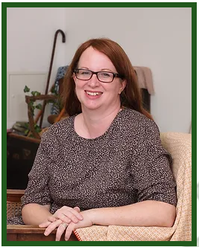
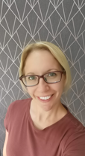
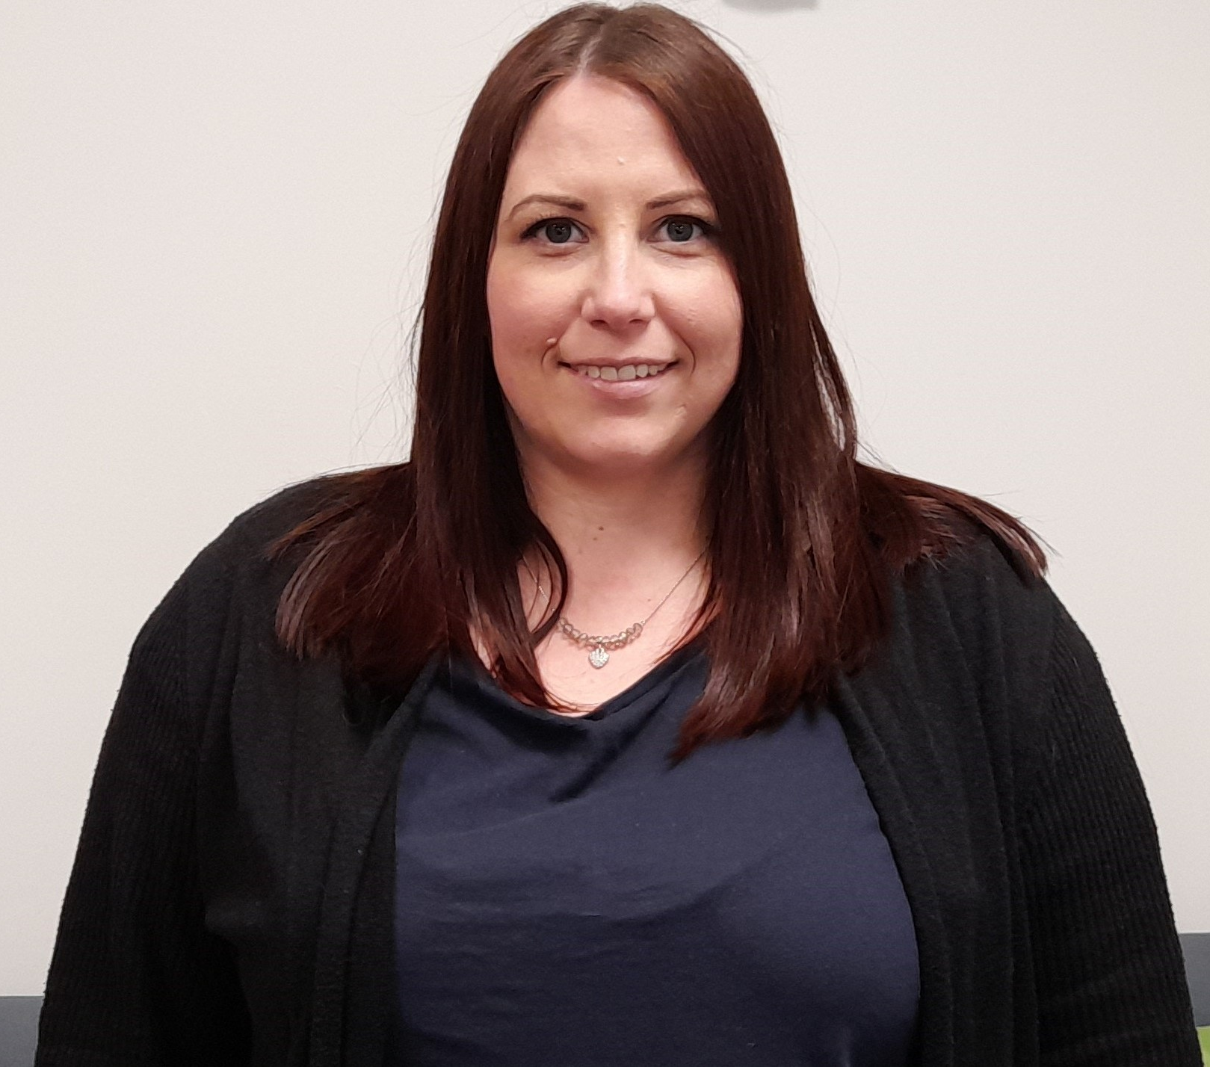
Meet the Apple Tree Class Team
Mrs Laura Humphries
Nursery Class Teacher
Mrs Heap
Teaching Assistant
Mrs Payne
Teaching Assistant

Slide 3
Our Vision
We want happy, engaged leaners within a
beautiful, authentic learning space that is calm
and consistent.
We use natural, versatile, open-ended resources that are carefully chosen to provoke creativity, wonder and concentration both inside and outside.
We want an environment where children are confident to take risks and problem solve whilst learning both knowledge and skills and where the natural world takes center stage.

Slide 4
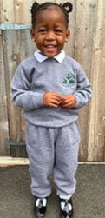
What uniform does your child need in Nursery?
School uniform:
Grey school jumper/cardigan
White polo t-shirt
Grey tracksuit bottoms
Black shoes/trainers
School dress or shorts in summer
No jewellery please except for small studs.
Please name everything!

Slide 5
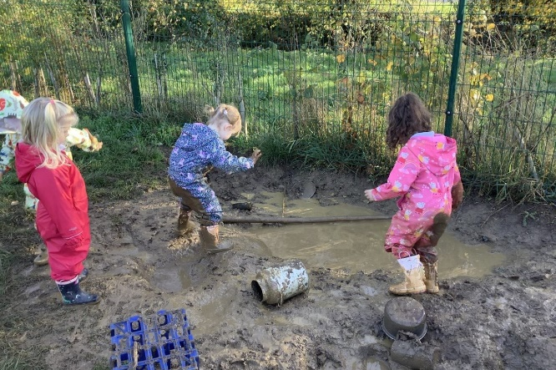
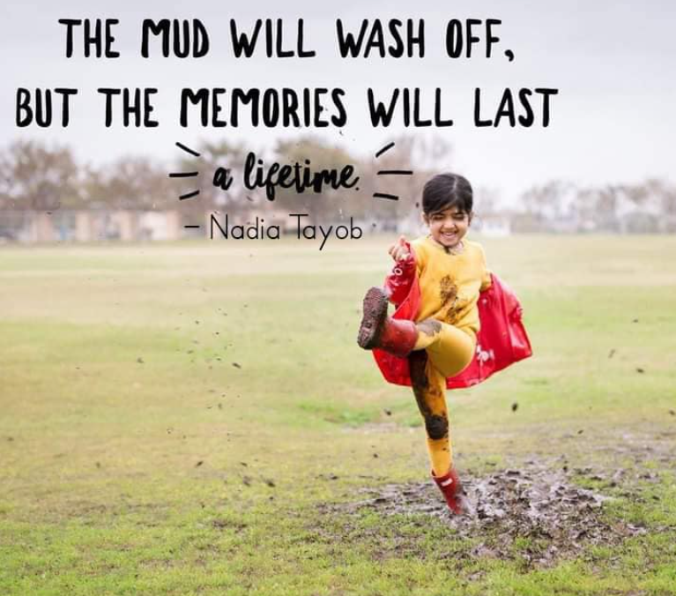
What else does your child need in Nursery?
Water bottle (with only water)
Wellies and waterproofs
Spare clothes (named) in a named bag to keep in school
Please name everything!

Slide 6
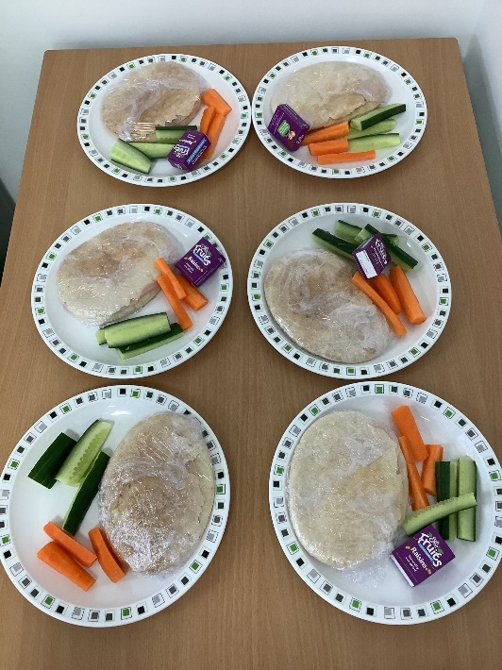
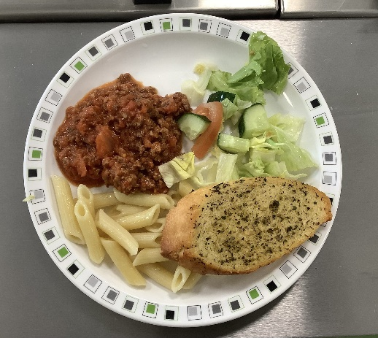
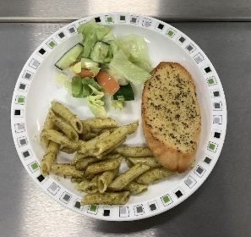
Food, Glorious Food!
Snack
all children will be provided with a morning or afternoon snack (fruit or vegetables).
There is a charge of £15 per year for snack payable bi-termly
Lunch
If your child attends 30 hours, they will come for lunch in the hall.
Lunch club costs £4 per day and will be invoiced monthly and can pay via My Child At School app.
Parents can book a hot dinner via app

Slide 7
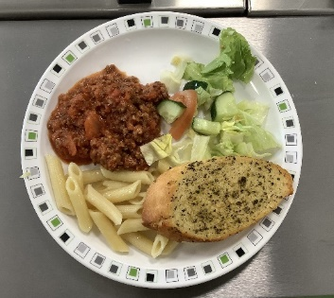
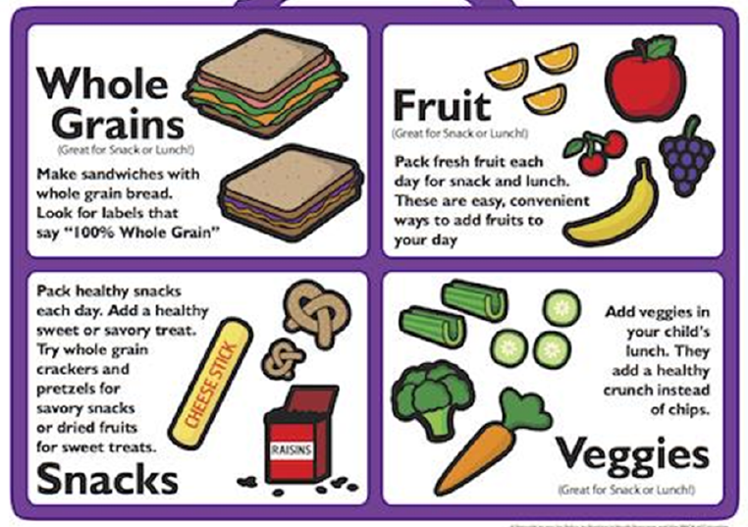
Food, Glorious Food!
Hot Dinner
Mrs Biggs - Catering Manager
Fresh cooked meals (meat, vegetarian, jacket potato)
A school packed lunch including wraps and baguettes (meat/vegetarian)
If you send a packed lunch from home, please ensure it is healthy and balanced.

Slide 8
Stay and Play Sessions
A chance to meet and explore inside and outside together with parents attending the sessions.
Class teachers, Mrs Dance (Headteacher) and Mrs Christmas (SENDCo) will be available during these times if you want to discuss specific needs.
The next dates for this are:
Tuesday 27th June at 3.30pm
Tuesday 11th July at 3.30pm
Home visit dates will be sent out shortly for July.

Slide 9
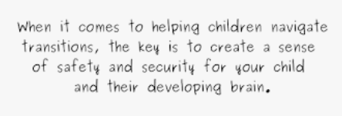
Starting School – Days & Times
Wednesday 6th September
You will be sent a one-hour slot for your child to attend. During this session, you will leave your child with us to see how they settle. If the sessions goes well and your child is happy, they will then begin their regular sessions from Thursday 7th September. If your child needs a little longer to settle, we will work with you to plan a longer transition into Nursery.
Notes:
Come and speak after if you have any concerns over the transition or want to discuss your child.

Slide 10
What does a day in nursery look like?
For children, play is as natural as breathing…and as necessary”
Mimi Brodsky Chenfeld

Slide 11
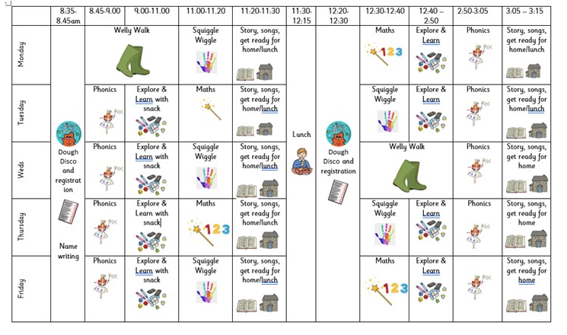
Snack – rolling snack (children access with an adult, or whole
class snack)

Slide 12
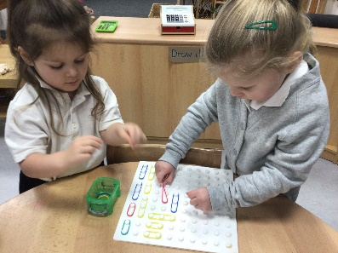
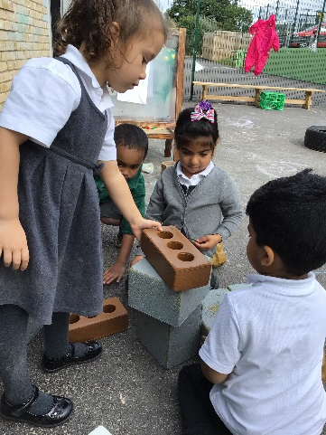
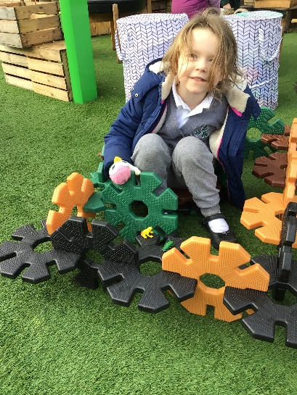
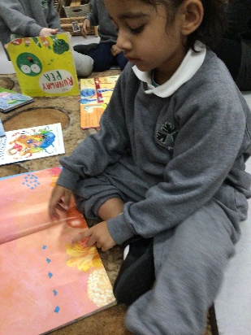
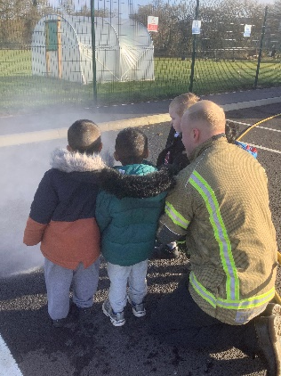
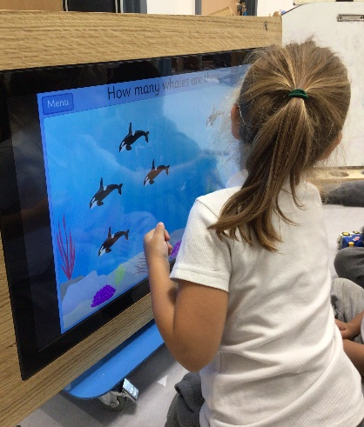
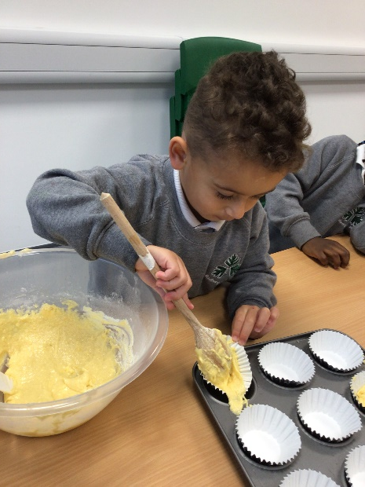
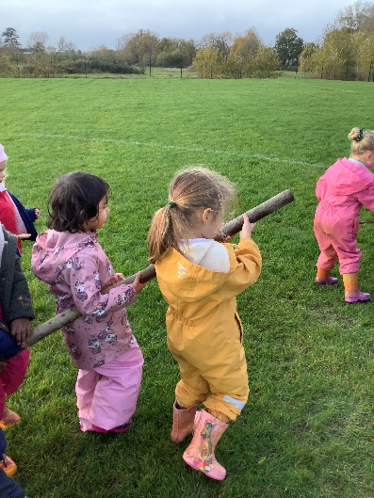
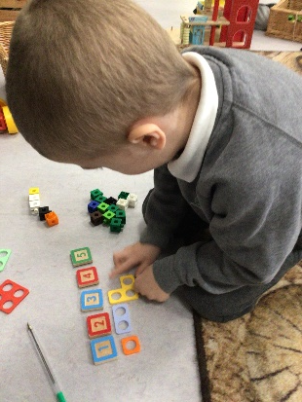
Collaboration
Learning to share
Being engineers
Building resilience
Exploring numbers

Slide 13
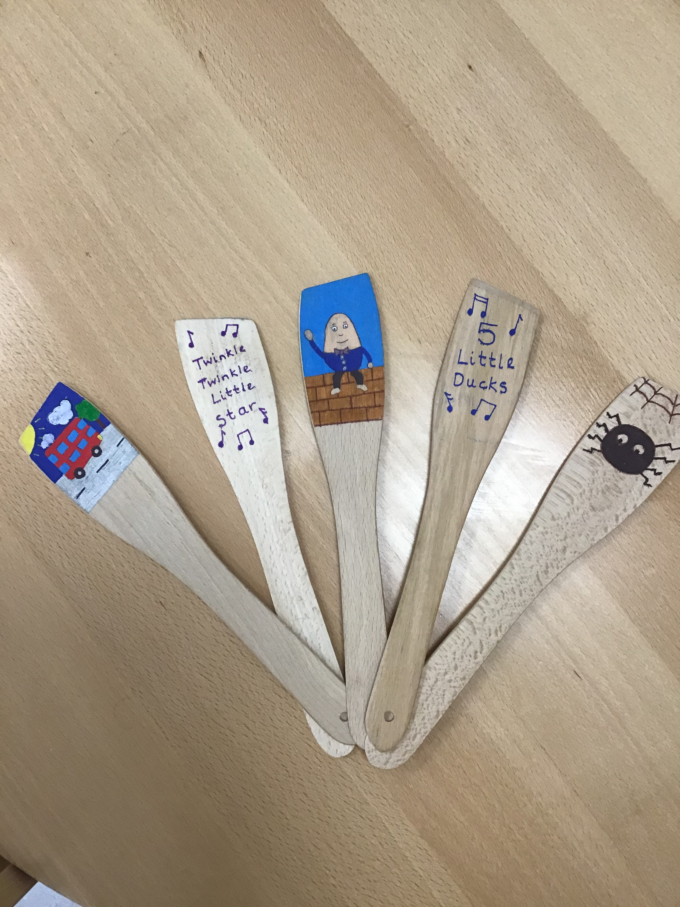
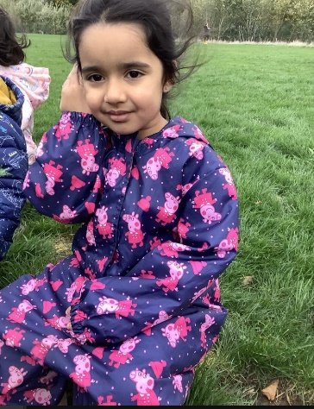
What does phonics look like in Nursery?
Early phonics teaching in Nursery focuses on developing children’s listening, vocabulary and speaking skills.
Typical activities for teaching Phase 1 phonics include 'listening' walks, playing and identifying instruments, action songs, learning rhymes and playing games like I-Spy.
In Phase 1 phonics, children are taught about:
Environmental sounds e.g. car/train/animal sounds
Instrumental sounds
Body percussion e.g. clapping and stamping
Rhythm and rhyme
Alliteration
Voice sounds
Oral blending and segmenting e.g. hearing that d-o-g makes ‘dog’

Slide 14
Reading at home
Reading at home is one of the best ways to support your child’s learning.
Top Tips:
- No distractions – turn off the TV, put down the tablet
We will send home a picture book each week for you to share and enjoy with your child. These will be changes on a Thursday.
We will share some ideas and prompts of how to enjoy a story together
When you are out and about, encourage your child to read shopping
lists, familiar logos

Slide 15
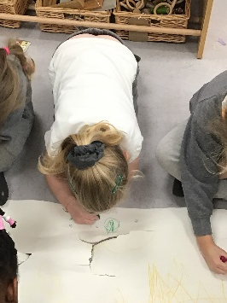
Dough Disco and Squiggle Wiggle
Both are used to help children develop the motor strength and control they need for writing, eating, manipulating objects and getting dressed.
Squiggle Wiggle
- Uses dance and large movements to support
gross motor.
We then transfer these movements onto paper – the children love it!
Dough Disco
Involves moulding dough in time with music, performing different actions such as rolling, squeezing and working individual fingers.
Helps to develop the dexterity which is necessary to be good writers.
We have seen the impact of these this year!

Slide 16
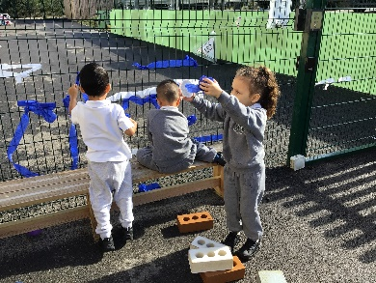
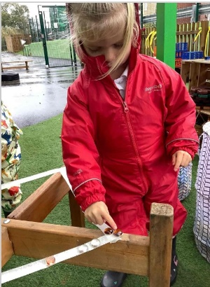
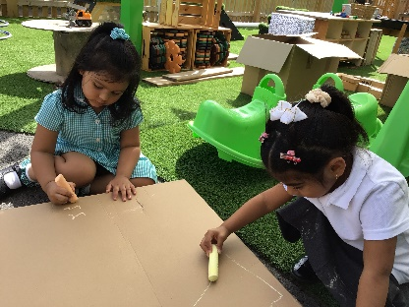
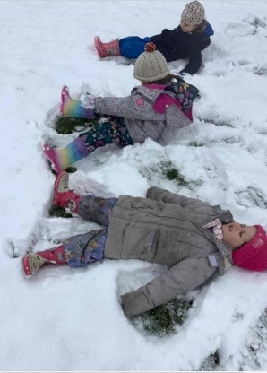
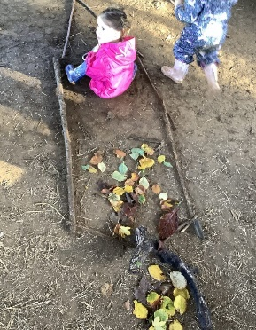
Outdoor Learning and Welly Walks
We will start welly walks as soon as the children are settled into nursery.
All children have access to outdoor space as soon as we go to explore and learn. The children are able to set their own learning and follow their interests. Being able to freeflow allows for deeper level of learning and engagement.
Children will need
warm and waterproof clothing
old trainers or wellington boots
Hats in cold weather
Change of clothes in school
Children will learn
risk taking and boundary setting
scientific and environmental knowledge
respect for the environment
communication skills
Children will build
confidence and self esteem and a sense of
awe and wonder

Slide 17
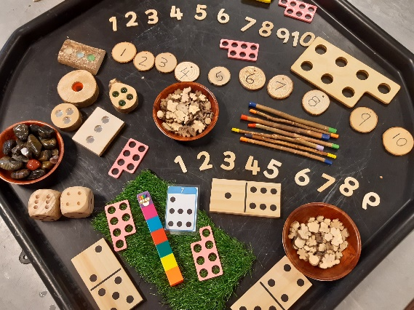
EYFS Curriculum
Prime Areas
Personal, social and emotional development
Physical development
Communication and Language
Specific Areas
Literacy- including phonics
Mathematics
Understanding the World
Expressive Arts and Design
Characteristics of Effective Learning and Executive Function Skills
Playing and Exploring
Active Learning
Creating and thinking critically

Slide 18
Interactive Learning Diary (ILD)
Used to observe and assess children
Parents able to sign up and create an account
Able to view observations and next steps
Create your own observations from home and share achievements from out of school
Good way to communicate with us if you need to send us a message
Each week your child will have at least one observation
Please do not share these photos on social media

Slide 19
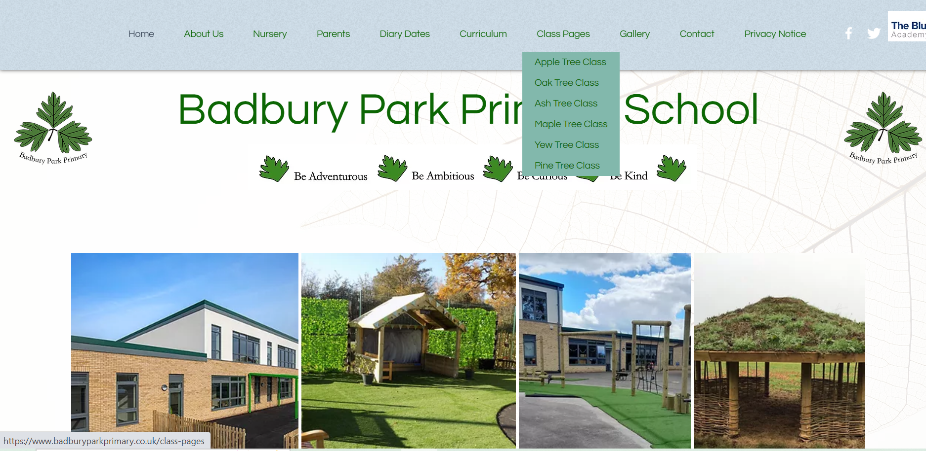
School website – class pages
https://www.badburyparkprimary.co.uk/

Slide 20
How can you help at home?
Encourage indoor voices and walking indoors
Encourage children to tidy away their toys
Independently put on coats
Independently use the toilet
Encourage your child to be curious and enjoy the outdoors
Read together at home – magazines, picture books, school books
Encourage name recognition and writing
Ditch the buggy and dummy.
World Health Organisation – 3 hours of physical activity per day
10-13 hours of good quality sleep.

Slide 22
“How was your day?” “Fine!”
Ideas of questions to ask your children…
What did your friend tell you that you did not know before?
Who did you sit next to at lunch?
Who was the first person you smiled at?
Who made you laugh?
What was your favourite moment from today?
What did you find easy and what did you find hard?
Also be ready to share some of your day too.
“What did you learn?”
“Nothing, I just played.”

Slide 23
Other notices:
First aid:
We will notify you of a head injury or if we feel your child needs to be collected, as stated in our policy.
You will receive a notification if your child has been given first aid.
If no first aid was given to a child, you will not be notified.

Slide 24
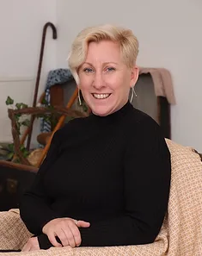
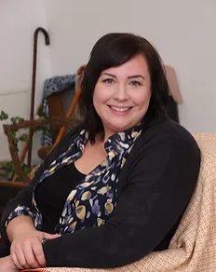
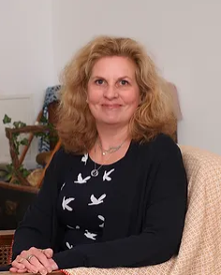
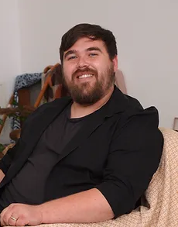
Other Adults:
Mrs Dance Mrs Christmas Mrs Debono Mr Hanks
Headteacher SENDCo Assistant Headteacher Inclusion Worker
Assistant Headteacher

Slide 25
Safeguarding
We aim to promote wellbeing and maintain a safe, secure and caring environment where everyone is treated with respect.
If you have any concerns about a child please report it to Mrs L Dance as the designated safeguarding lead. You can also report your concerns to Mrs Christmas if Mrs Dance is not available.

Slide 26
Please do come and talk to us!
In the morning, on the door can be busy, but if it is urgent, please let us or the office know. You can make an appointment through the office. They have access to our diaries and can pass a message on.

Slide 27
Online Safety
The age restriction is a MINIMUM age for each platform.

Slide 28
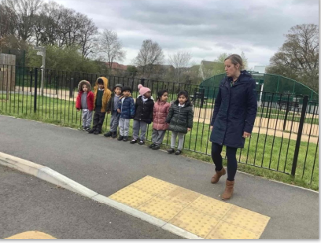
Road Safety
Please remember to walk, cycle or scoot to school – it is probably quicker!
If you have to drive, please park carefully and turn off your engine.
Please walk safely with your child and cross in a safe place.

Slide 29
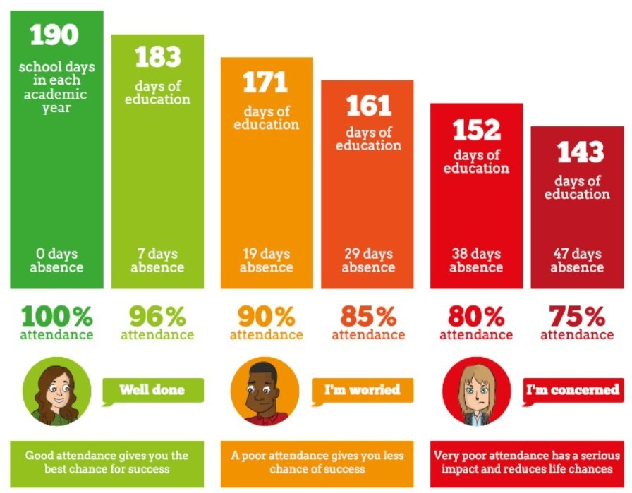
Attendance

Slide 30
Can you help?
We would love to have some reading volunteers in school. Is this something you would be interested in? Please let us know ☺
Any Questions?

