Slide 1
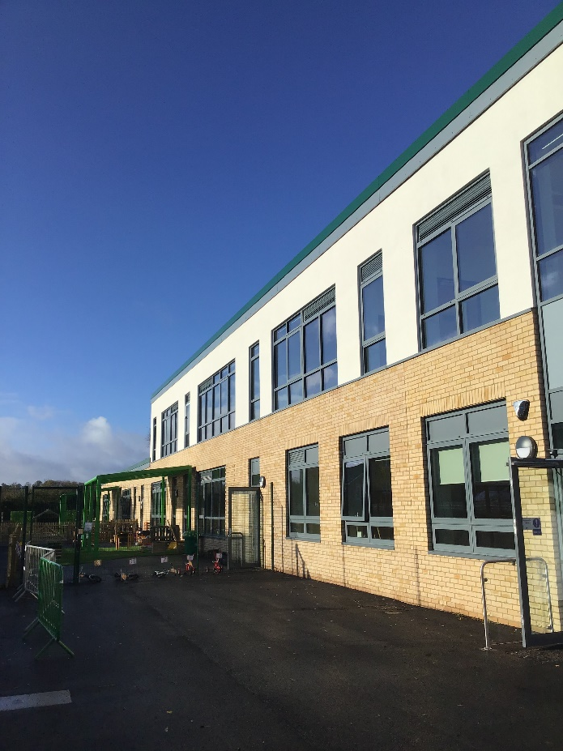
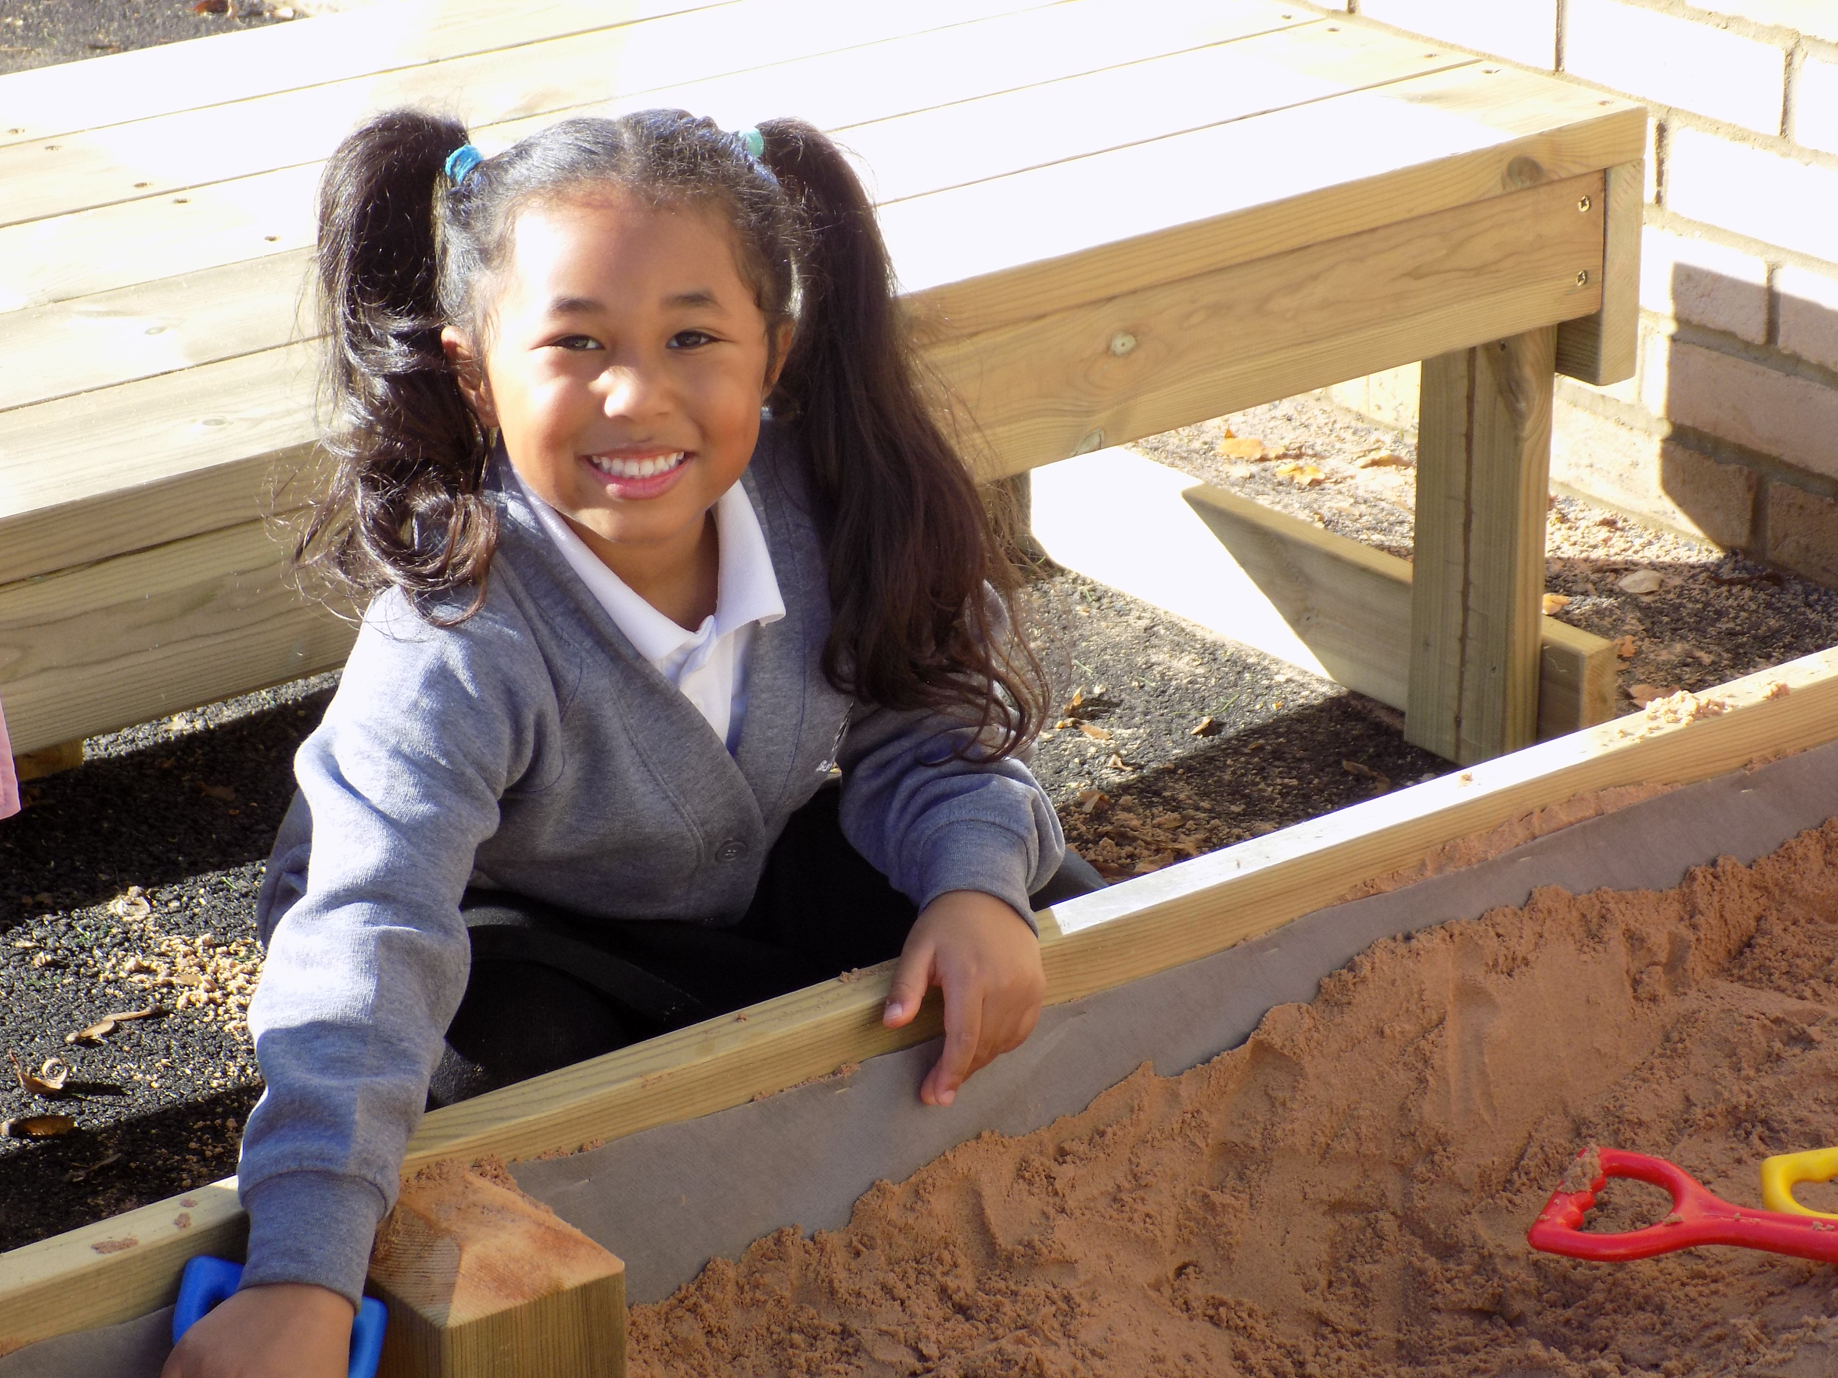
Welcome to Badbury Park Nursery

Slide 2
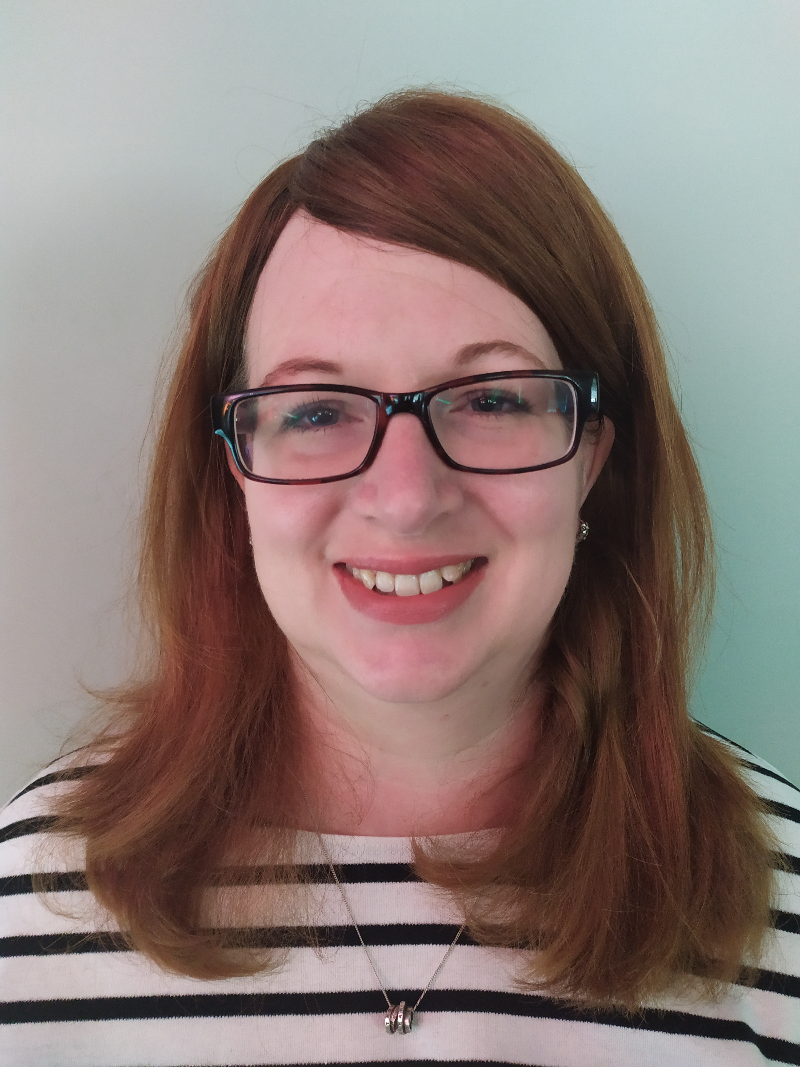
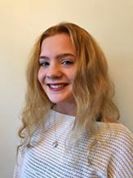
Welcome to Apple Tree class!
Mrs Humphries- Class Teacher
Miss Coley Class teacher on Thursday
Mrs Heap- Teaching Assistant Miss Harvey- Lunch time assistant

Slide 3
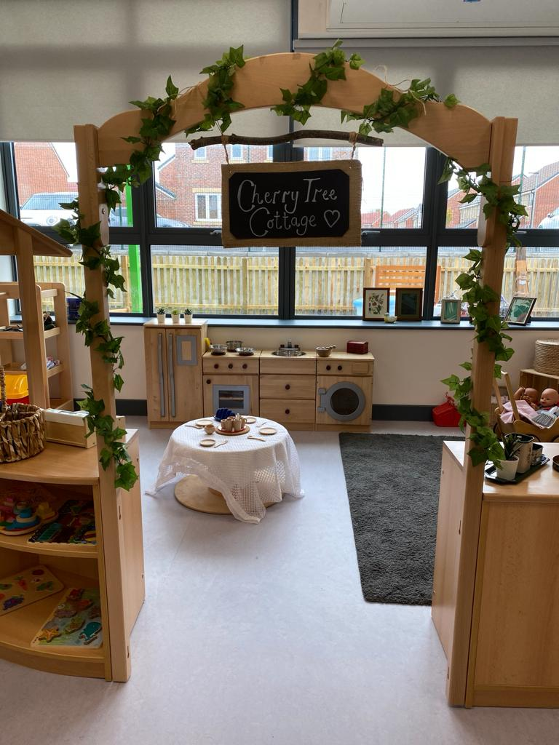
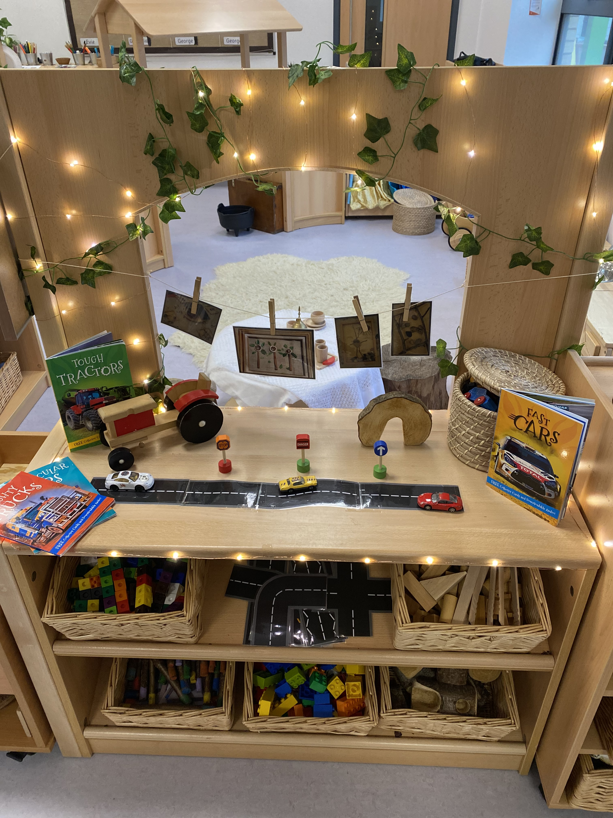
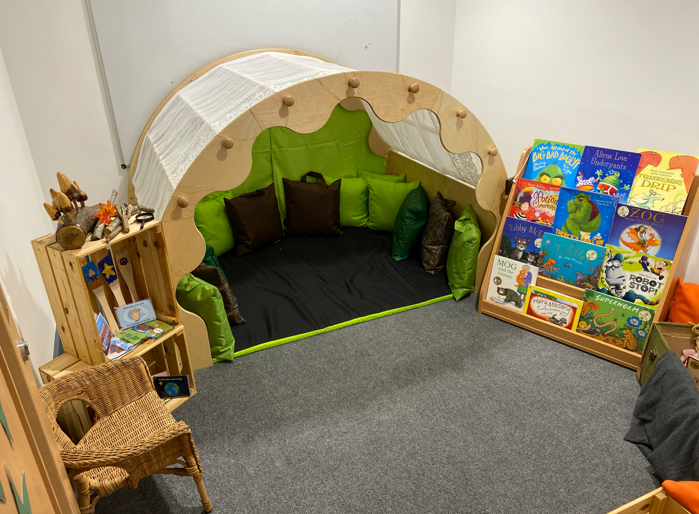
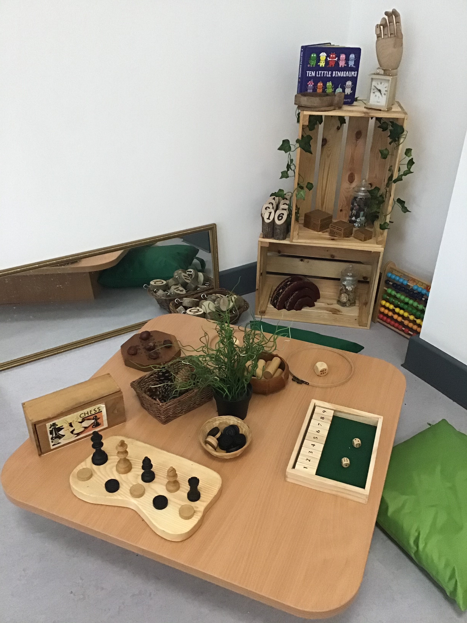
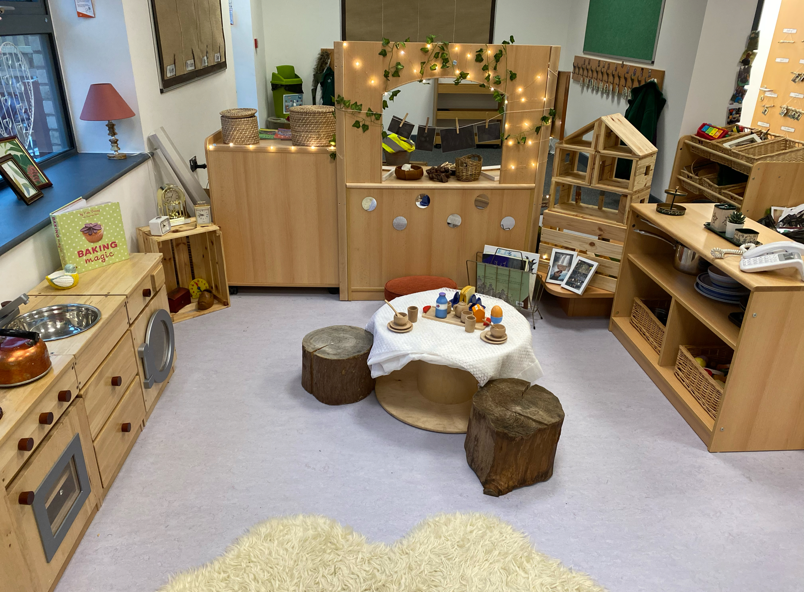
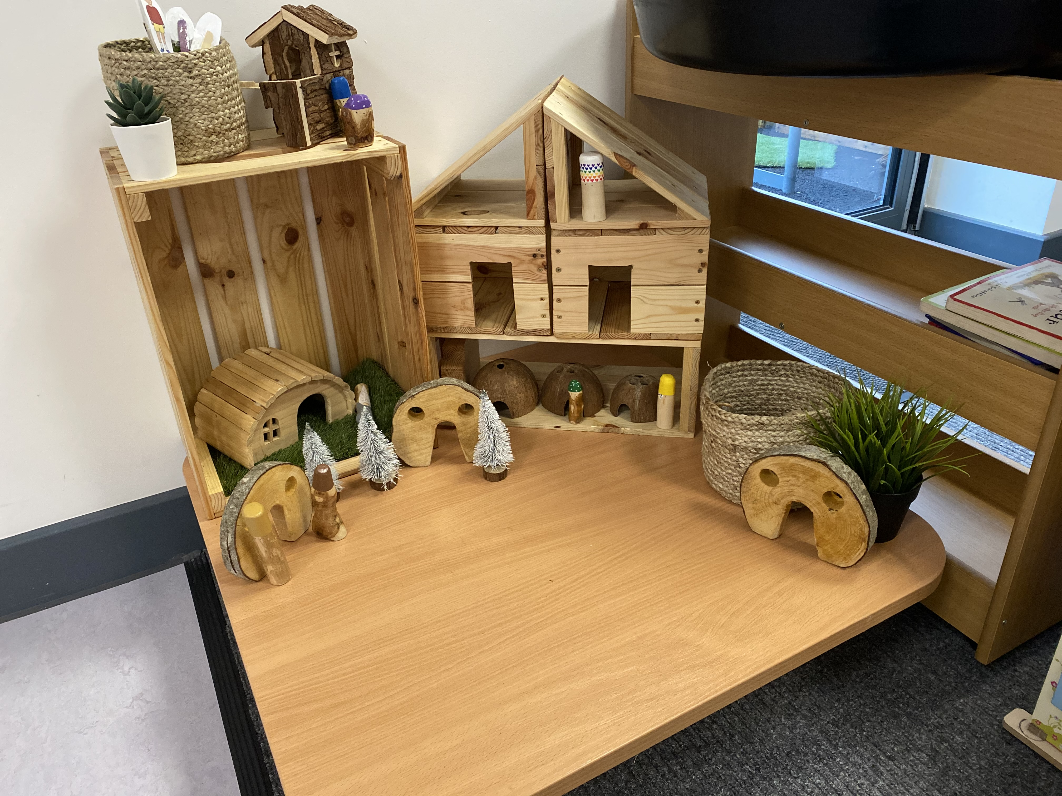
Our setting
Our indoor environment

Slide 4
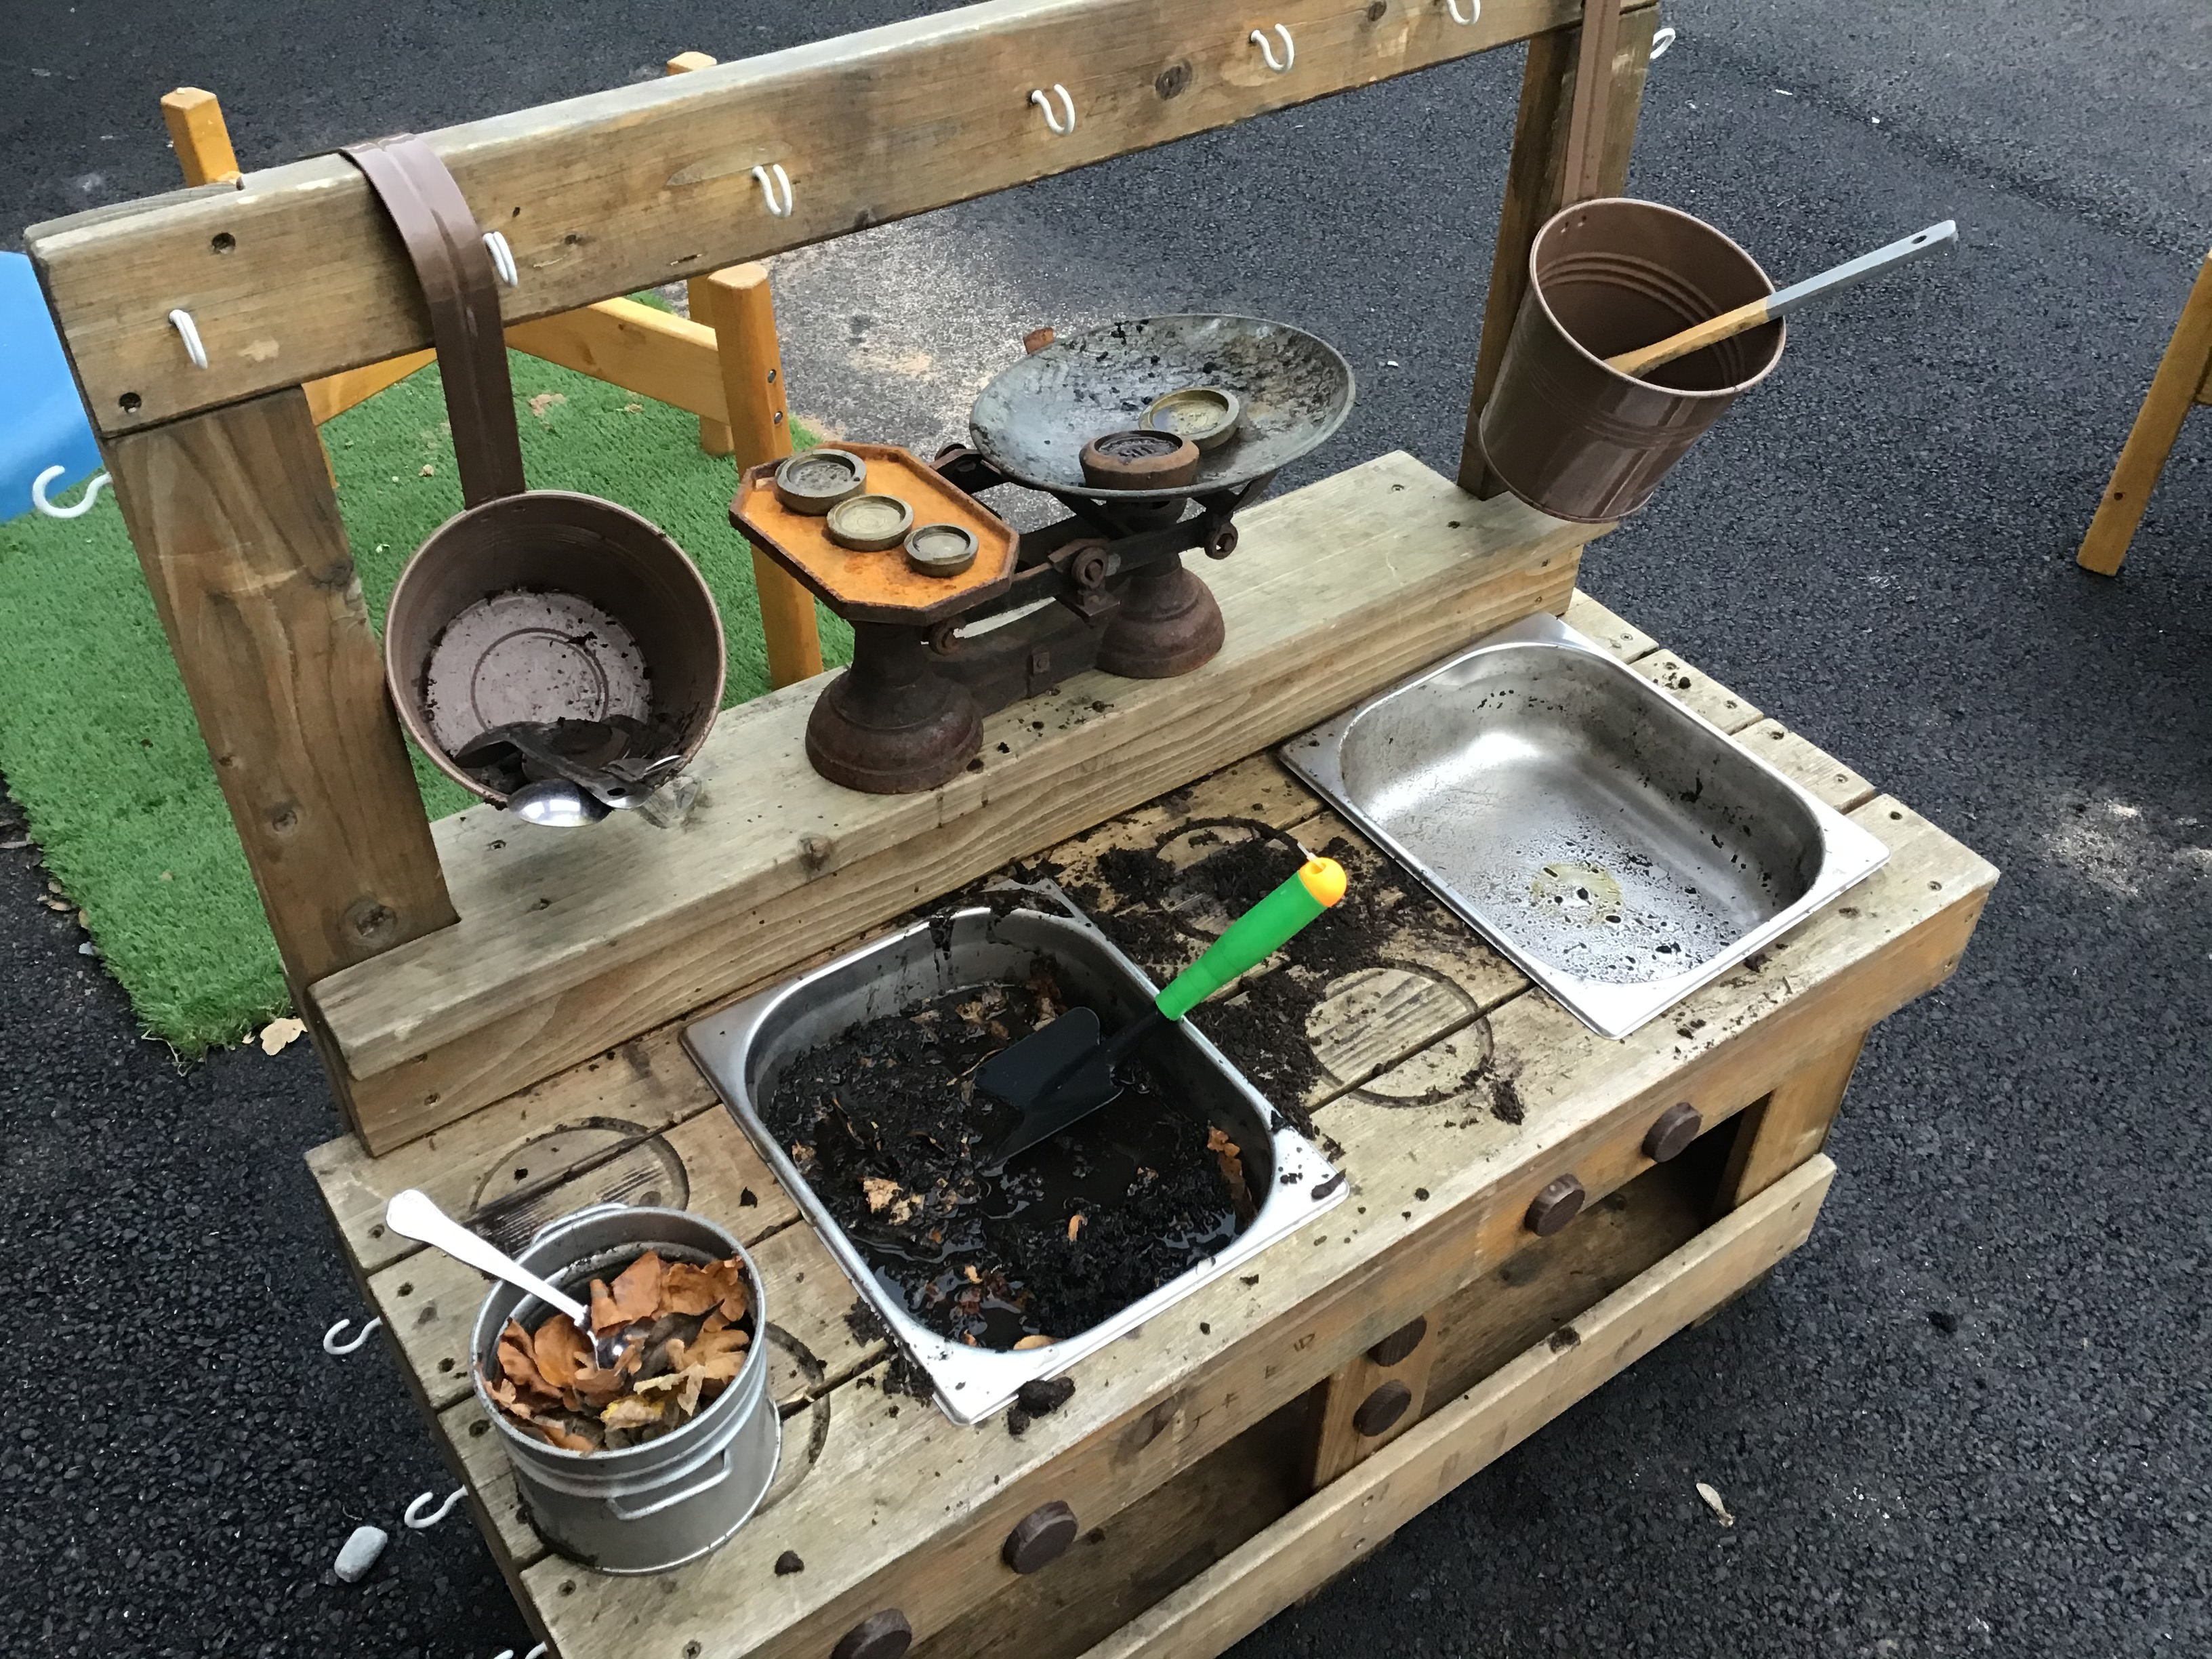
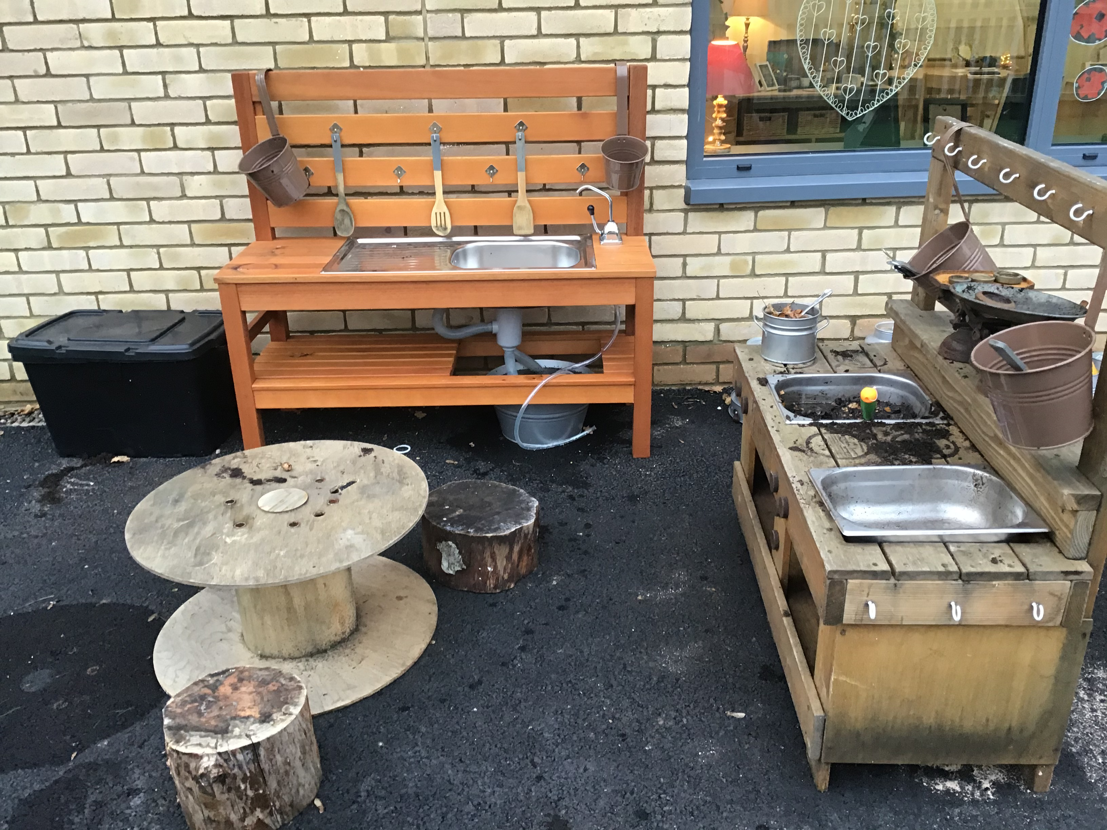
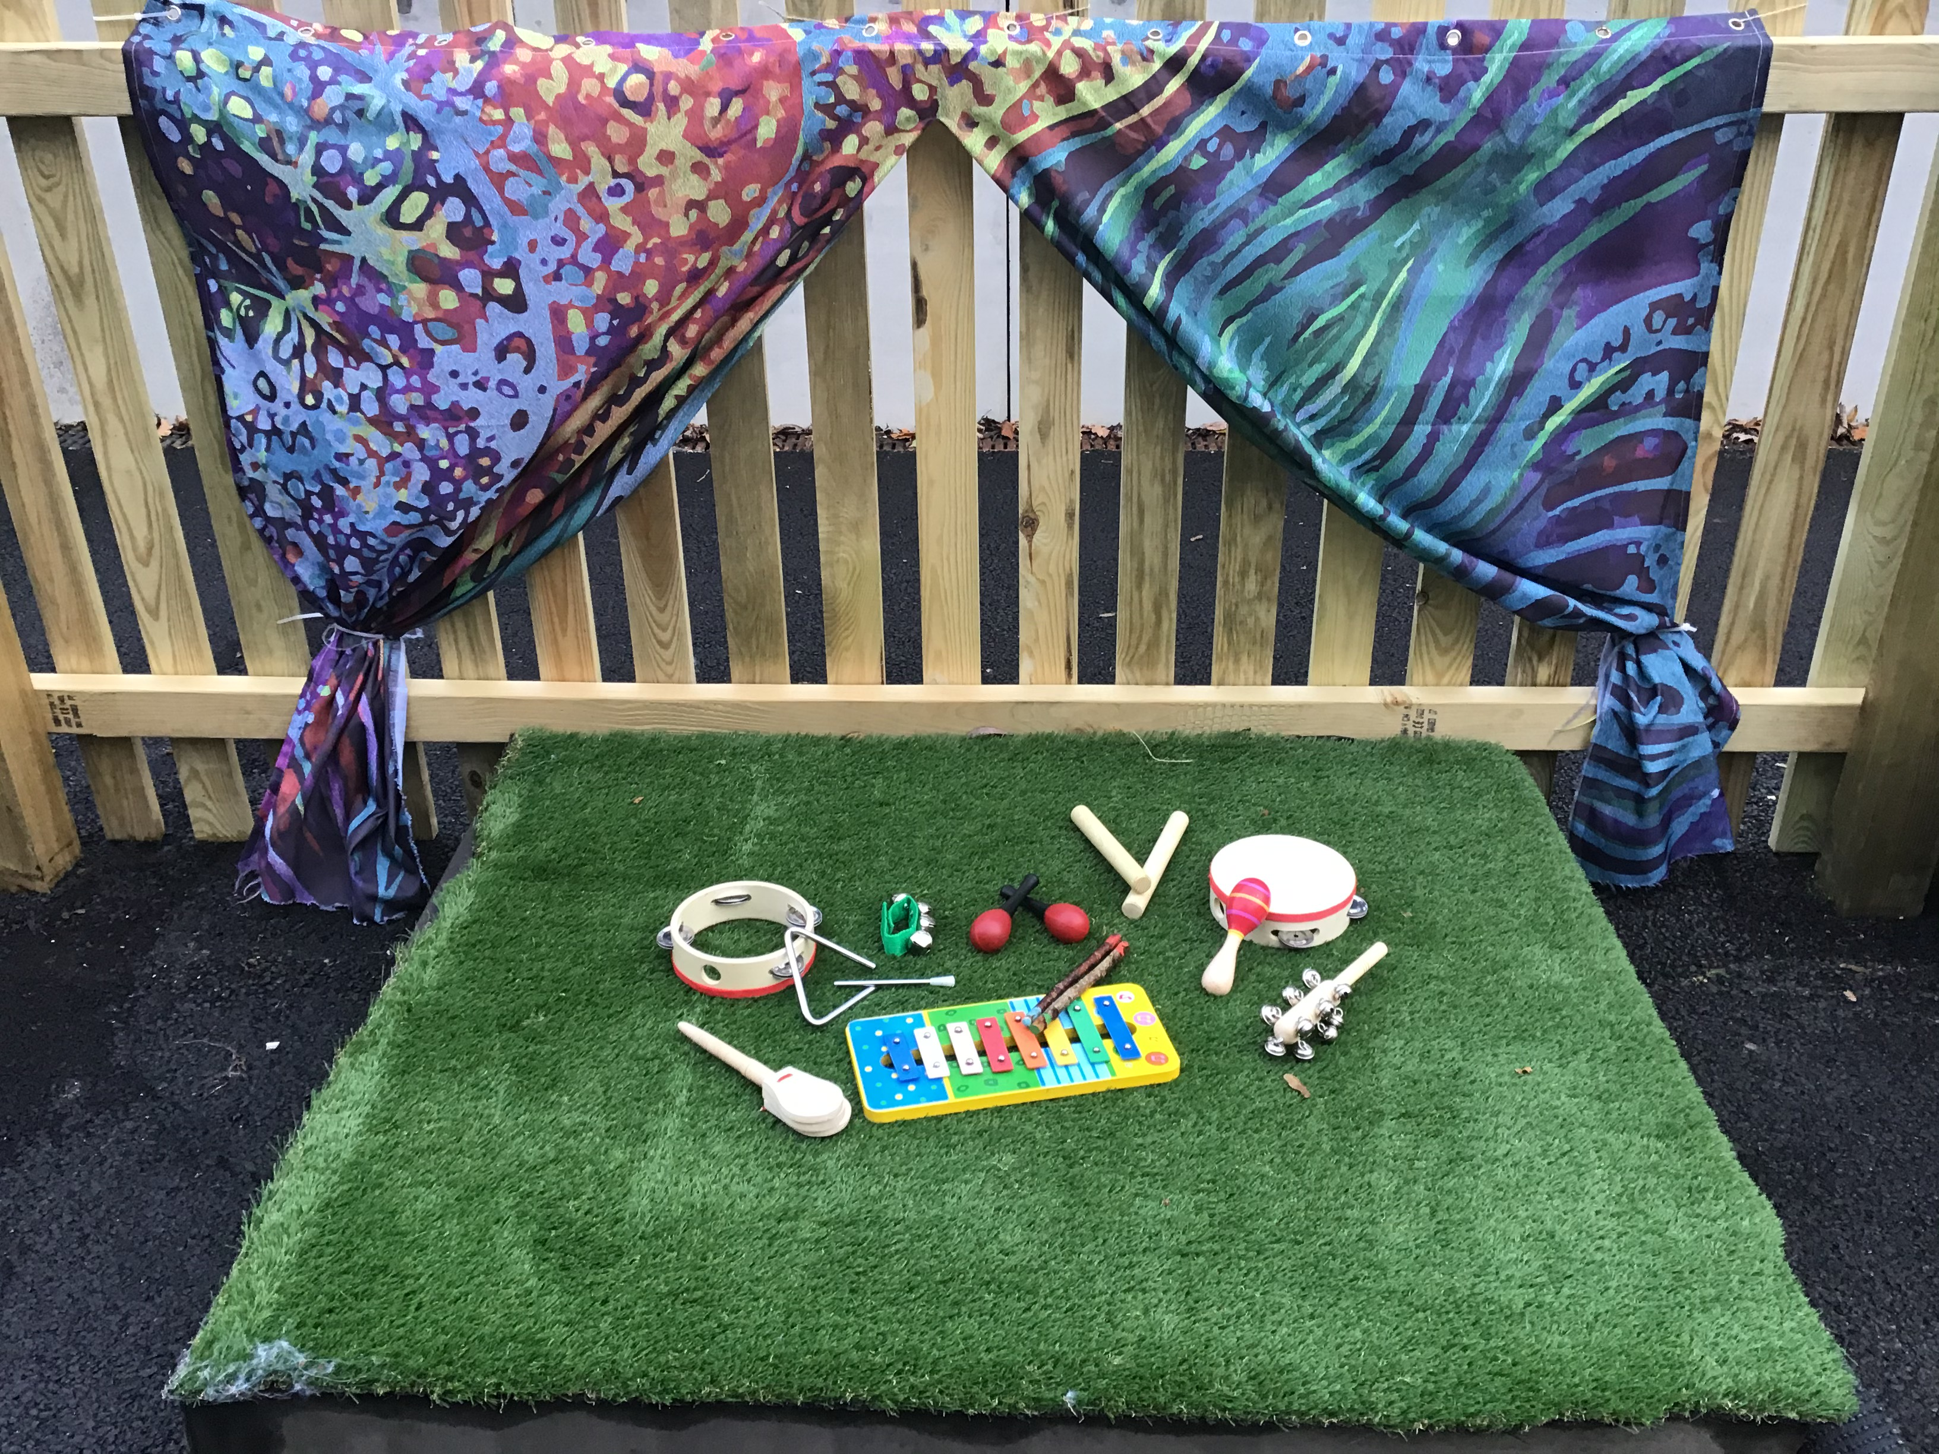
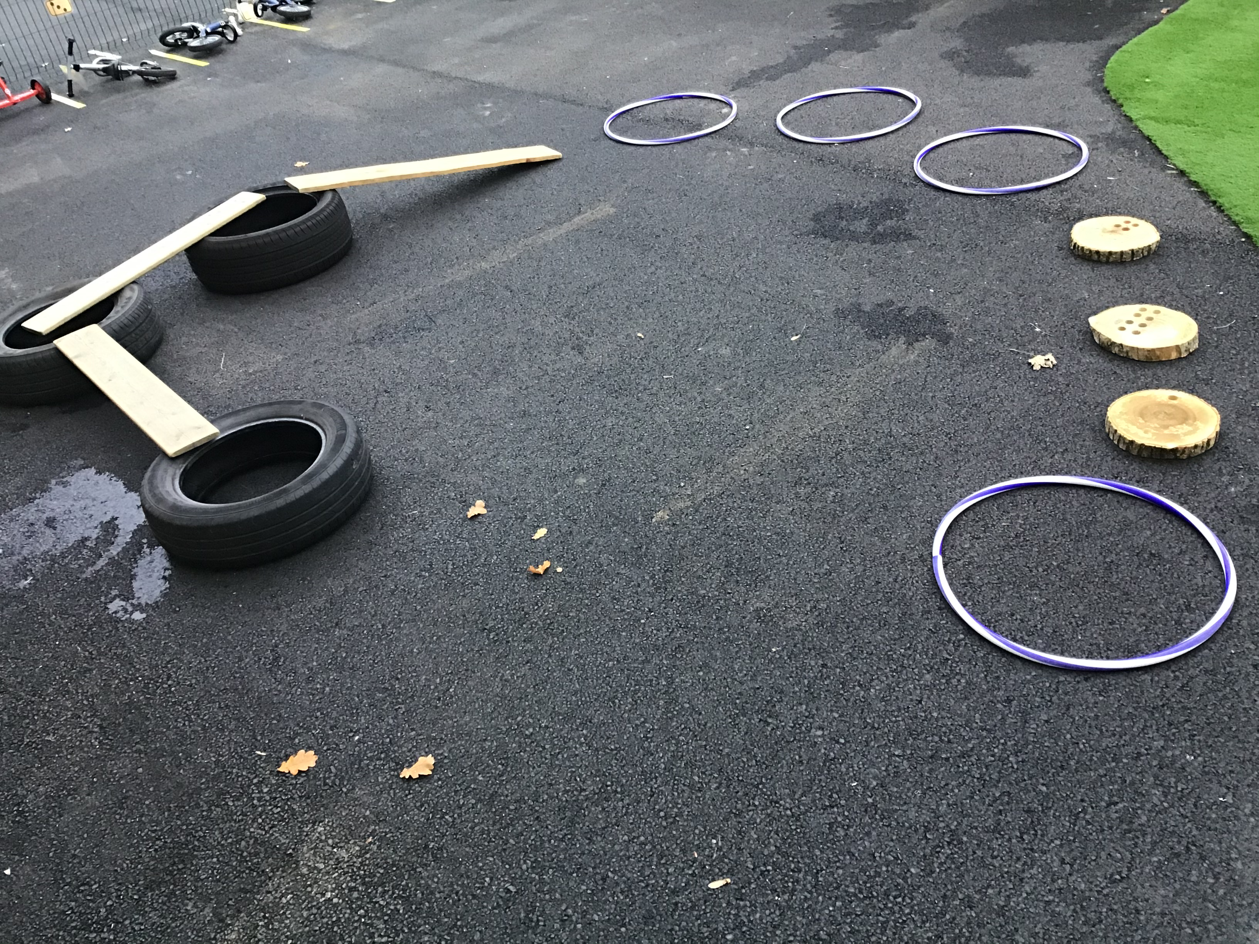
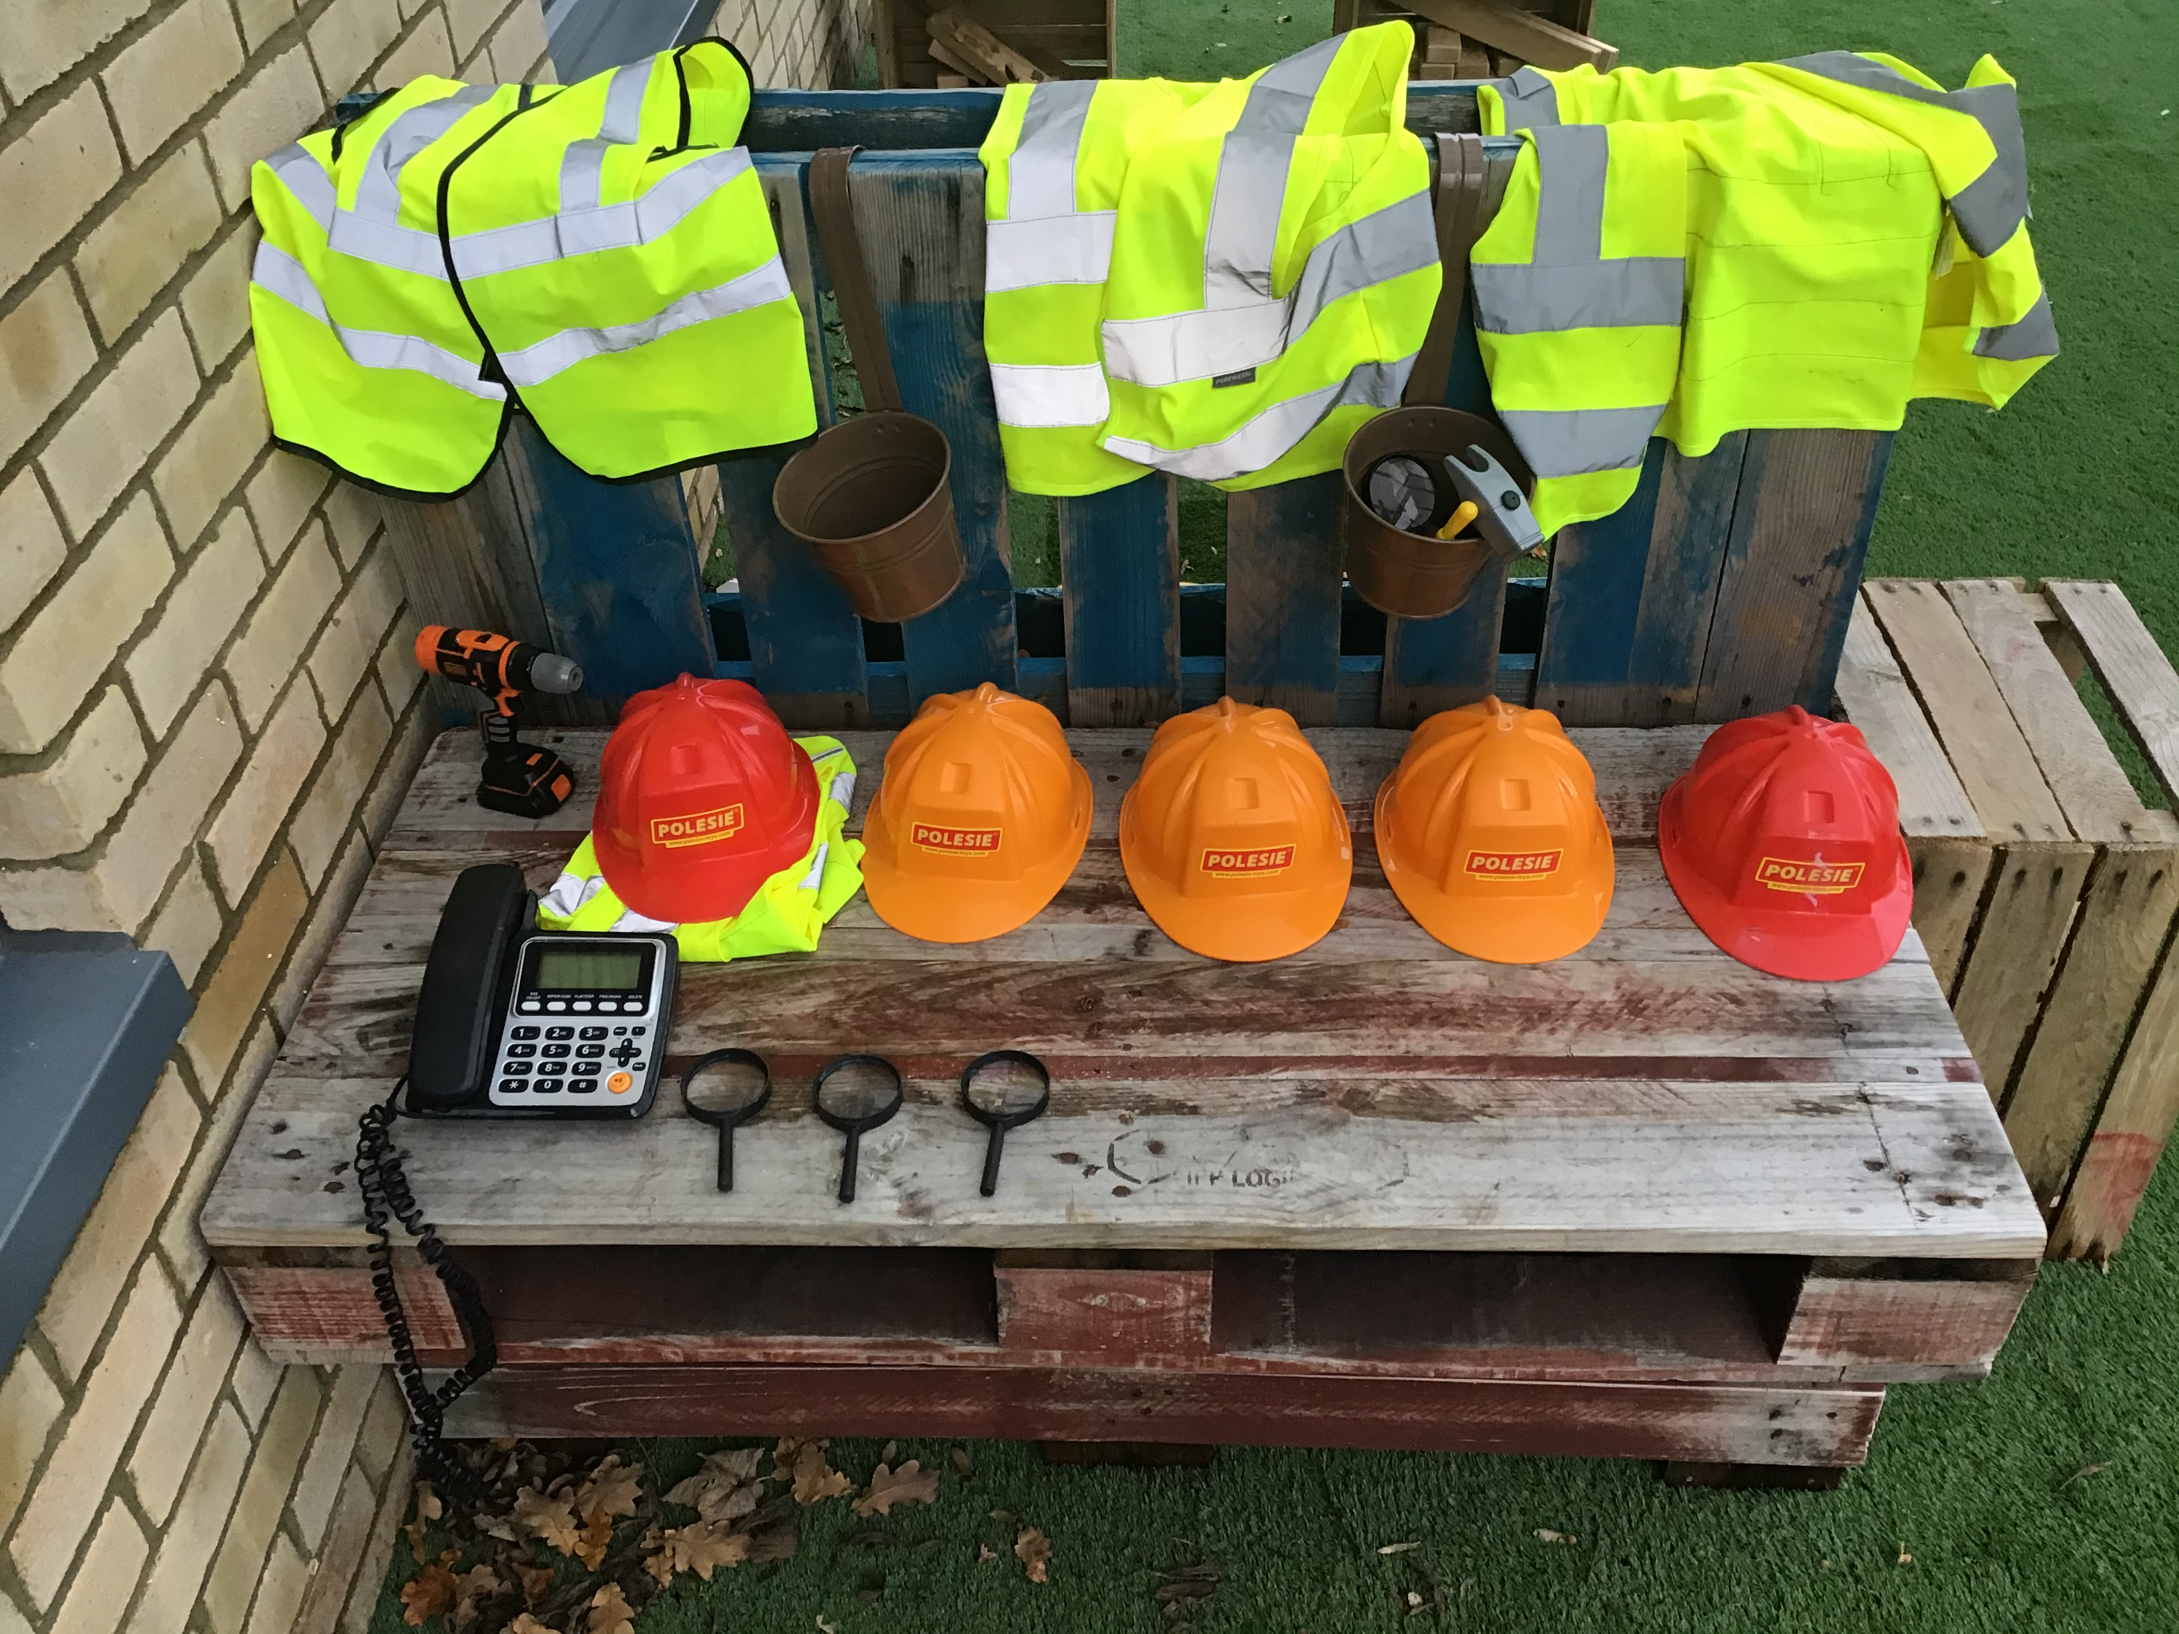
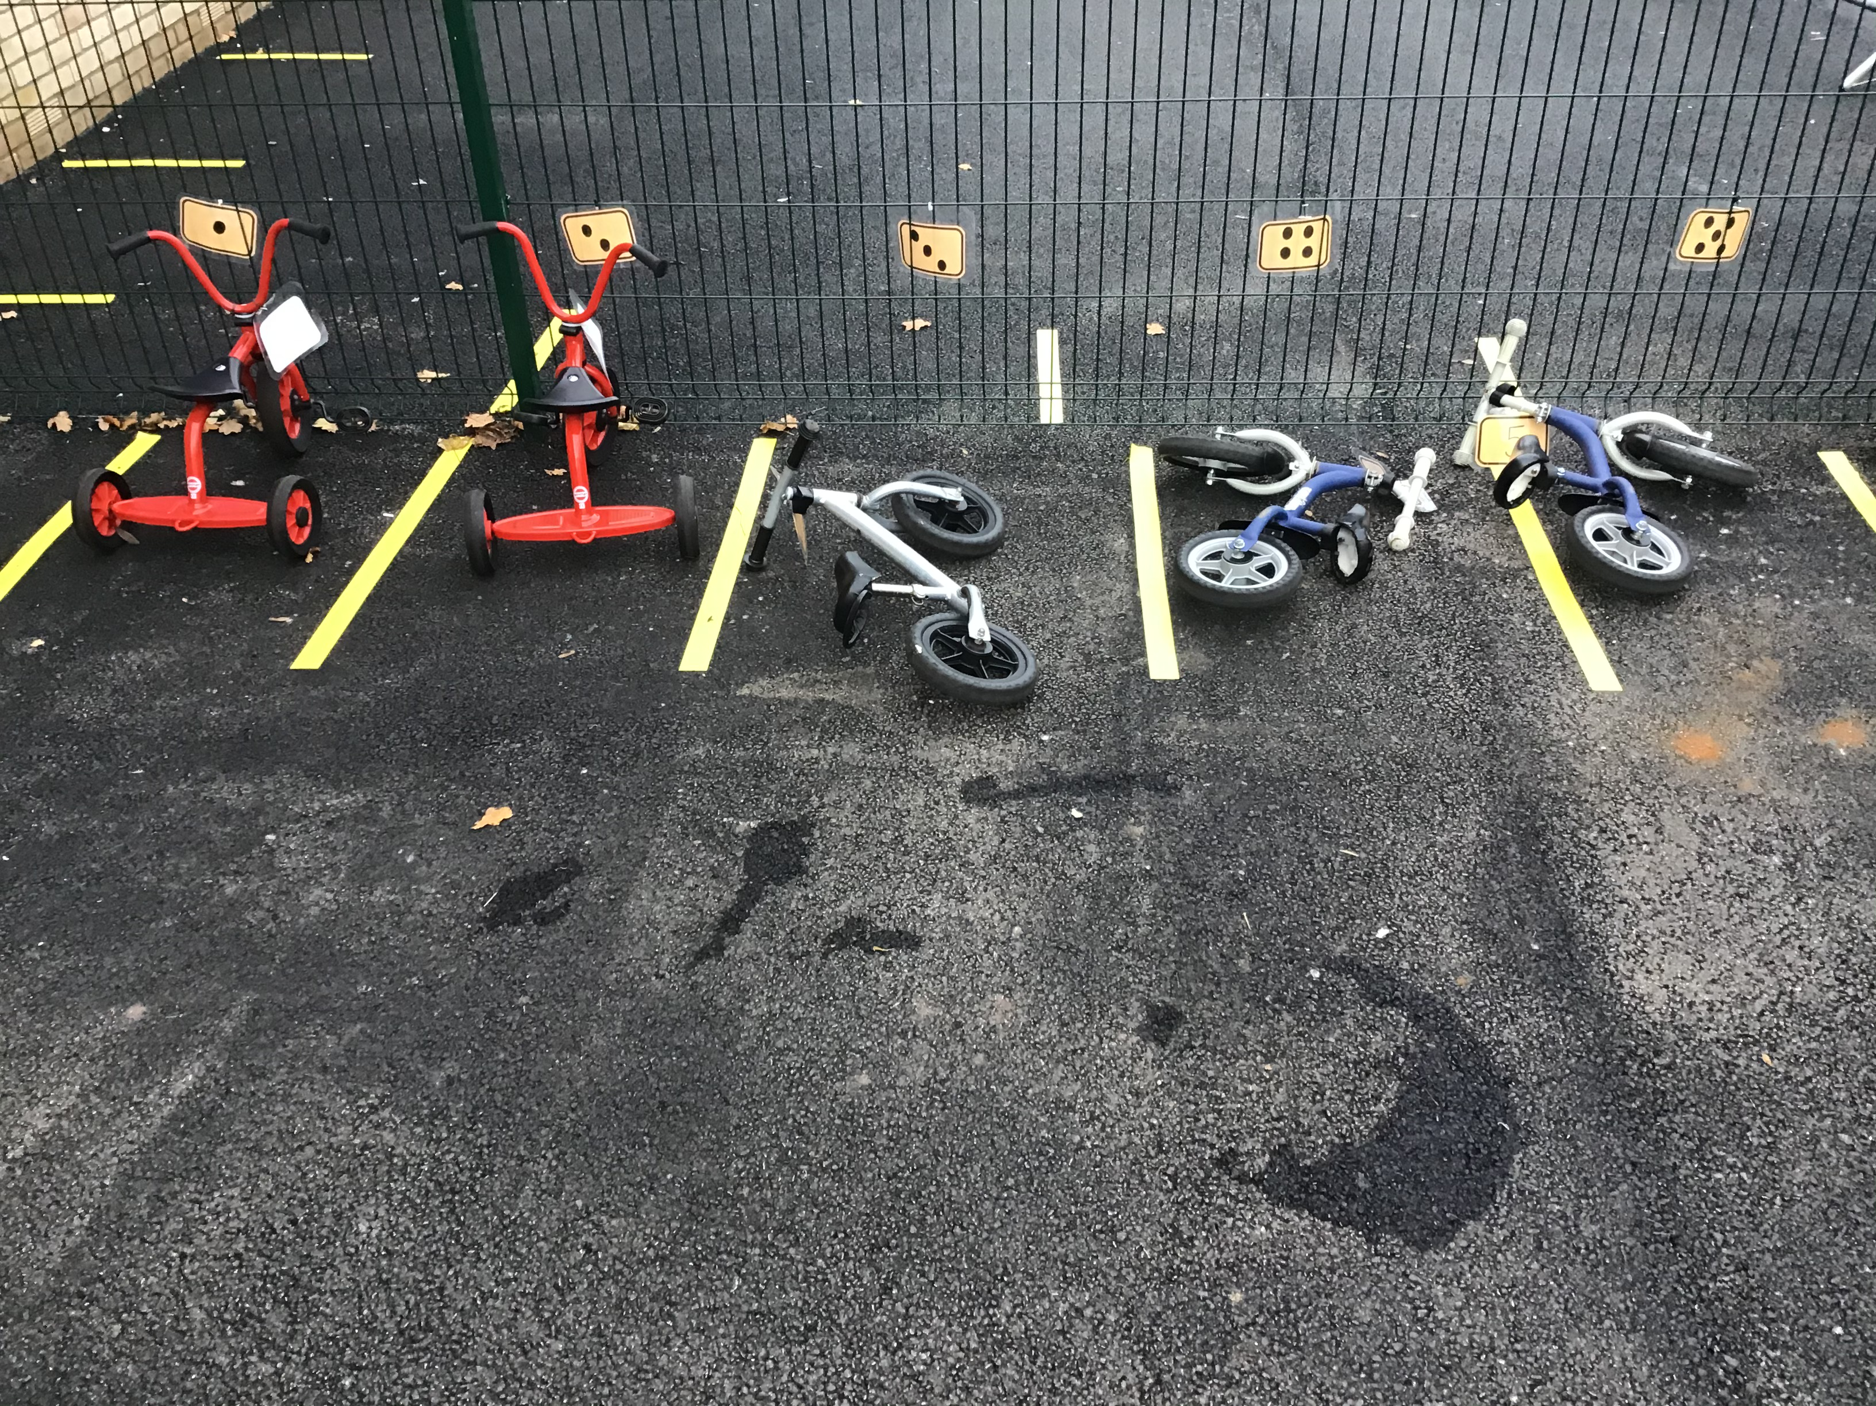
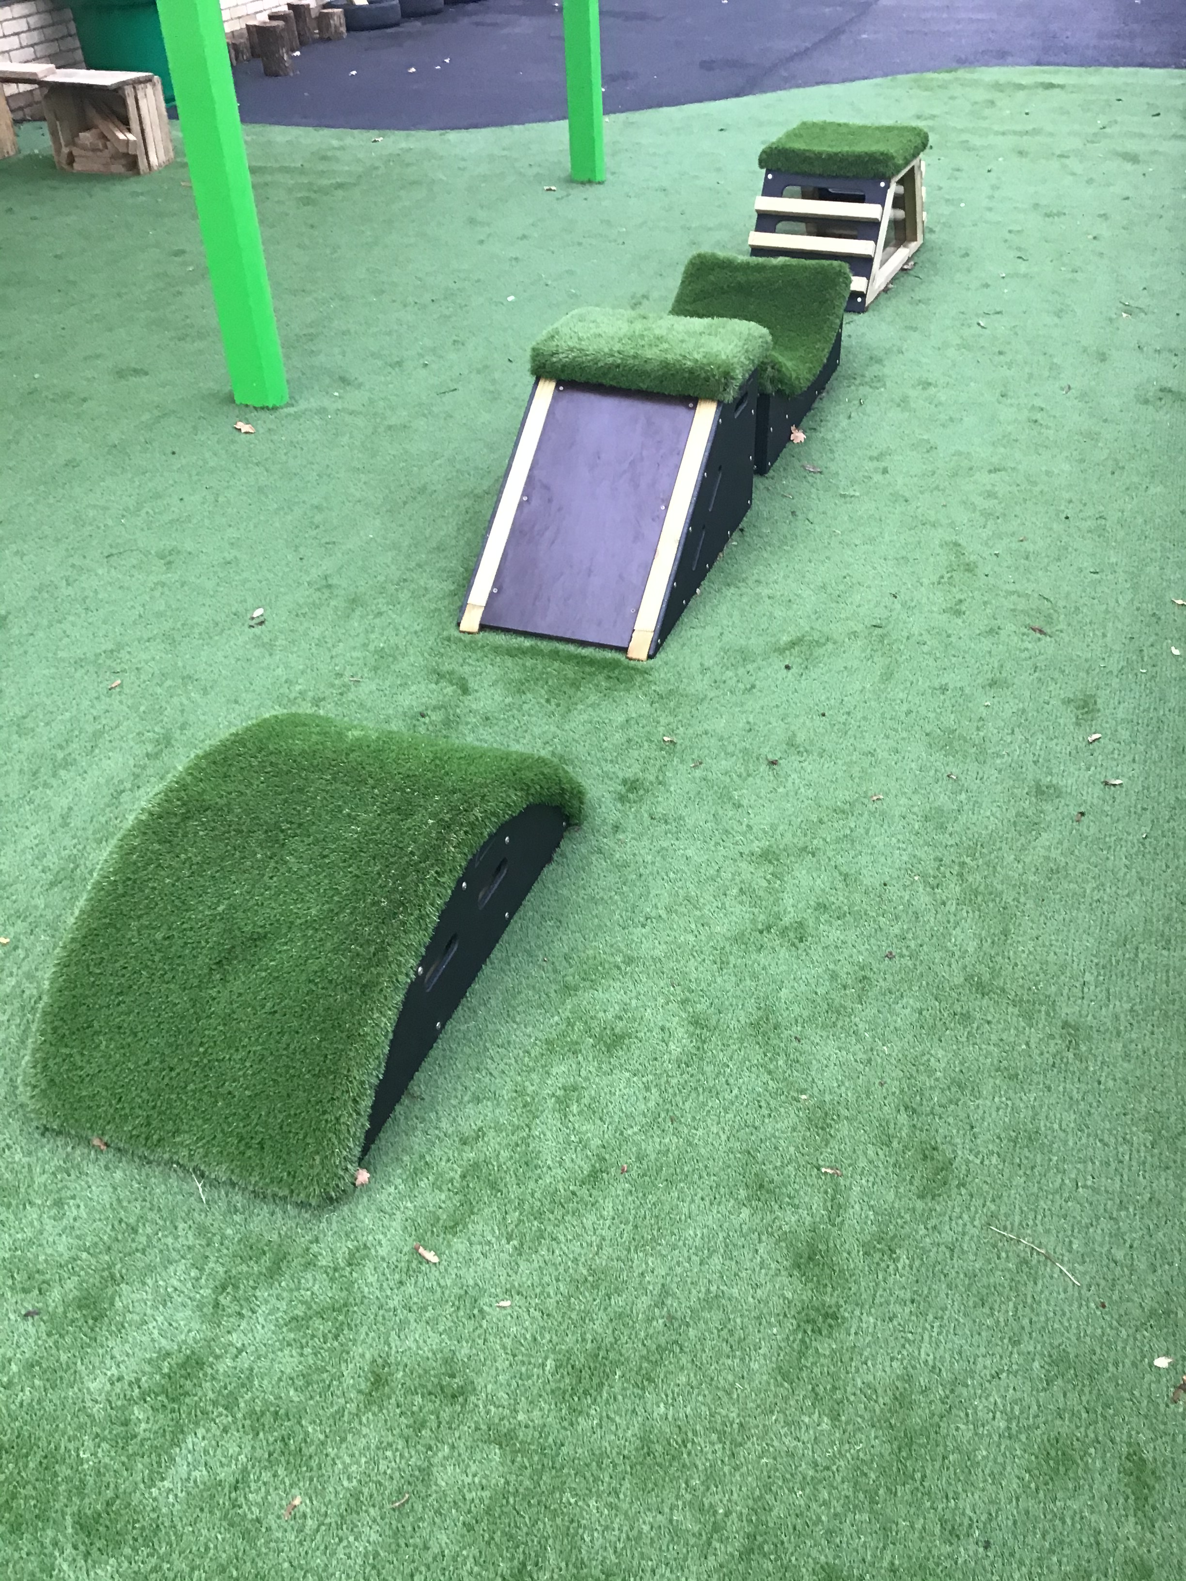
Our outdoor environment

Slide 5
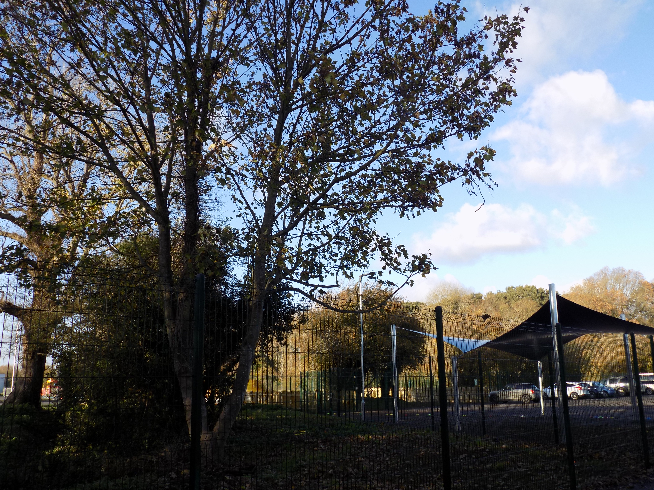
Our sessions 8.30-11.30am (15 hours) 12.15-3.15pm (15 hours) 8.30am-3.15pm (30 hours, limited spaces)- this includes lunch time which costs £4.00. Children may bring a packed lunch or order and pay for a hot dinner at £2.30. Hours can be a mixture of full days and half days depending on capacity. There is a £15.00 charge per year to cover a fruit snack. This can be paid bi termly at £5.00 We do accept child care vouchers

Slide 6
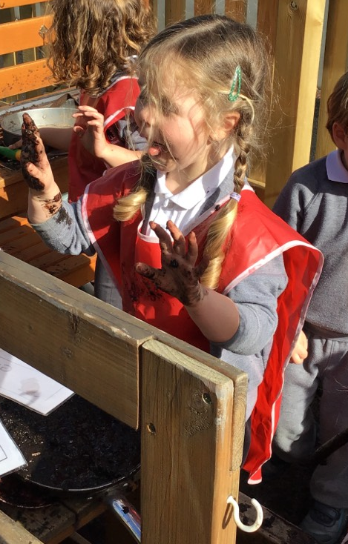
What is the Early Years Foundation Stage?
The Early Years Foundation Stage (EYFS) is the stage of education for children from birth to the end of the Reception year.
Children in the EYFS learn by playing and exploring, being active, and through creative and critical thinking which takes place both indoors and outside.
We will ensure your child's early years experiences are happy, active, exciting, fun and secure.
Adults will support your child to learn with enjoyment and challenge through their play.

Slide 7
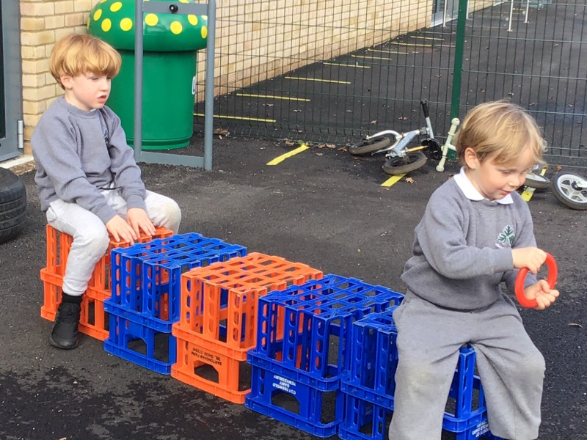
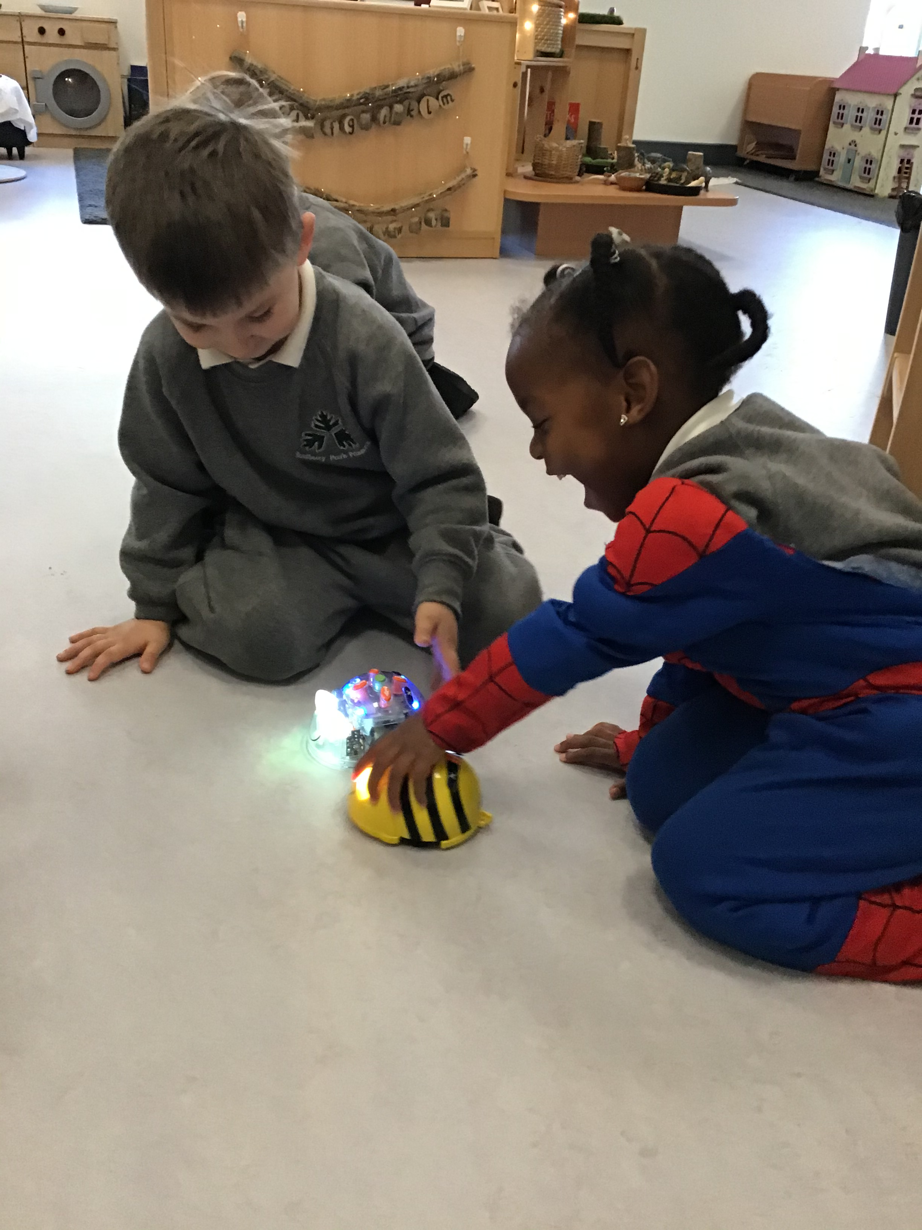
Characteristics of Effective Learning
Playing and Exploring
Active Learning
Creating and Thinking Critically
Prime areas
Personal, Social and Emotional Development
Communication and Language
Physical Development
Specific areas
Literacy
Mathematics
Understanding the World
Expressive Arts and Design
The three prime areas are the most essential for your child’s healthy development and future learning. These prime areas are what your child should develop first and foremost.

Slide 8
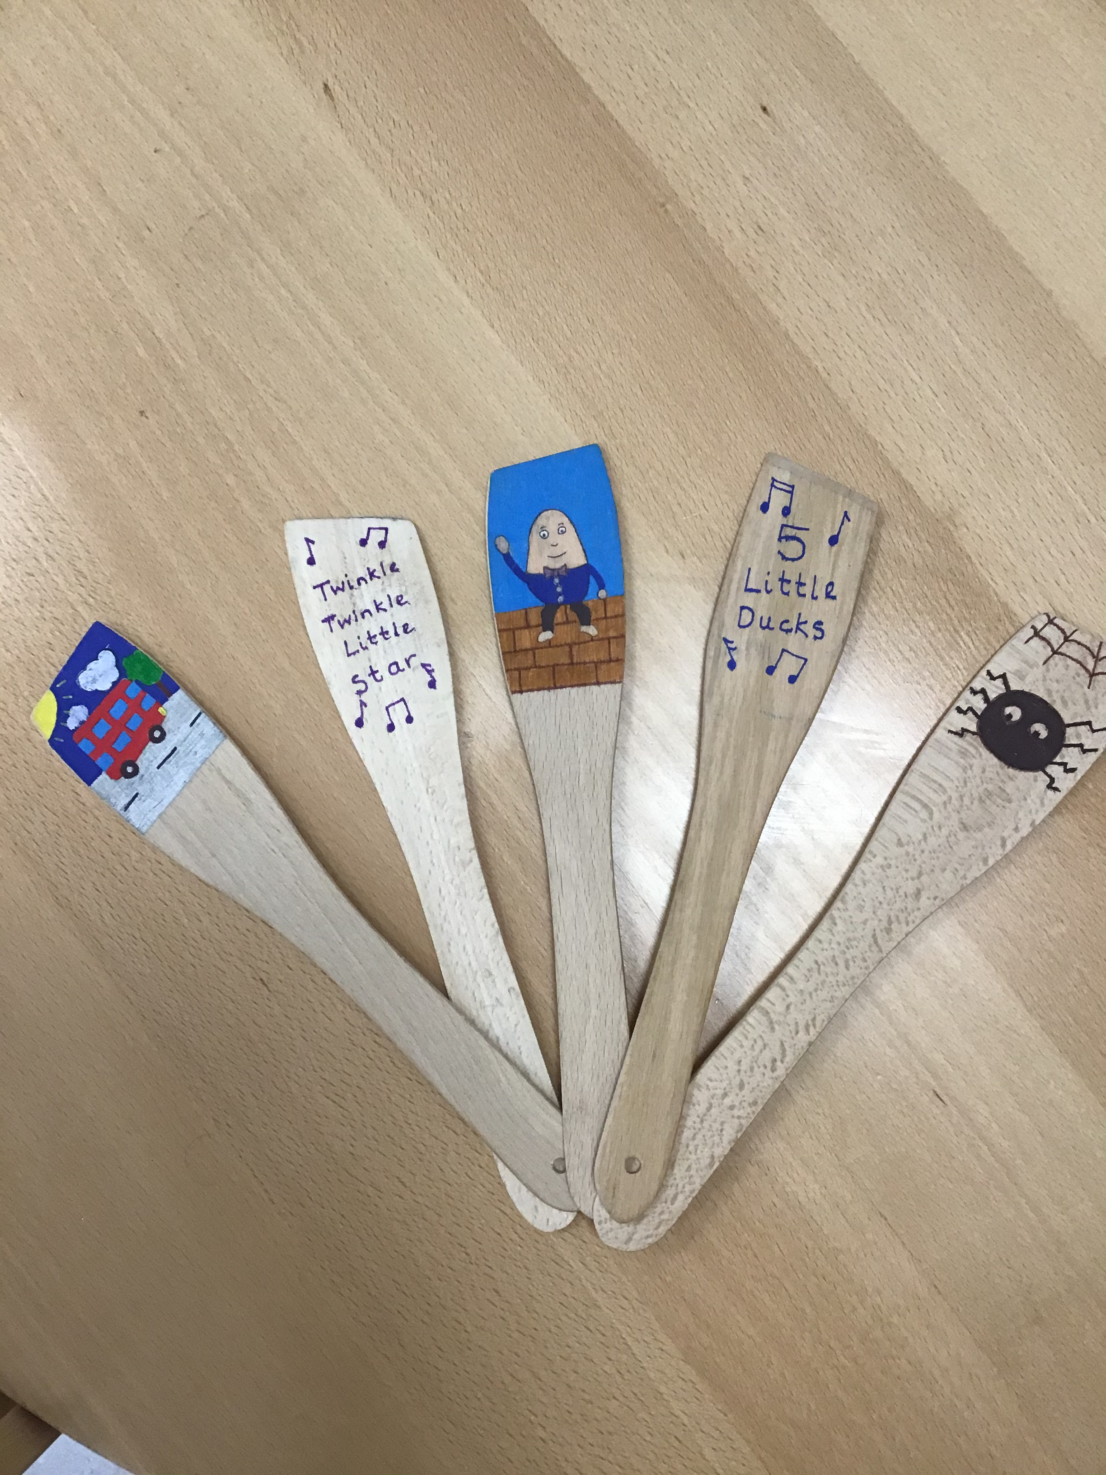
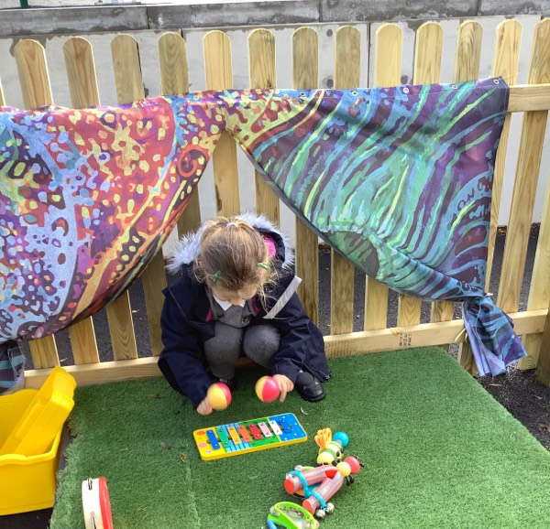
What does phonics look like in Nursery?
Early phonics teaching in Nursery focuses on developing children’s listening, vocabulary and speaking skills.
Typical activities for teaching Phase 1 phonics include 'listening' walks, playing and identifying instruments, action songs, learning rhymes and playing games like I-Spy.
In Phase 1 phonics, children are taught about:
Environmental sounds e.g. car/train/animal sounds
Instrumental sounds
Body percussion e.g. clapping and stamping
Rhythm and rhyme
Alliteration
Voice sounds
Oral blending and segmenting e.g. hearing that d-o-g makes ‘dog’

Slide 9
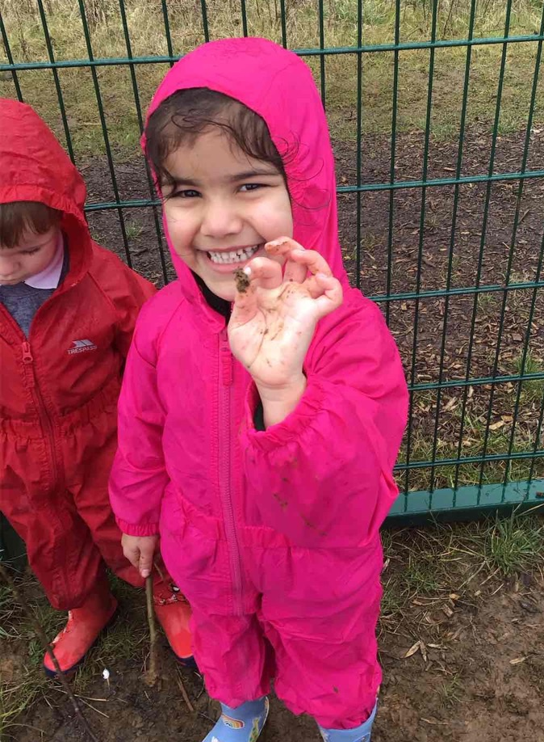
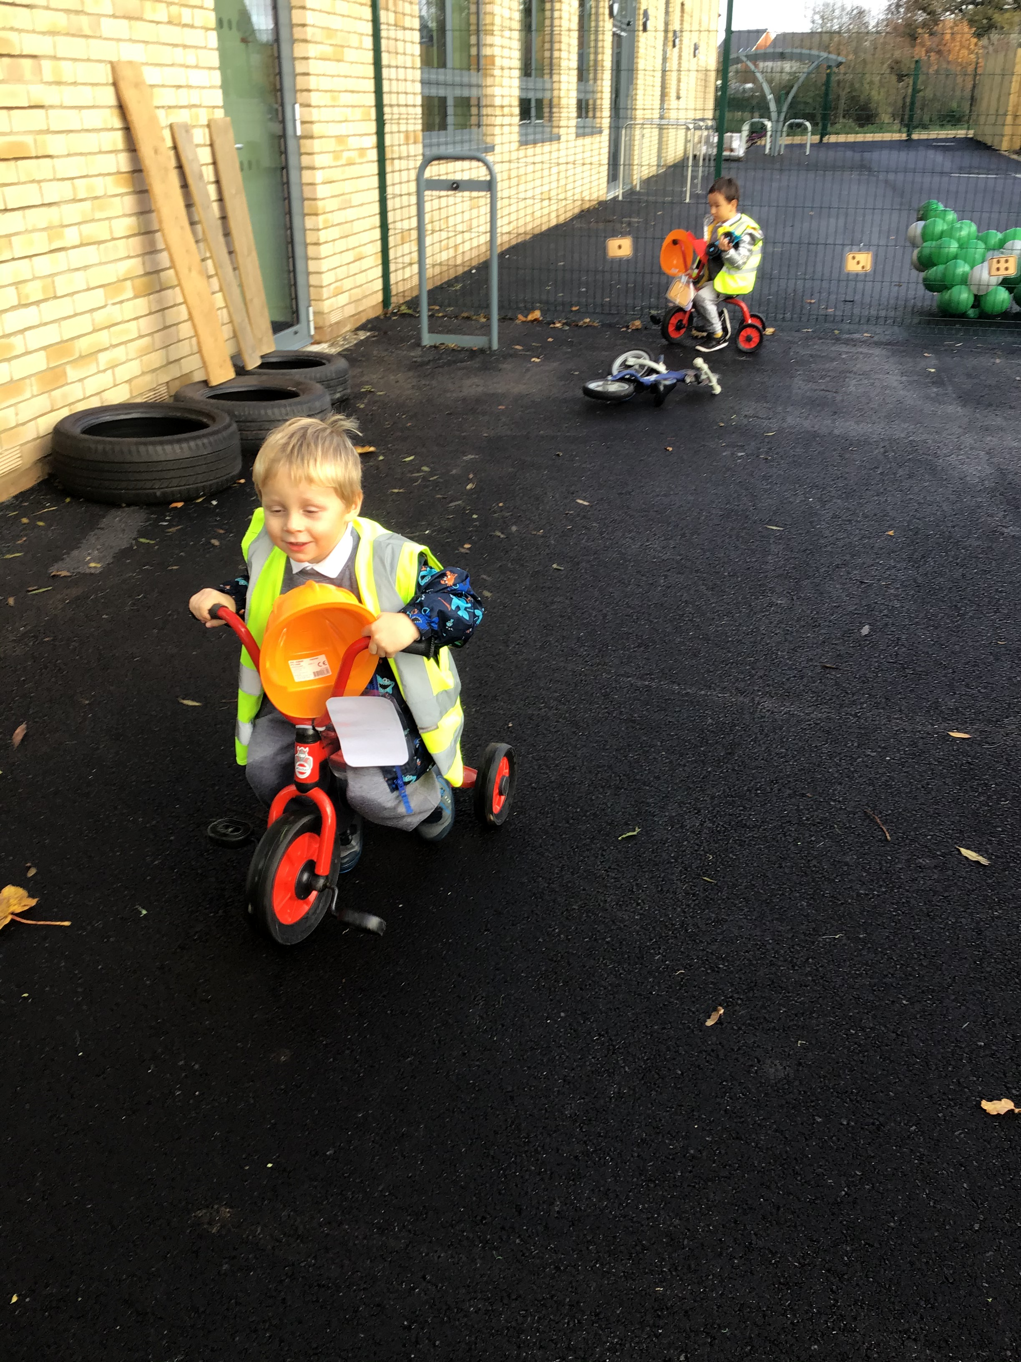
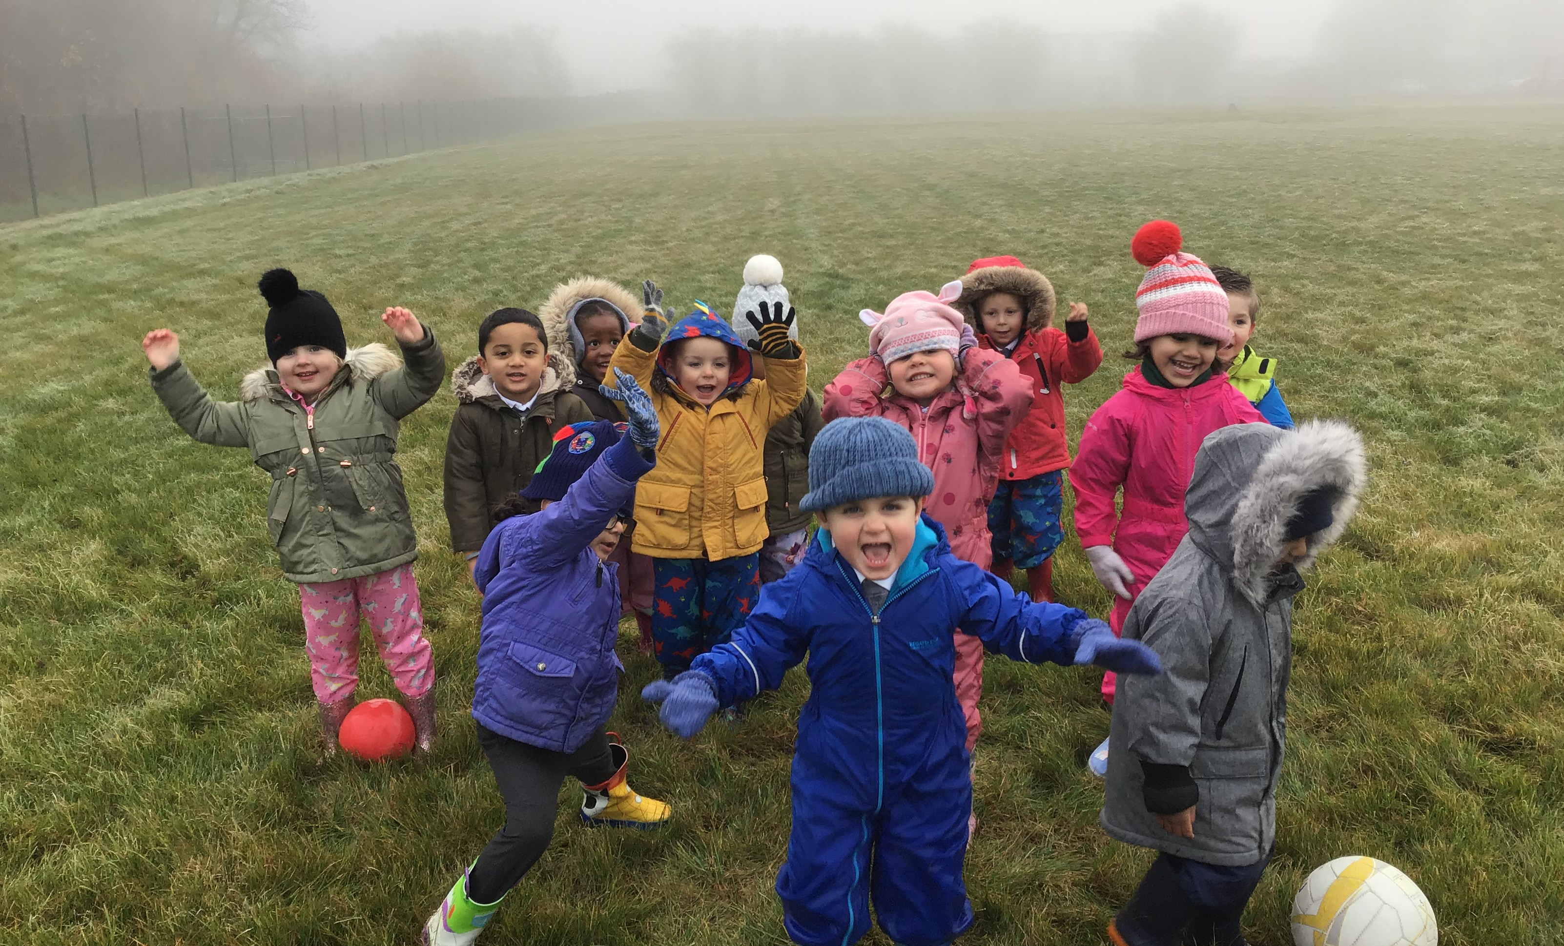
Outdoor Learning
The outdoors is an extension to our indoor classroom and we will use our outdoor area every day… whatever the weather!
We use our school forest area and field for Welly Walks
Learning outdoors allows children to develop skills in different ways:
They will learn how to take risks and problem solve
They will develop their social skills and friendships
They will develop a love of nature and learn how to take care of the world around them
They will build their self-confidence and self-esteem and build a sense of awe and wonder

Slide 10
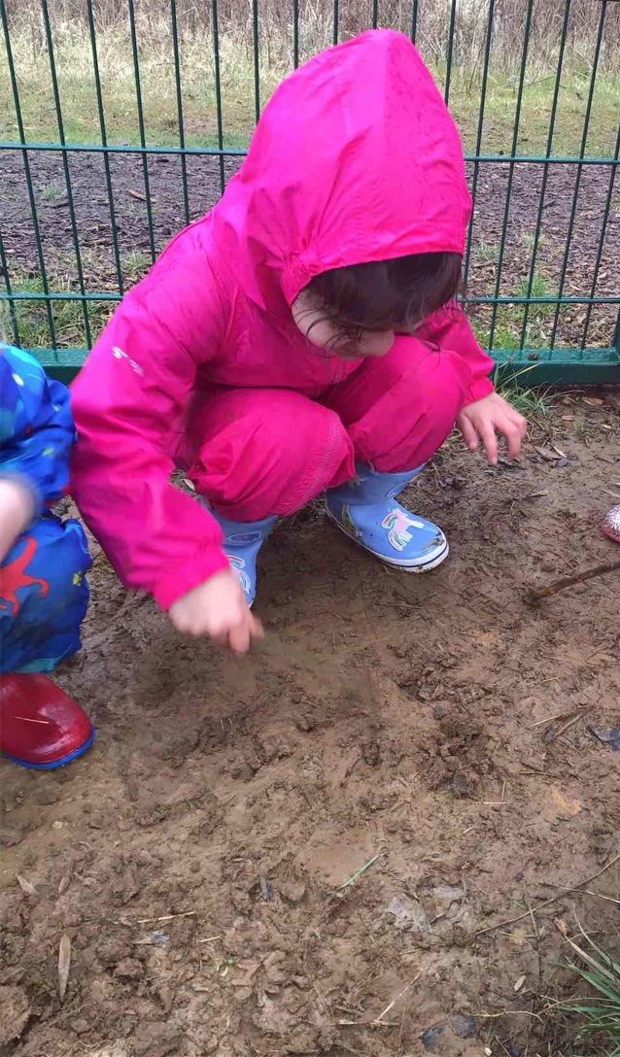
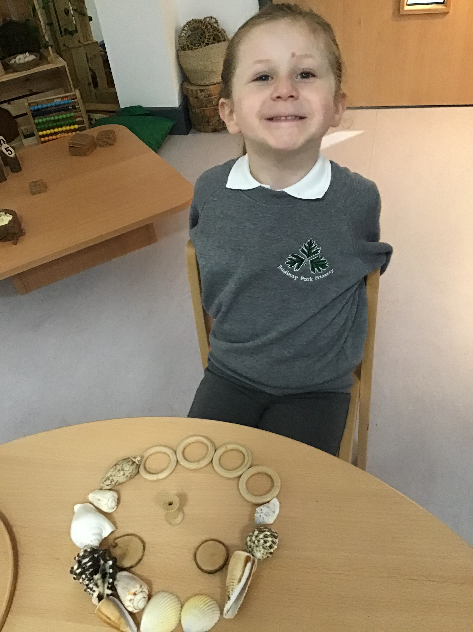
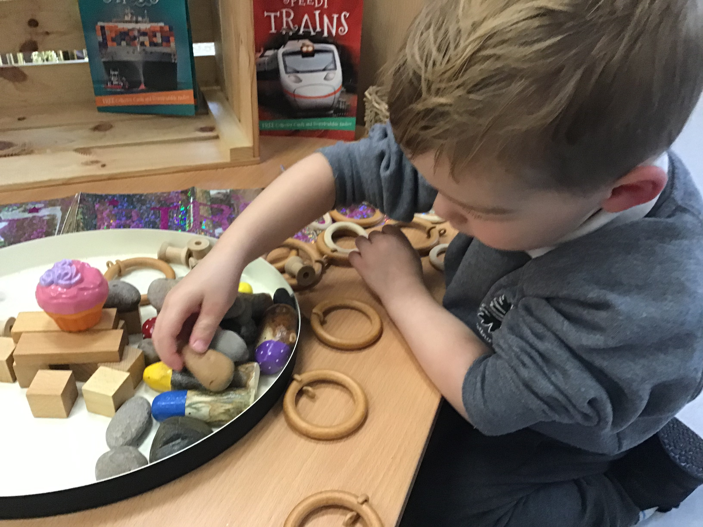
Our approach to learning
Being part of Apple Tree class means that your children will have fun and learn many new skills each day. We will provide a learning environment which will feel homely, safe and secure and will be filled with exciting resources to spark curiosity and imagination.
In the Early Years, we learn through play, following children’s interests whilst challenging them along the way. We learn through real life experiences whilst taking risks and solving problems.
To be part of Apple Tree class will mean that your child will be a happy, curious and inquisitive learner, filled with questions to answer and new things to find out.

Slide 11
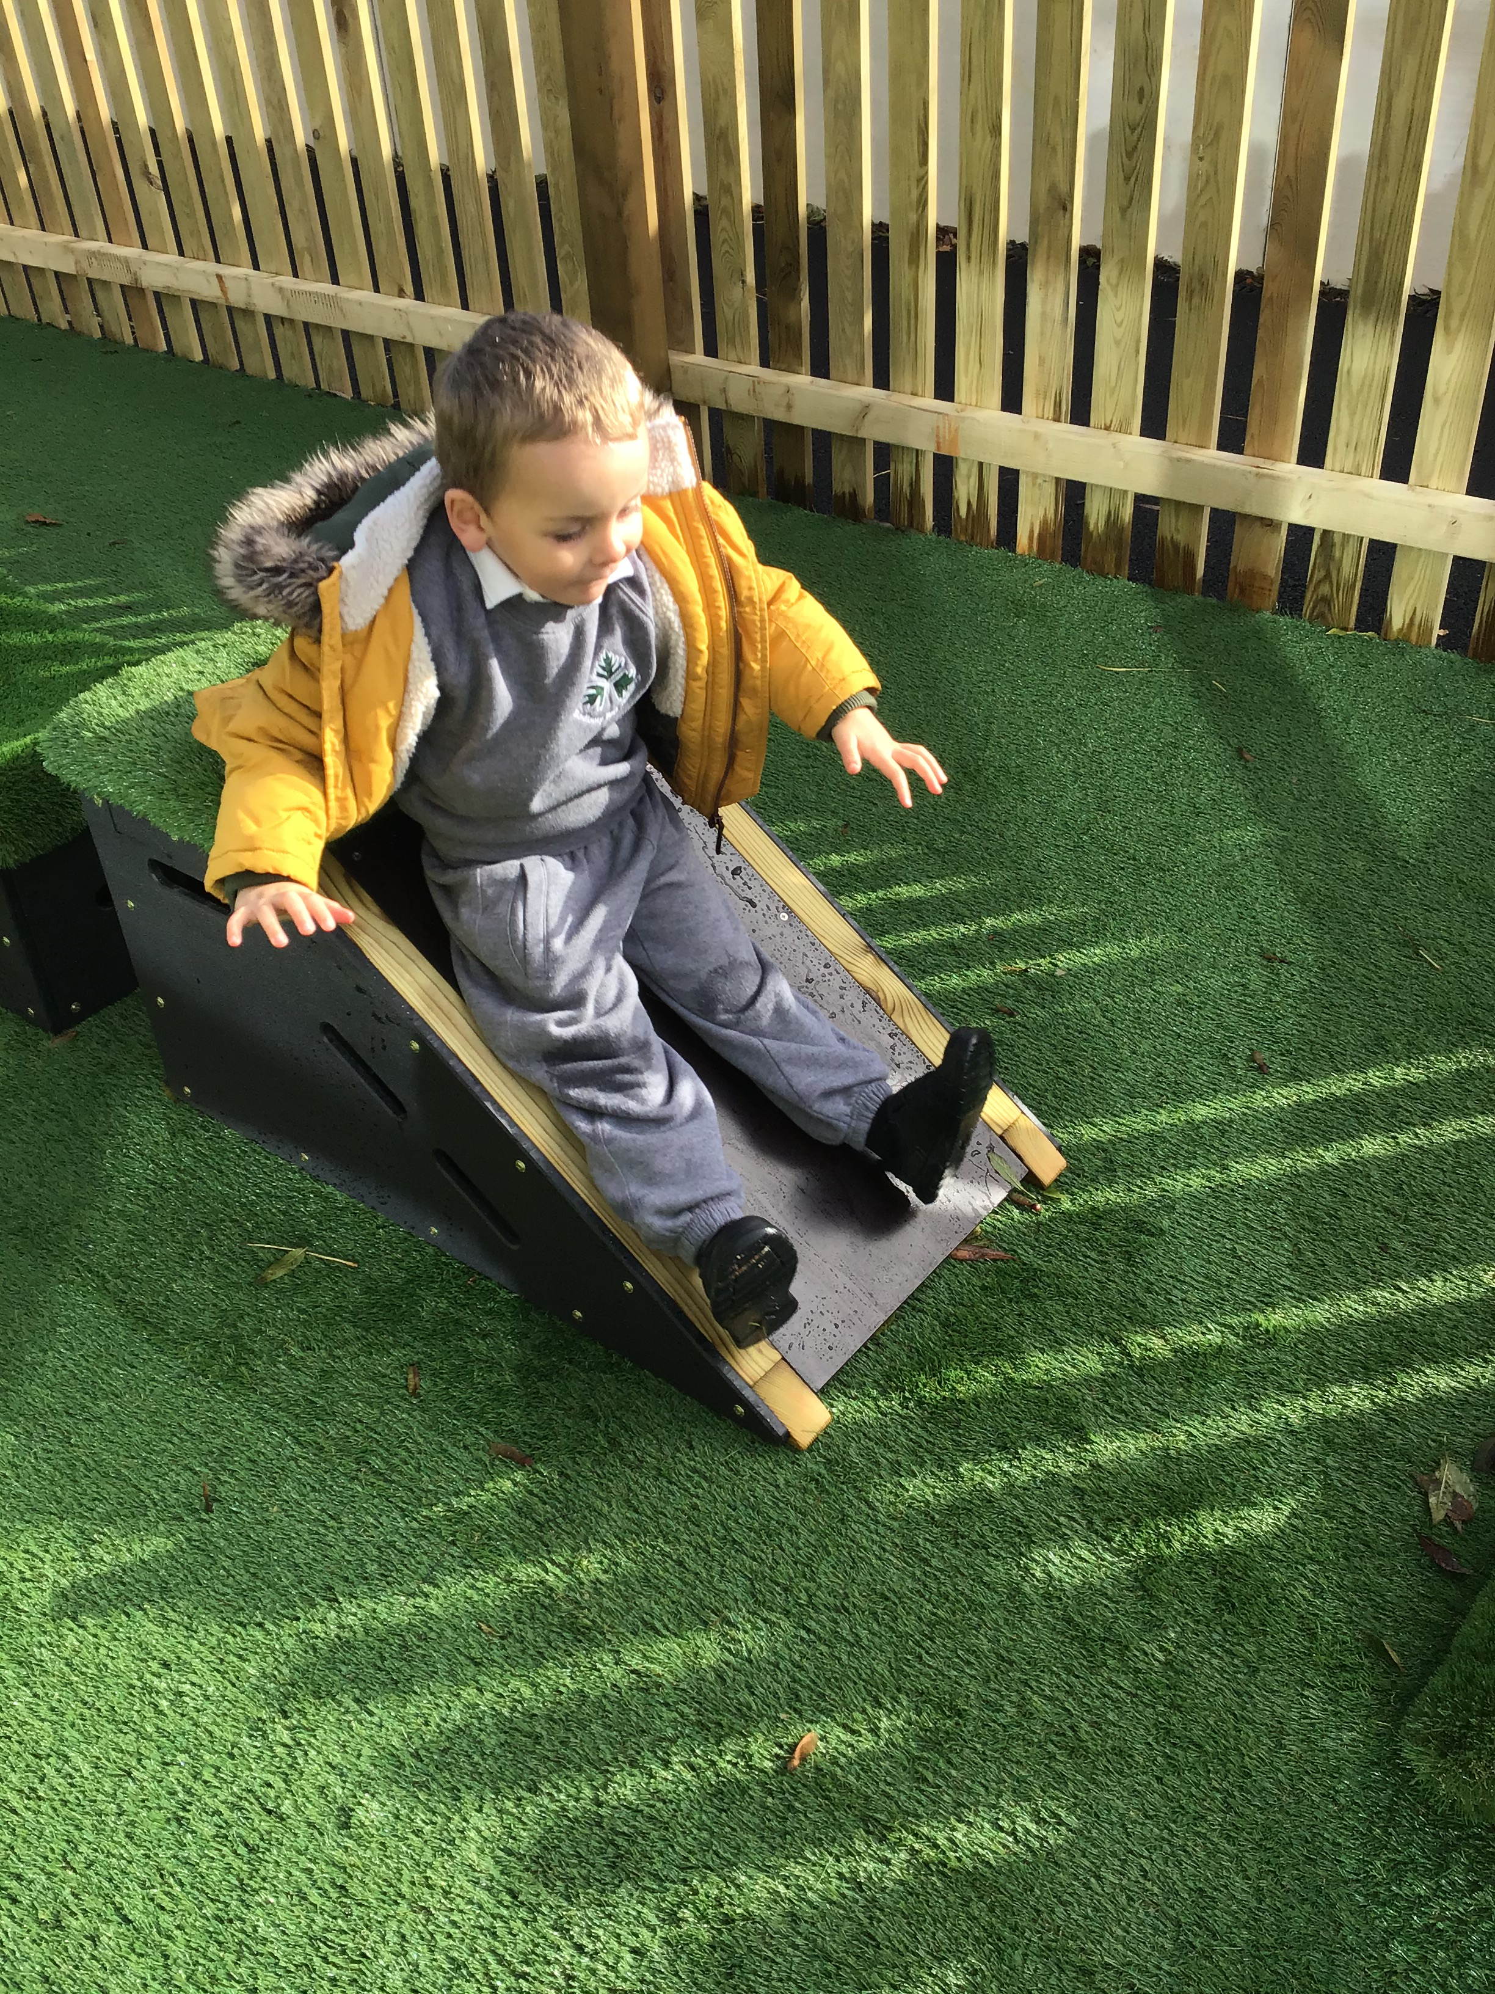
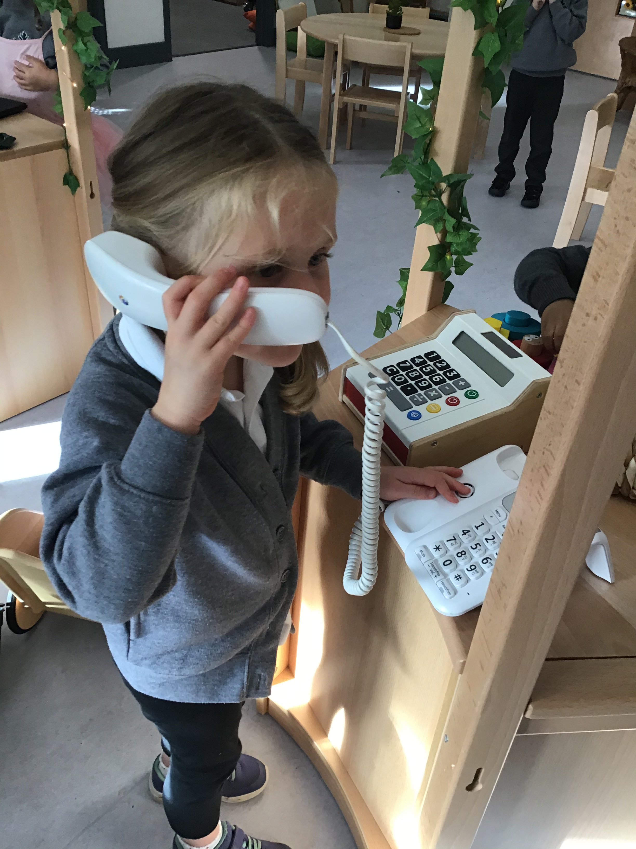
Induction process
Visit to Nursery class either Monday 19th July or Tuesday 20th July 4pm till 5pm
Parents only invited into outdoor area to meet staff and each other
These sessions will allow your child to familiarise themselves with the setting and to meet the adults. It will also give you the opportunity to ask questions, explain any strengths or concerns and talk to our Nursery Class Teacher, on an individual basis.
Home visits Monday 6th and Tuesday 7th September
Transition visits Wednesday 9th- Friday 10th for an hour in the afternoon. Nursery starts for full sessions Monday 13th September unless a longer transition is needed.
There are lots of pictures on our website and social media to share with your child to familiarise them with the setting and adults before they start.

Slide 12
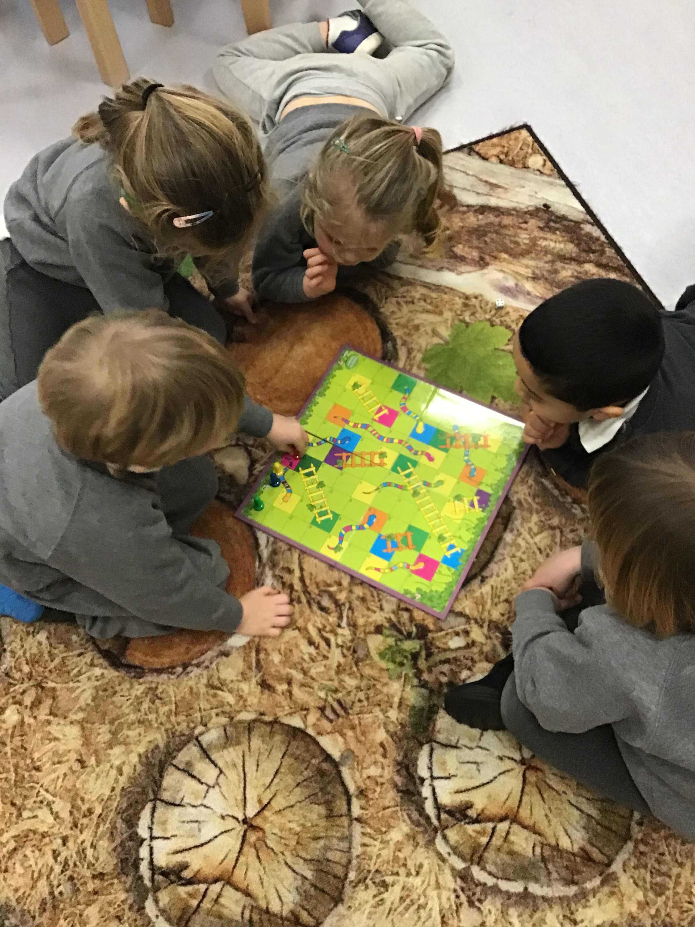
How can you help your child prepare for Nursery?
Play and talk with them! Talk about going to Nursery, what are they excited for? Are they nervous about anything?
Sing songs and nursery rhymes together
Play games which encourage turn taking and sharing
Talk about feelings and how things make others feel
Read lots of stories together and talk about what has happened in the story

Slide 13
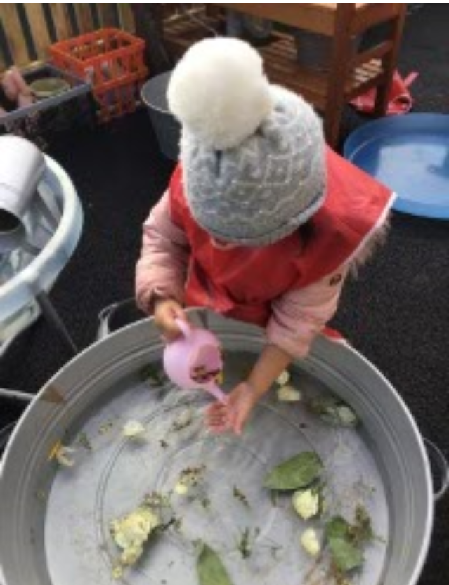
Support your child in recognising their name. If they show an interest in mark making, make sure they see their name written correctly e.g. capital letter at the start and the rest of the letters lower case
Use letter sounds rather than letter names
Develop your child’s independence skills e.g. getting dressed by themselves and taking responsibility for their belongings, starting to use the toilet if they are ready
Fine motor skills – play dough, cutting, threading etc
Physical activities – running, climbing, jumping, ball games

Slide 14
What will your child need?
Spare clothes including underwear and socks (please ensure these are labelled)
Wellies and waterproofs – essential for Welly Walks!
Uniform – Grey jumper and tracksuit bottoms, white polo shirt. School dress or shorts in summer. All information for uniform is on our website
Water bottle
Your child is likely to get messy during their day… Please don’t worry! This is a sign of a brilliant day!
Please label everything!!

Slide 15
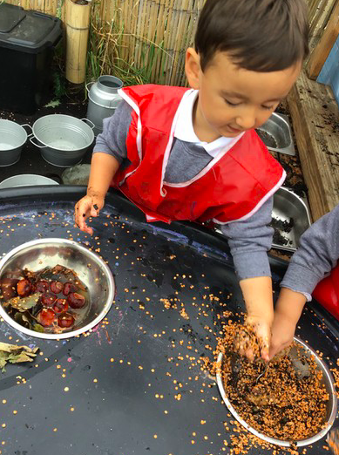
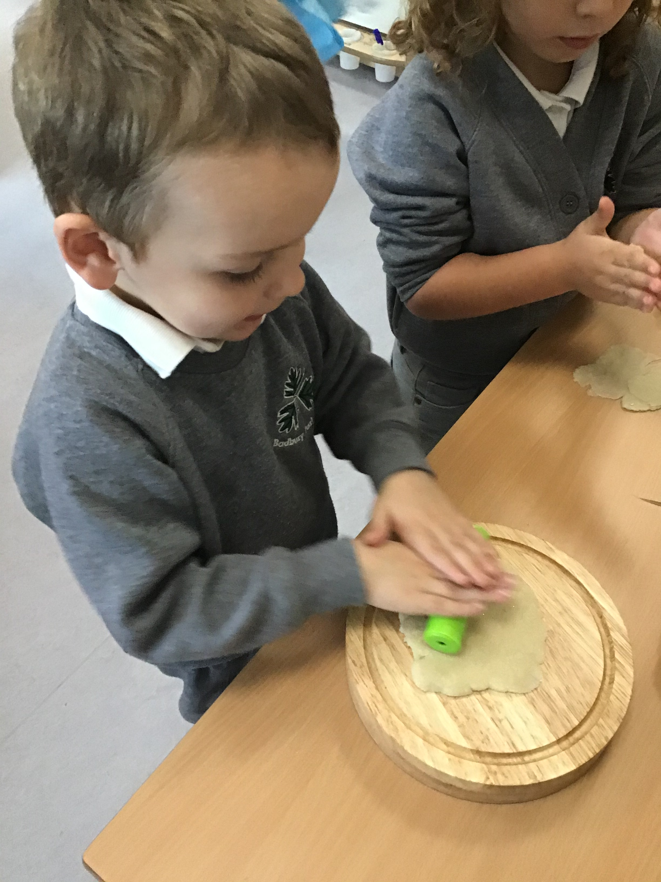
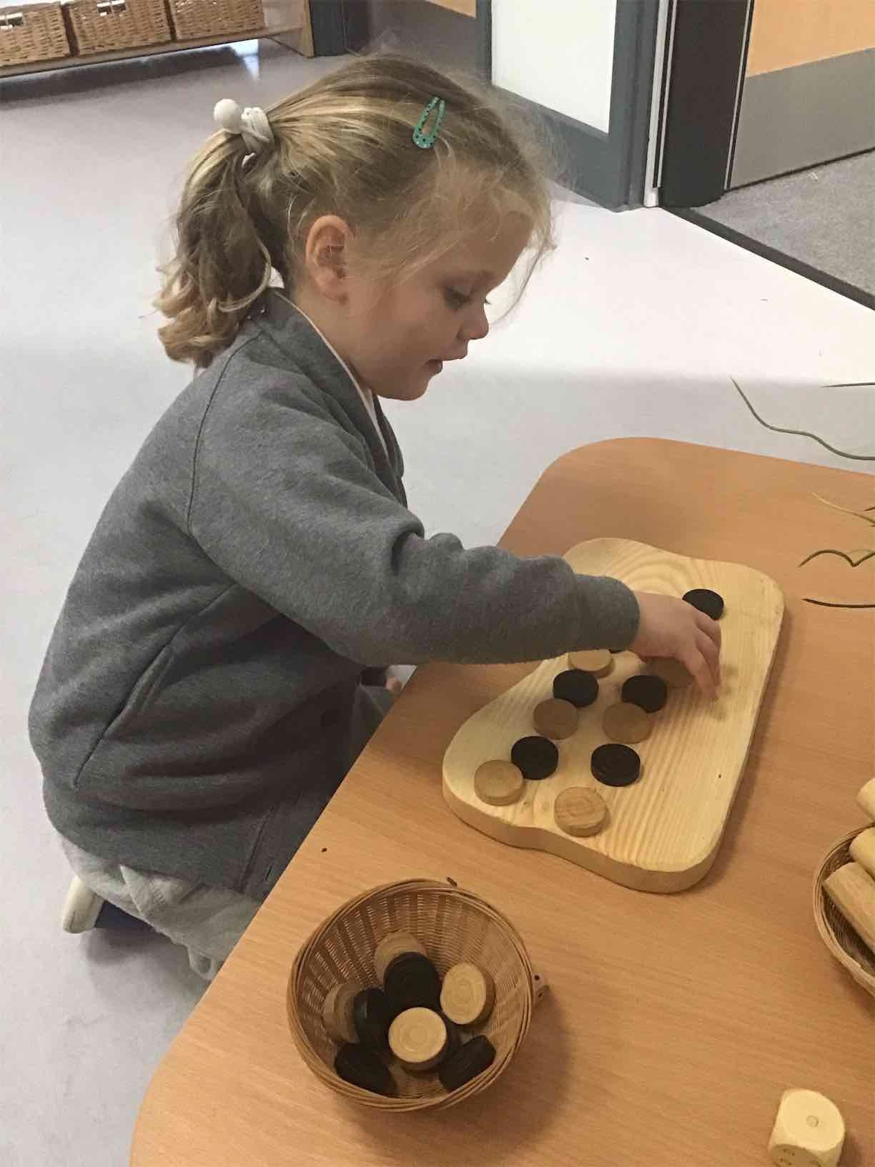
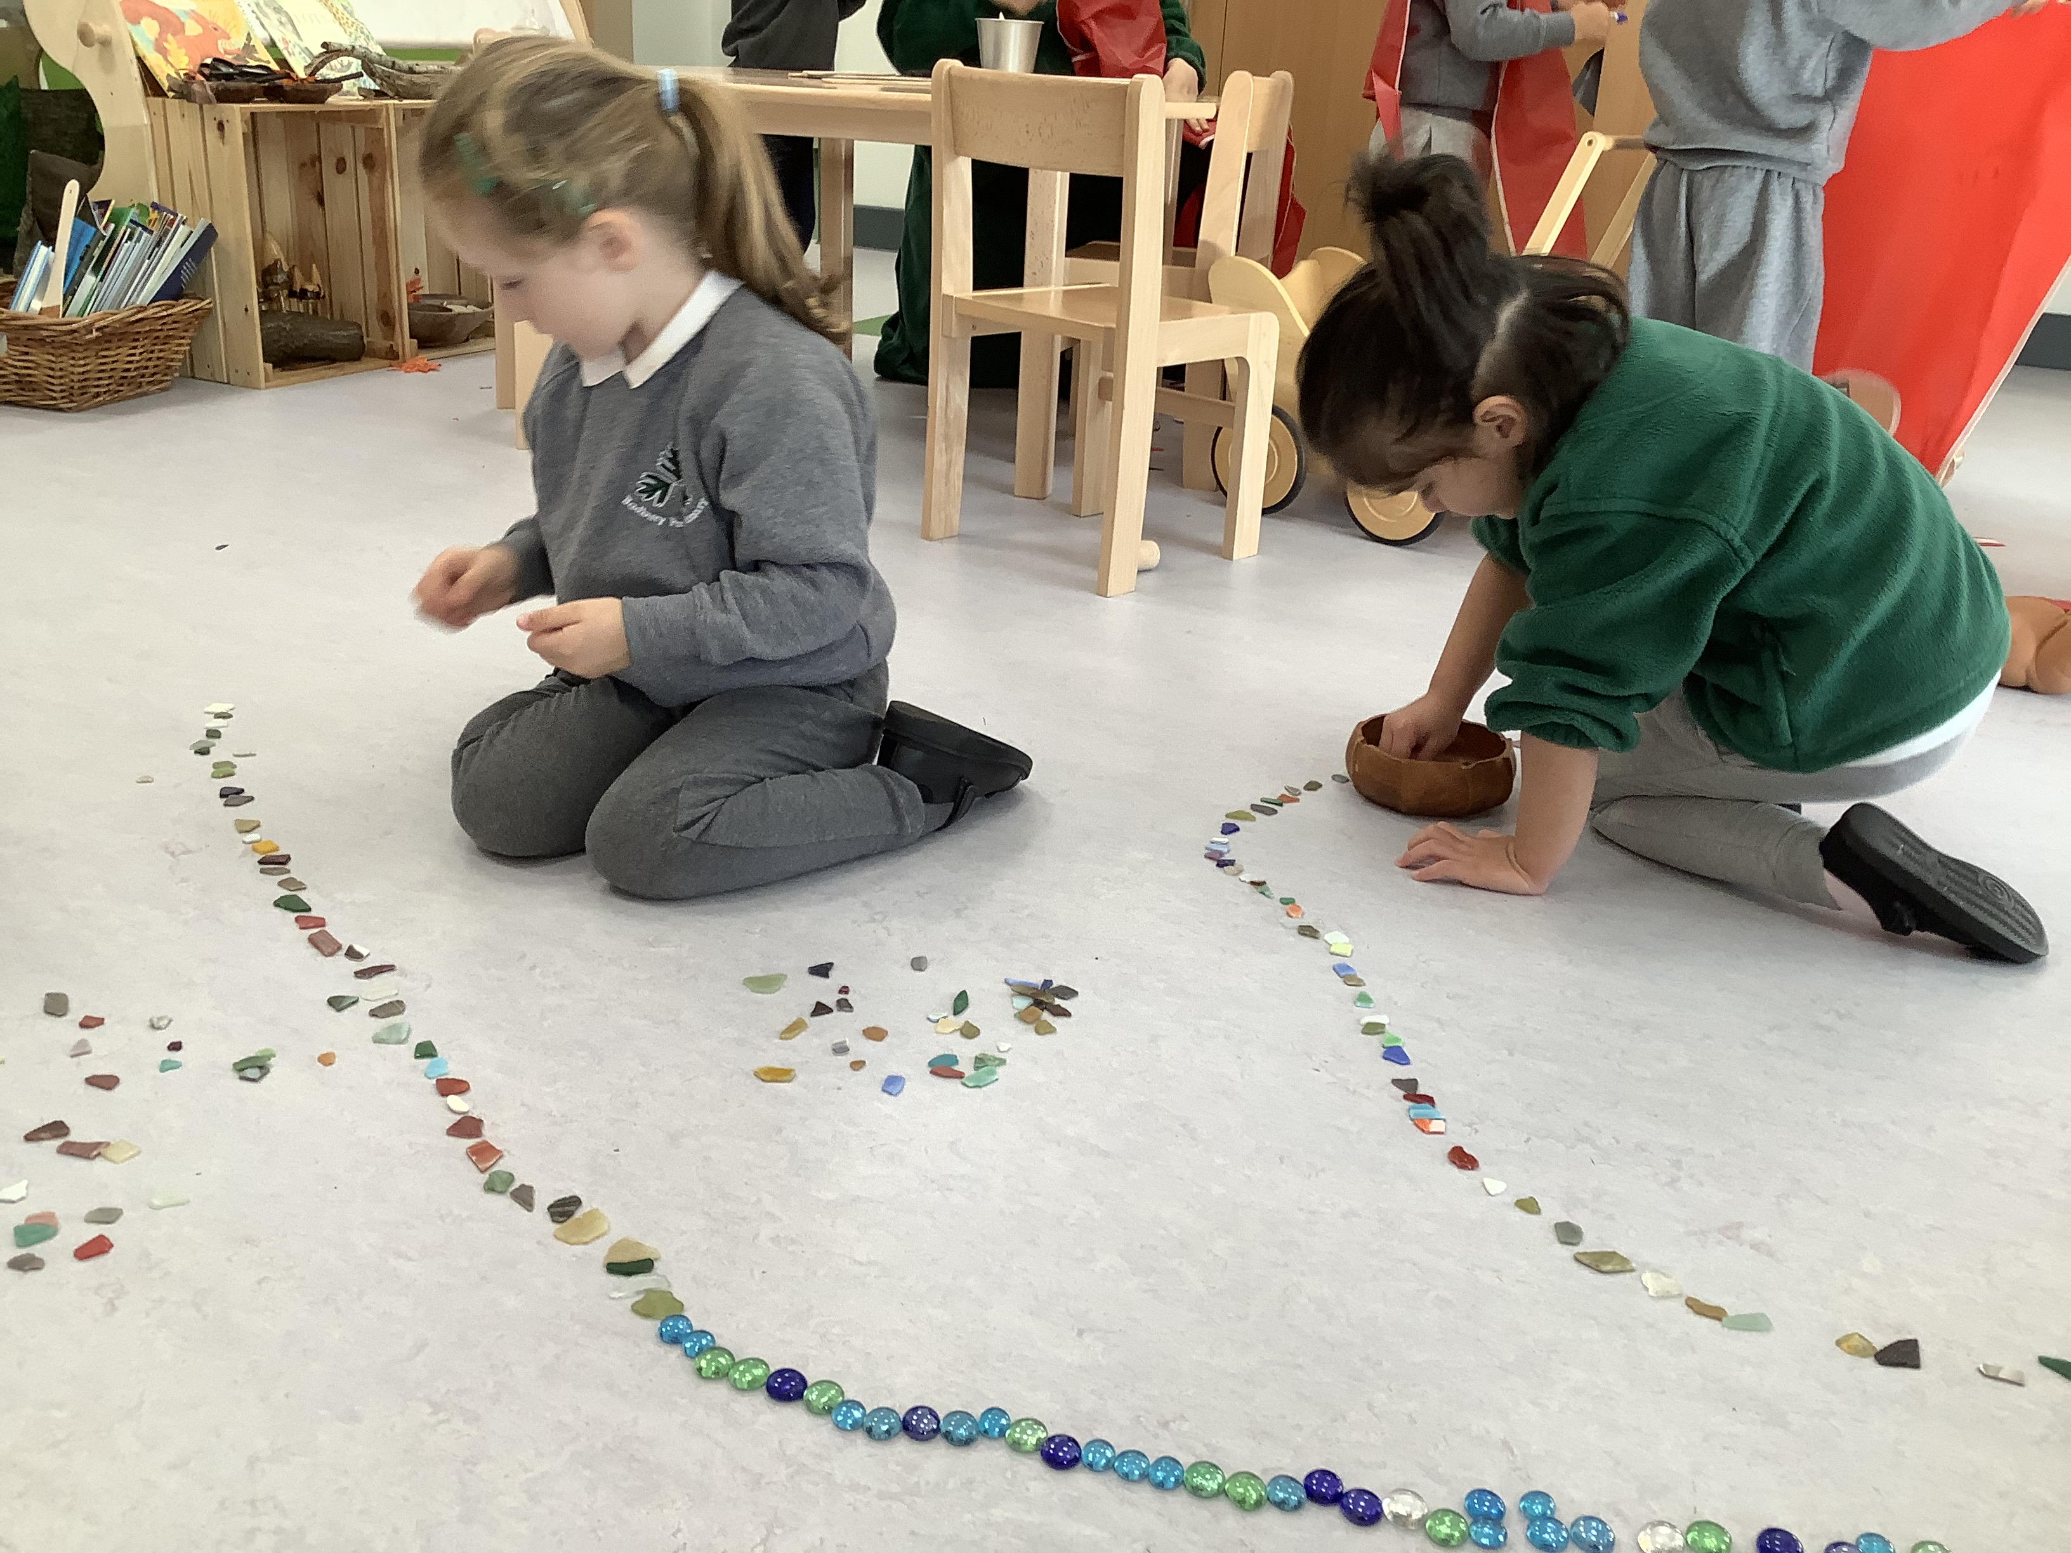
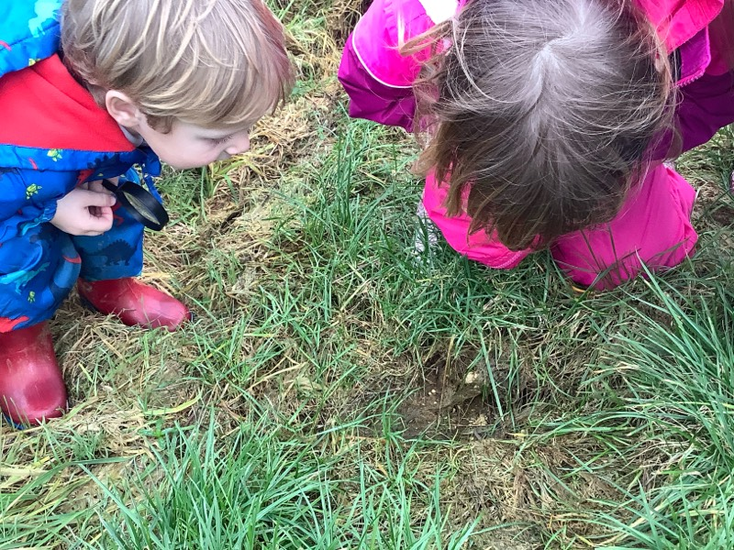
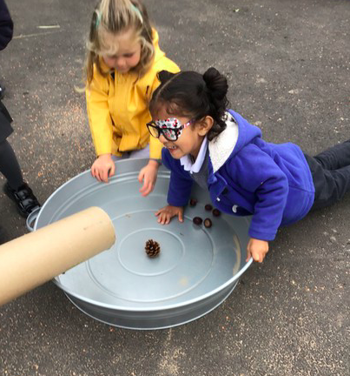
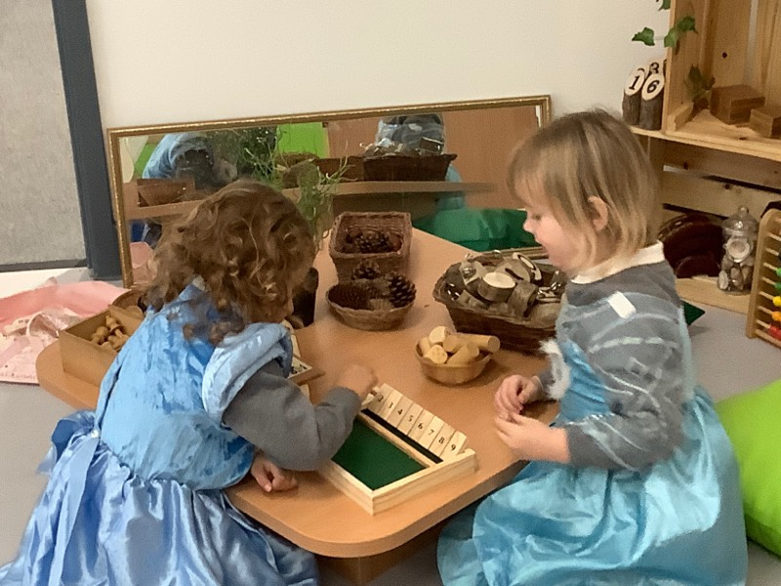
It looks like we are ‘just playing’ but we are…
Learning to count
Learning to make friends
Investigating
Learning to hold a pencil
Problem solving
Learning to share
Exploring

Slide 16
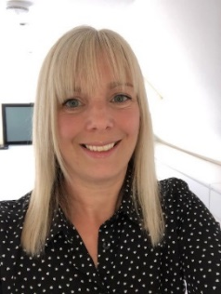
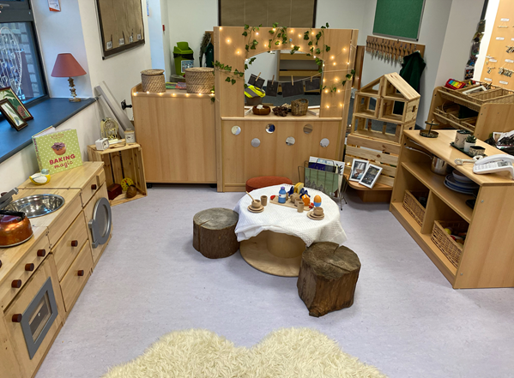
SEND or Additional Needs
If you are worried about any area of your child’s development, please organise a telephone call with our SENDco Mrs Alyson Mazzotta.
This enables us to meet your child’s needs as best as possible and arrange a careful transition

Slide 17
Any Questions?

