Slide 1
Welcome
EYFS/Year 1
Badbury Park Primary School

Slide 2
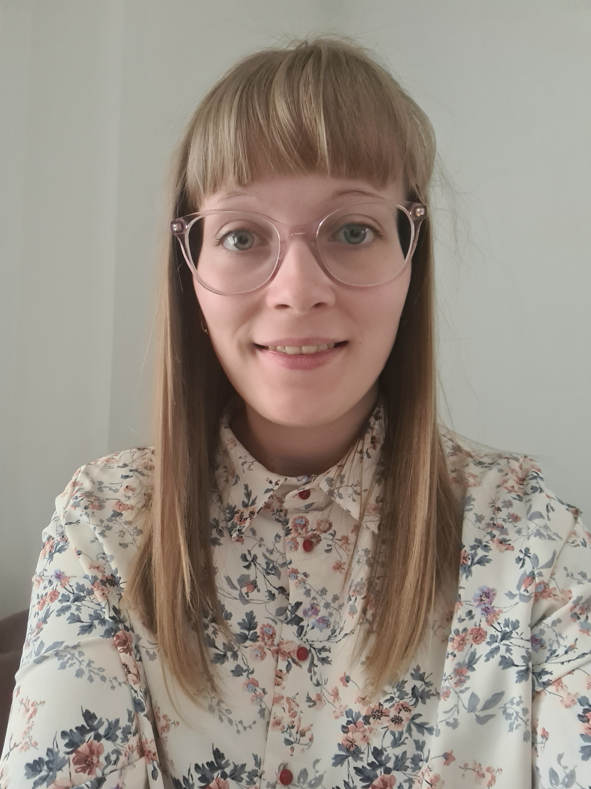
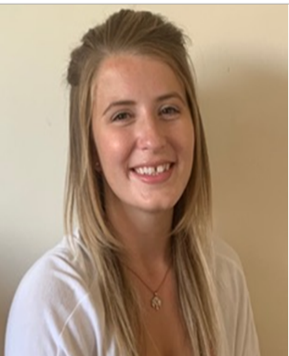
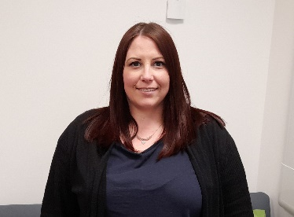
Meet the Oak Tree Class Team
(Reception and Year 1)
Teacher- Miss Stephanie Lester (4 days)
Teacher- Mrs Louise Dance (1 day)
Teaching Assistants-
Miss Charley Lawrence
1:1 Mrs Faye Payne

Slide 3
Meet the Ash Tree Class Team
(Reception and Year 1
Up to 30 children)
Reception and Year 1 Teacher
Mrs Charlotte DeBono
Teaching Assistant
Mrs Magda Magiera

Slide 4
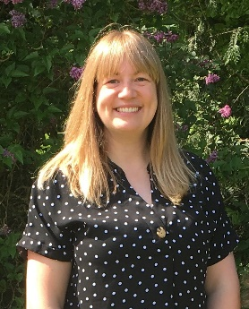
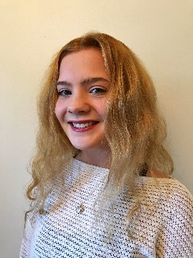
Meet the Cherry Tree Class Team
(Reception and Year 1 up to 30 children)
Teacher-Mrs Alison Mazzotta (3 days)
Teacher-
Teacher- Mrs Nicola Newman (2 days)
Teaching Assistants- Mrs Kayla Fenwick
and Miss Caitlin Harvey

Slide 5
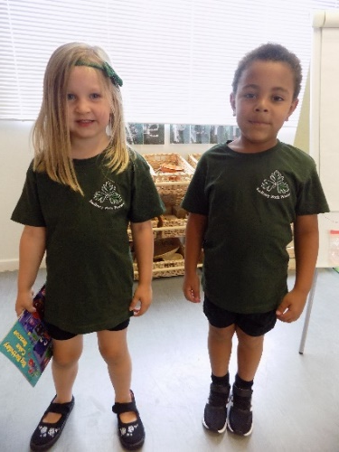
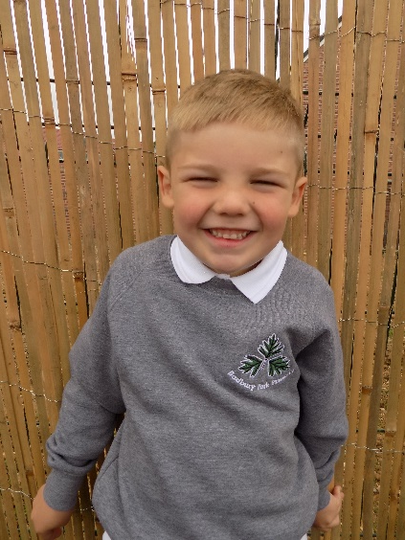
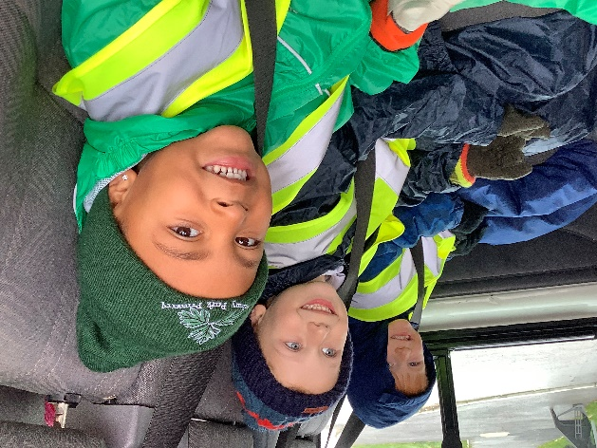
Being ready for school
What do we need?
Uniform
Grey school jumper/cardigan
White polo t-shirt
Black trousers/skirt
Black shoes/trainers
Water bottle
Spare clothes
Please name everything!

Slide 6
Your child will also need …
A PE bag with a PE kit
Wellies
Waterproof clothes
Book bag or folder
Please name everything!

Slide 7
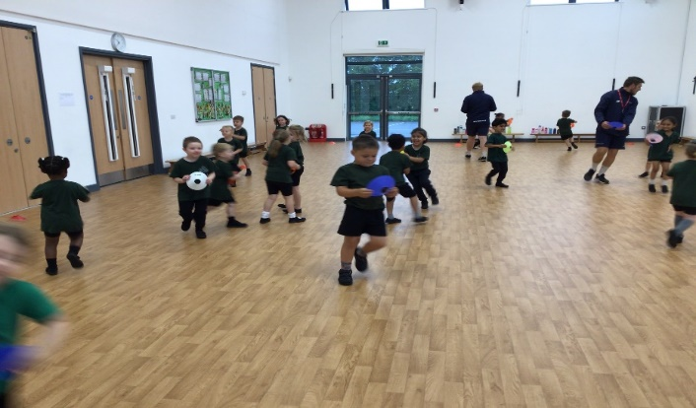
PE
2 sessions a week
Cherry Tree – Monday and Tuesday
Ash Tree - Tuesday and Thursday
Oak Tree – Tuesday and Friday
Updates on the website soon!
Green t shirt, black shorts and trainers/daps
All uniform will stay in school.
Please name everything!

Slide 8
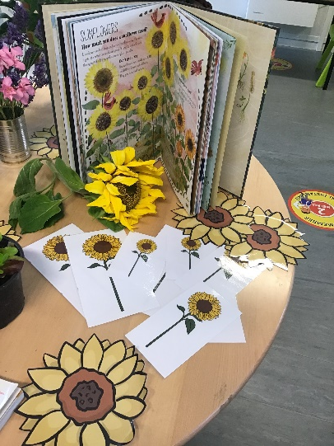
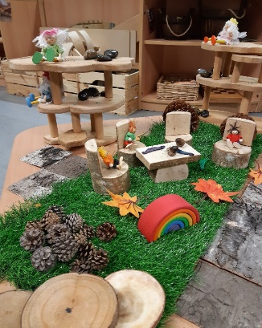
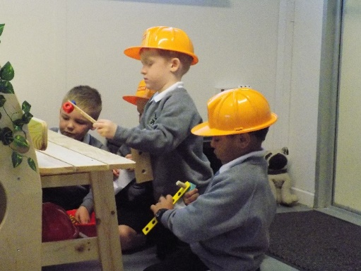
Our Vision
We want happy, engaged leaners within a beautiful, authentic learning space that is calm and consistent. We use natural, versatile, open ended resources that are carefully chosen to provoke creativity, wonder and concentration both inside and outside. We want an environment where children are confident to risk take and problem solve whilst learning both knowledge and skills and where the natural world takes center stage.
Post Lock Down and recovery
We are aware that children will continue to need lots of nurture and wellbeing work and we have planned our curriculum around this. Interventions to help any children will be put in place once we get to know your children. Wellbeing and feeling safe and secure are our primary goals because without that, the learning won’t take place.

Slide 9
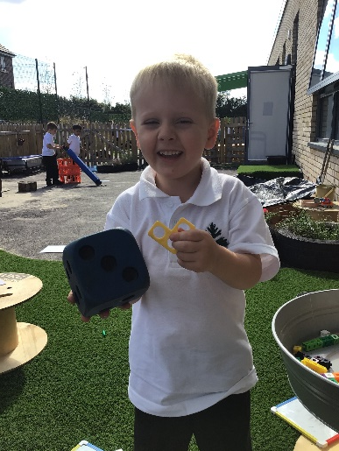
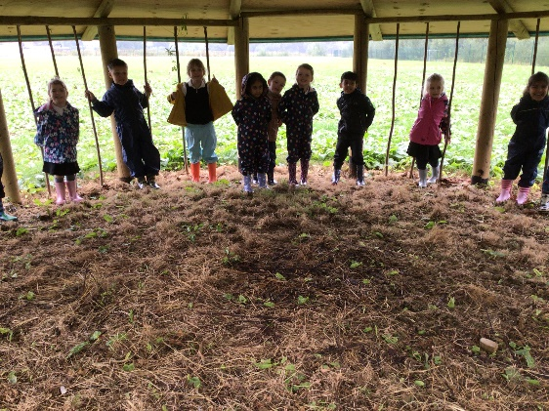
Our School Day
8.50 Welcome and registration in class
9.00 Phonics
9.20 English and Explore and learn time, inside and outside
10.30 Play time
10.45 Maths and explore and learn time, inside and outside
12.00 Lunch
1.00 Whole Class learning time
1.15 Learn and Explore time, inside and outside (Year 1 foundation subjects)
2.30 Assembly and recognition time
3.00 Home time
Year 1 will begin to work on set challenges during Explore and learn time.

Slide 10
…into Year 1
For those children who need to finish off the Early Learning Goals, they will continue to work alongside their peers but their focus will be on the EYFS objectives. The children who are ready, will work on the Year 1 objectives.
Our Year 1 children will continue to have a play based approach. This is known as continuous provision and looks very similar to the reception year except the objectives, knowledge and skills are more advanced. They will take part in independent learning alongside teacher led whole class sessions and teacher led focus groups. These focus groups will ensure children are challenged and stretched from their starting points.
Children will be set challenges at the start of the week. How to approach these will be modelled by the teacher. These challenges will be linked to different curriculum subjects. They will have independent journals where they carry out their independent learning and teacher led books where they work with a teacher or teaching assistant.
Targeted interventions may be used for children needing additional
Help as well as children who need to be challenged further.

Slide 11
Reading

Slide 12
Reading
Individual reading
At school we hear each child read individually at least once a week. At home we ask you to ‘strive for five!’, this means that your child is aiming to read at home 5 times over the week- every day would be amazing!
Sharing stories and book talk
At school we share books and stories at least twice a day. We ask that you try to share a book with your child each day, a bedtime story would be ideal. You can also talk about
what happened and what their favourite bit was.

Slide 13
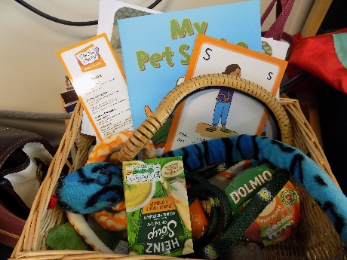
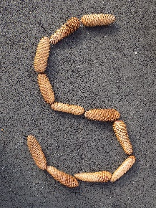
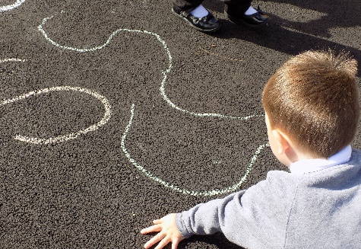
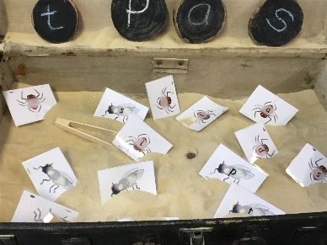
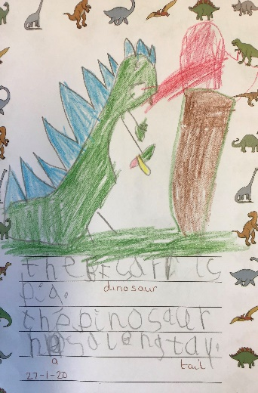
We follow the Story Time Phonics validated scheme and use the structure of Letters and Sounds to facilitate the learning. We will recap phase 1 during the first few weeks of term and assess the children’s knowledge. We will then teach phase 2, 3 and 4 in Reception and Phase 5 in Year 1. Each day a new sound will be taught and then we will move onto applying them in our reading and writing. Each sound has a ‘caption action’ and a ‘sparkle mark’. The children will hear a story and watch a video to help them remember the sound. Very quickly the children will learn to blend sounds together to read and write words. They will also meet Tricky Troll and Beegu words!

Slide 14
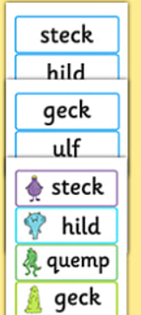
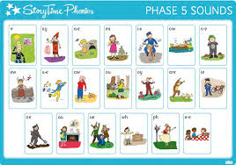
Year 1
We will recap phase 2,3 and 4 sounds and the ‘high frequency’ words that they make. We will recap the Tricky words too. We will move onto reading longer words within these phases.
Once secure, we will teach Phase 5. Some of these are alternative spellings of sounds they already know
For example, ai/ay/a-e.
In the summer- Phonics Screening Check. This is a short assessment where children read words that are both real and not real (Beegu words). The words will be based on all of the phonics they have learnt so far.

Slide 15
Physical development, making marks, leading to writing
In the EYFS children will have the opportunity to…
Develop the fine/gross motor skills required to write
The children are developing these skills all of the time. We encourage and support through the use of ‘squiggle while you wiggle’ and ‘dough disco’.
Make marks
Please celebrate all attempts at writing and at home, where appropriate, support with letter formation saying the ‘sparkle mark’ to link the learning back to our Story Time Phonics scheme.
When ready, the children will use their phonics to write letters, then words and then captions (gradual development throughout the year.)

Slide 16
Writing
In Year 1 children must……
Write sentences by:
• saying out loud what they are going to write about
• composing a sentence orally before writing it
• sequencing sentences to form short narratives
• re-reading what they have written to check that it makes sense
• discuss what they have written with the teacher or other pupils
• read aloud their writing clearly enough to be heard by their peers and the teacher.
• leaving spaces between words
• joining words and joining clauses using and
• beginning to punctuate sentences using a capital letter and a full stop, question mark or exclamation mark
• using a capital letter for names of people, places, the days of the week, and the personal pronoun ‘I’
• learning the grammar for year 1
These can be taught in groups when the children are ready and modelled to all children in whole class writing. The children will be encouraged to imbed
these skills throughout a range of frequent writing opportunities and
continuous provision.

Slide 17
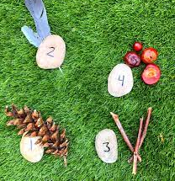
Mathematical development
In the EYFS children will have the opportunity to…
Explore mathematical concepts such as number (using numbers to 10 and then 20), shape, weight/capacity and measure.
Talk about Maths- we do lots of discussion to explore our understanding and develop use of mathematical vocabulary.
Children will begin to represent their maths using marks and jottings when they are ready.

Slide 18
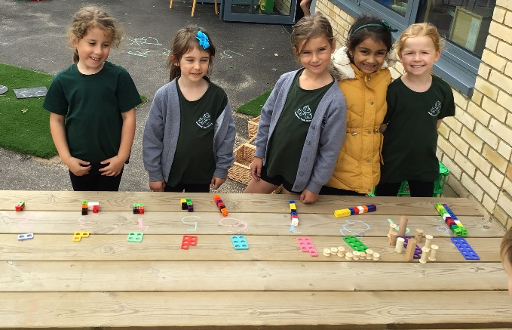
Maths
In Number, Year 1 children must……
• count to and across 100, forwards and backwards,
beginning with 0 or 1, or from any given number
• count, read and write numbers to 100 in numerals; count
in multiples of twos, fives and tens
• given a number, identify one more and one less
• identify and represent numbers using objects and pictorial
representations including the number line, and use the
language of: equal to, more than, less than (fewer), most,
least
• read and write numbers from 1 to 20 in numerals and words
Number: Addition & Subtraction
• read, write and interpret mathematical statements
involving addition (+), subtraction (–) and equals (=) signs
• represent and use number bonds and related subtraction
facts within 20
• add and subtract one-digit and two-digit numbers to 20,
including zero
• solve one-step problems that involve addition and
subtraction, using concrete objects and pictorial
representations, and missing number problems such as 7= ? – 9.

Slide 19
Year 1
The National Curriculum
We are providing a broad and balanced curriculum.
English- grammar, spellings (including phonics), handwriting, reading and writing
Maths
Science
Design Technology
Art
Music
RE
PE
PSHE
History and Geography

Slide 20
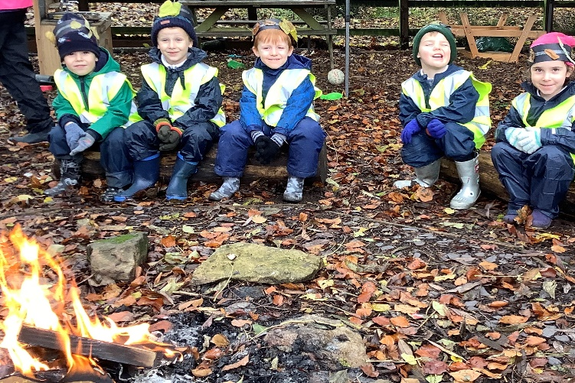
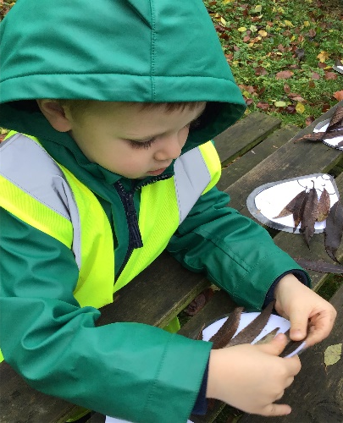
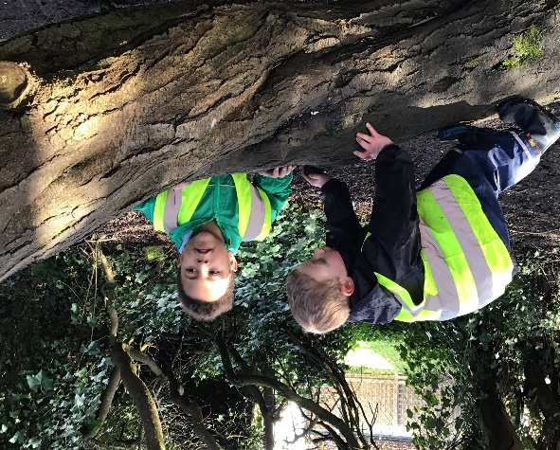
Outdoor Learning and Forest School
Education for social responsibility
Science
Design Technology
Art
Geography
English
Maths

Slide 21
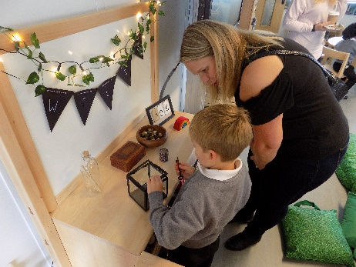
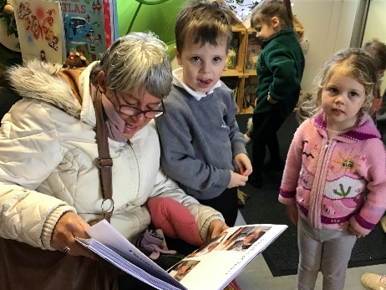
Assessments, parents evenings and learning journeys
EYFS
Government baseline assessment alongside our own baseline assessment
Interactive Learning Diary online learning journal and drop in sessions to share learning
Year 1
Y1- Entry assessment to identify gaps from EYFS
‘Phonic Screening check’ in the Summer term
ALL
Parents evenings x2 and termly drop ins to share work
End of year report assessed against the expectations for EYFS or Y1.

Slide 22
Safeguarding
We aim to promote wellbeing and maintain a safe, secure and caring environment where everyone is treated with respect.
If you have any concerns about a child please report it to Mrs L Dance, Mrs J Fraser or Mrs Mazzotta as the designated safeguarding leads.

Slide 23
Governors and PTA
We are still looking for a parent governor.
All parents and staff are invited to join the PTA.
Please see the School Handbook for further details.

